Slide 1
SCENOGRAPHERS

Slide 2
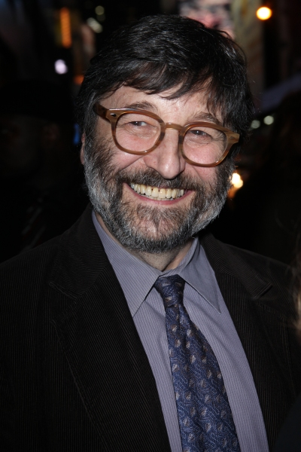
Bullets Over broadway
SANTO LOQUASTO
(1944-

Slide 3
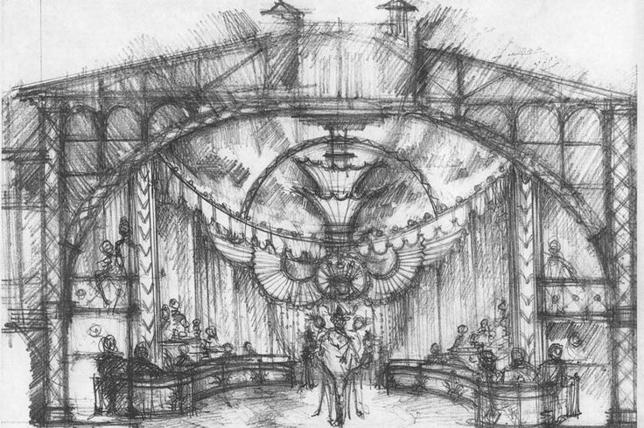

Slide 4
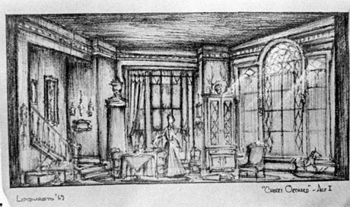

Slide 5
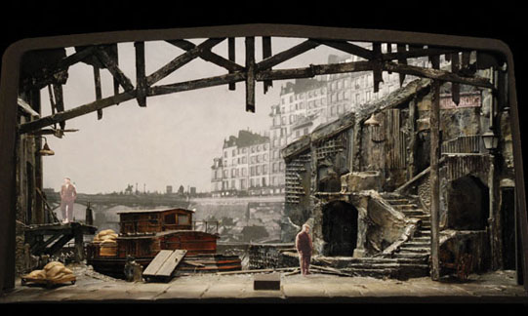

Slide 6
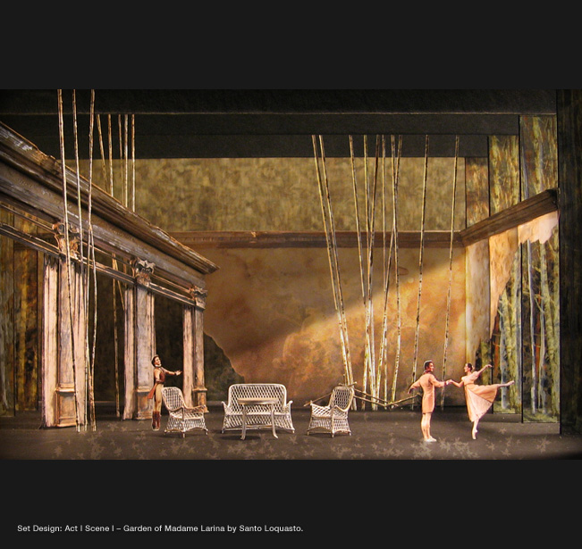

Slide 7
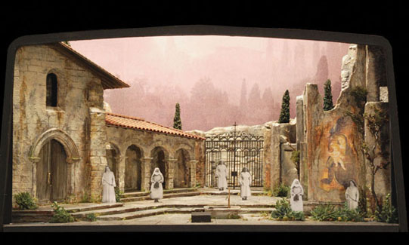

Slide 8
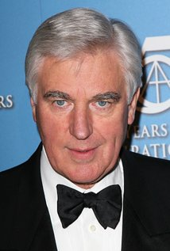
STUART CRAIG (1942-

Slide 9
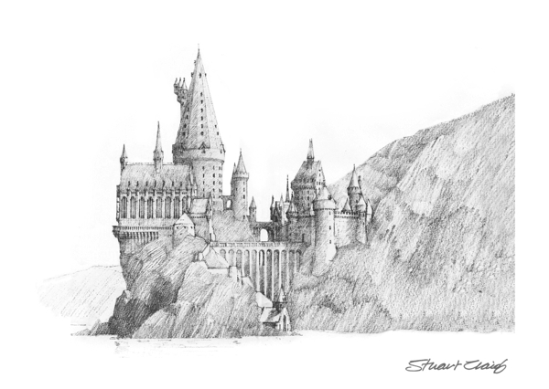

Slide 10
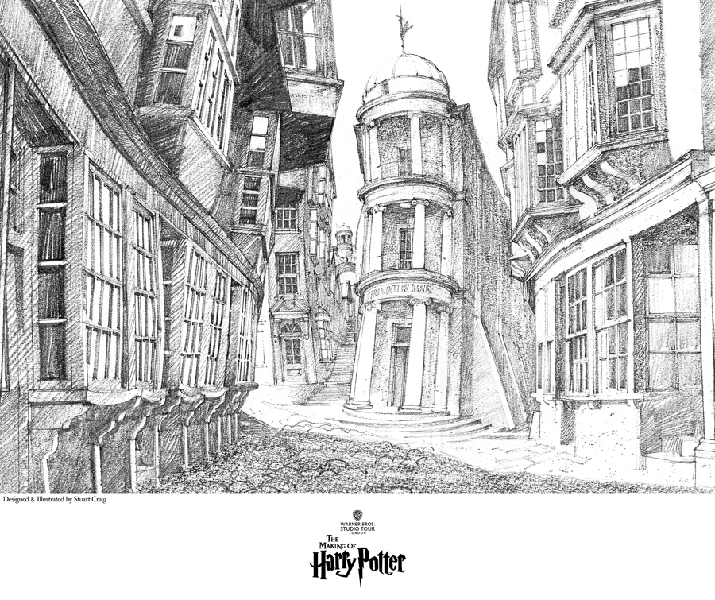

Slide 12
The English Patient
Harry Potter
Chaplin

Slide 13
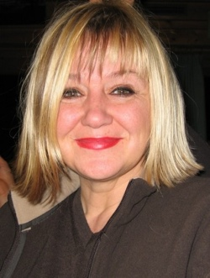
SARAH GREENWOOD

Slide 14
Sherlock Holmes
Pride & Prejudice
Atonement
Anna Karenina

Slide 15
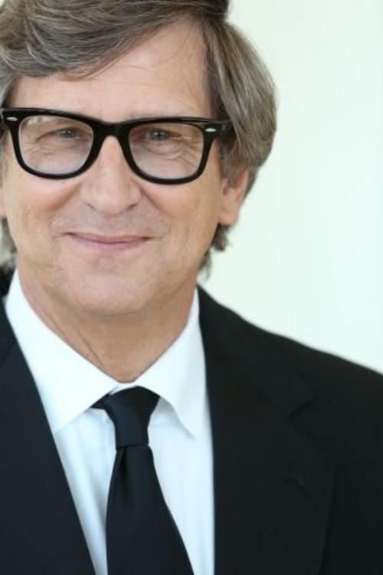
RICK CARTER (1952-

Slide 16
Avatar
Star Wars the Force Awakens
Jurassic Park
Interview: The Creative Process

Slide 17
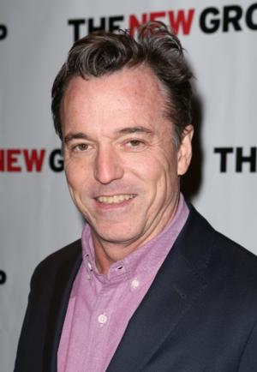
DEREK MCLANE (1958-

Slide 18
Derek McLane’s Portfolio

Slide 19
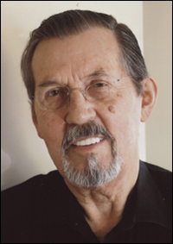
Robin Wagner
(b. 1933-

Slide 20
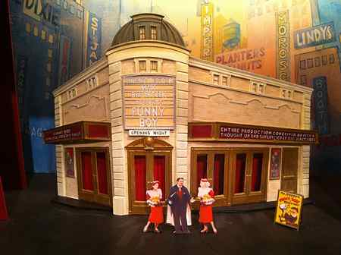

Slide 21
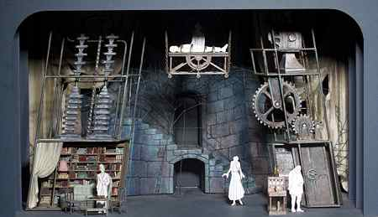

Slide 22
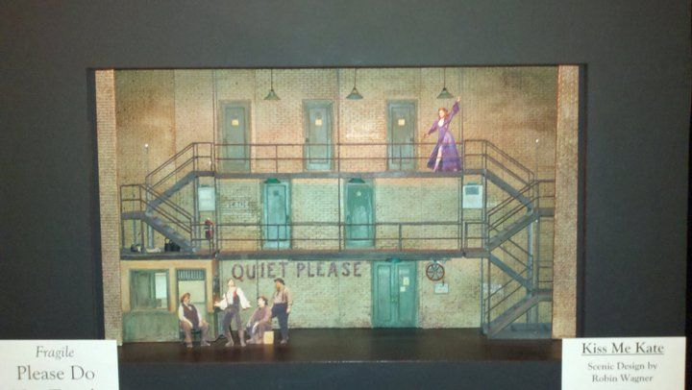

Slide 23
Behind the Scenes: Wicked
John Lee Beatty: The Nance
Interview with UW grad Andrew Lieberman
David Gallo The Mountaintop

