Slide 1
Compendium
Exemplar

Slide 2
Directions: Create a compendium of historic fashion (can include jewelry, hair, textiles, décor, art, architecture, etc.) that includes images of derivative styles.
The compendium should cover at least 17 of the following periods:
Ancient Egypt 1800s 1900s
Ancient Greece 1810s 1910s
Byzantium 1820s 1920s
High Middle Ages 1830s 1930s
Italian Renaissance 1840s 1940s
16th Century 1850s 1950s
17th Century 1860s 1960s
18th Century Bustle Period 1970s
Directoire Period 1890s 1980s
Each period should include at least SIX historic images (three of which you may pull from class lectures)
Each image should include a simple identifying label
Vocabulary terms should be briefly defined where appropriate
Each period should include at least FOUR images of fashion inspired by the historic period

Slide 3
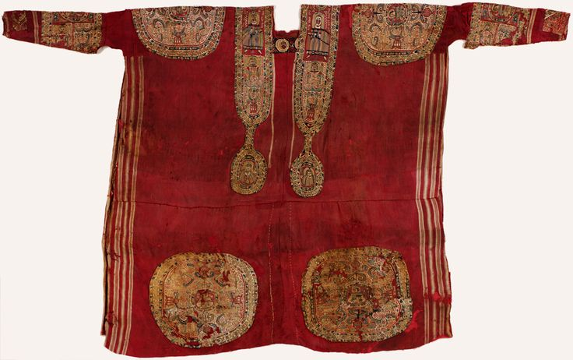
HISTORICAL PERIOD: BYZANTINE
dalmatica (tee-shaped garment worn for ceremonial occasions)with segmentae (round or square appliqued medallions)

Slide 4
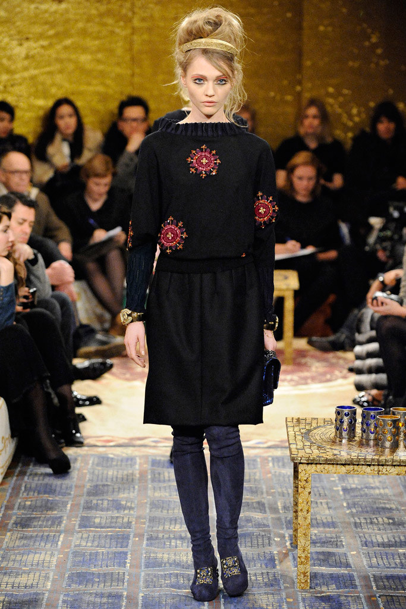
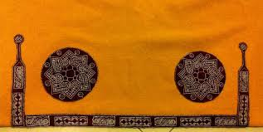
Byzantine tunica (showing only the bottom half)
Note: segmentae
Chanel, Fall 2011

Slide 5
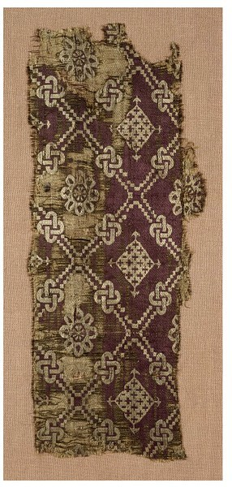
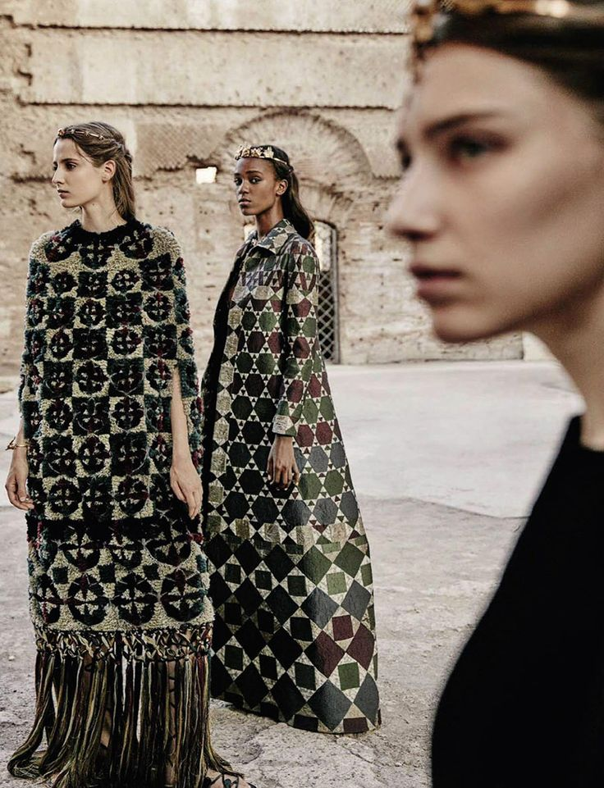
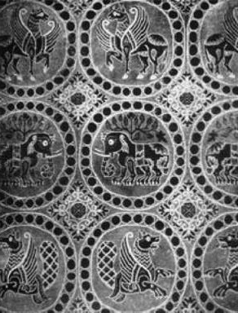
Byzantine Textiles
Note: Repetitive,
medallion –like
geometrics
Valentino by Fabrizio Ferri for Italian Vogue,
September 2015

Slide 6
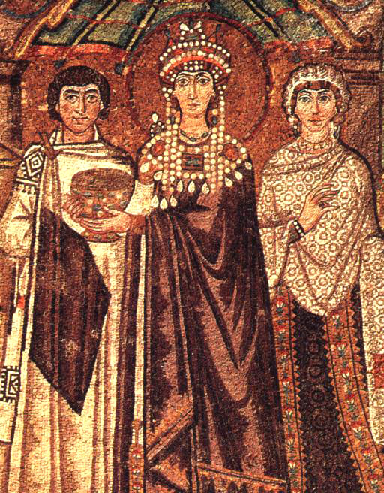
Figure on the left: tunica (tee-
shaped garment) with
segmentae, mantle
with tablion (black diamond-
shaped applique that
signifies nobility).
Center Figure: Empress
Theodora with
gown, mantle, crown, jeweled
collar.
Figure on the right: patterned
gown and mantle, clavi (vertical
stripes on tunic or gowns of
nobles)

Slide 7
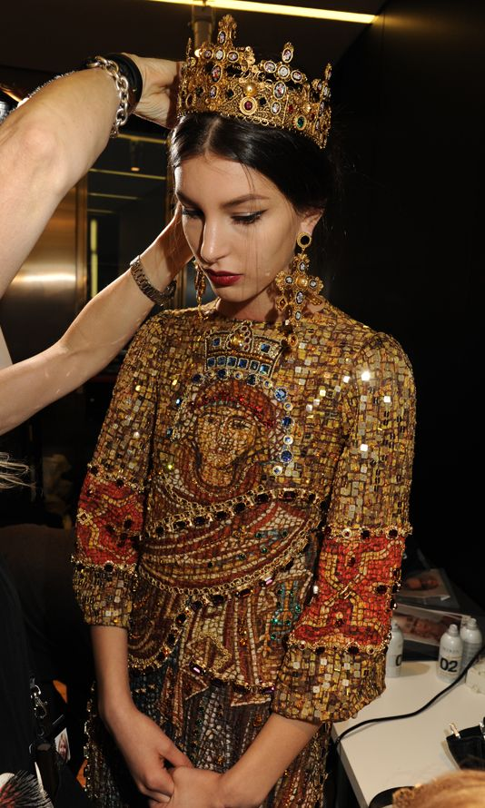
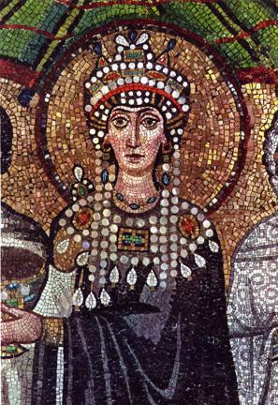
Empress Theodora (497-548)
Note: gold mosaic, opulent jewels, crown
Dolce & Gabbana, 2014

Slide 8
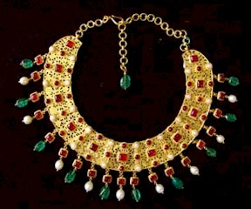
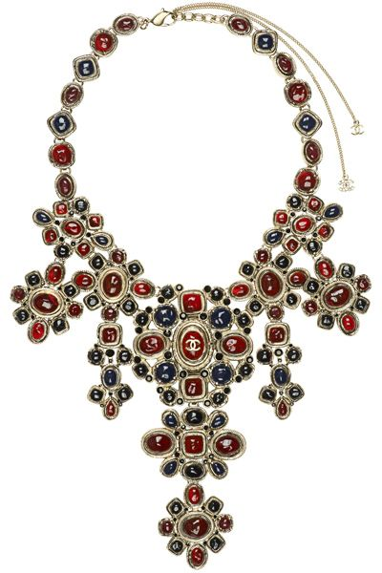
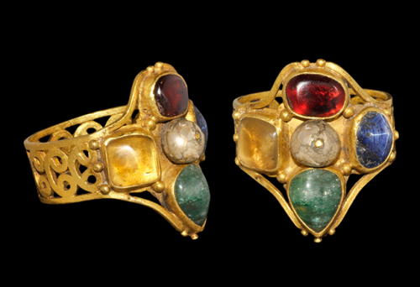
Byzantine Necklace
Byzantine Ring
Chanel, Fall 2011
Note: use of gold, rounded polished stoned

Slide 9
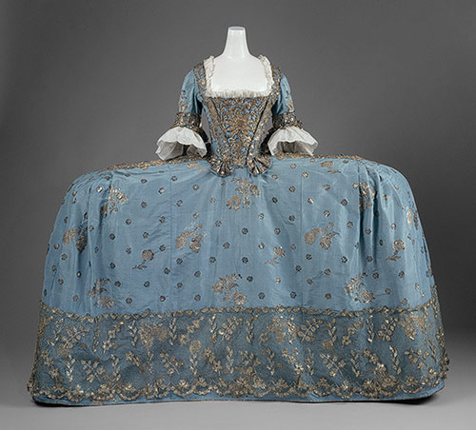
HISTORICAL PERIOD: 18th Century
Court Gown, c. 1750

Slide 10
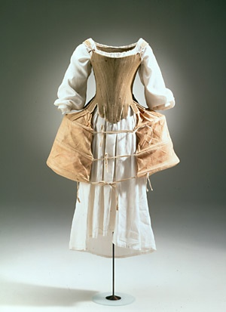
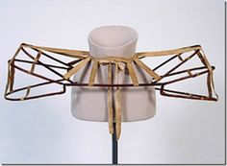
18th C. panniers (cage-like
structure that supported the
wide-hipped silhouette popular
during the 18th century)
18th C. Chemise, petticoat, corset & panniers

Slide 11
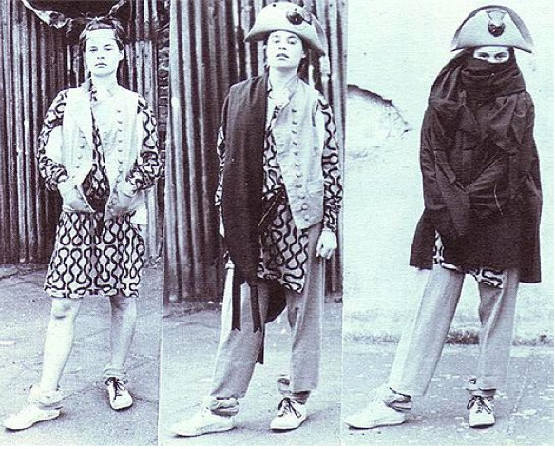
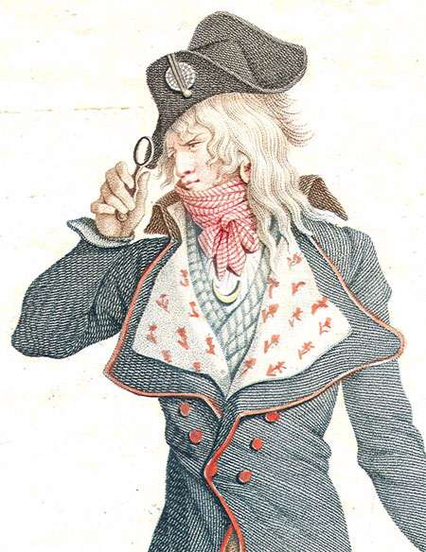
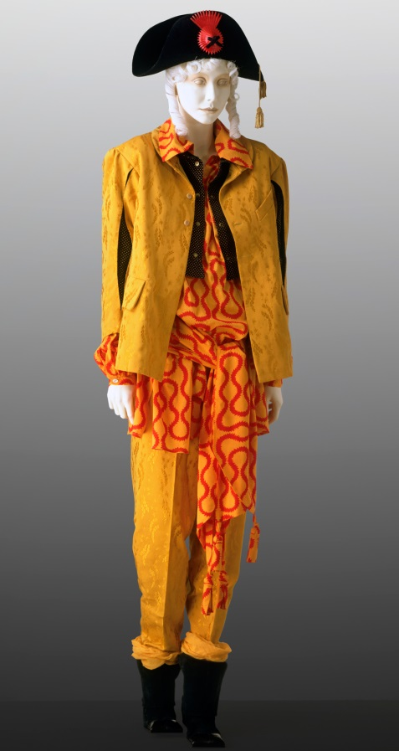
Vivienne Westwood,
Fall 1982
Note: pirate tri-corn hat,
bright pattern, oversized,
jacket pulled up over chin
18th C. Incroyables (post-revolutionary
subculture of young men who wore
exaggerated, outlandish clothes)

Slide 12
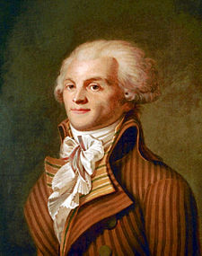
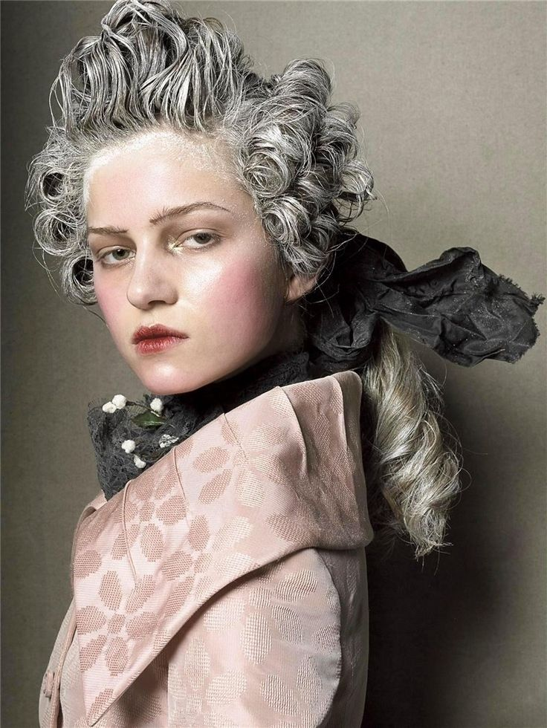
Robespierre, 1790
18th century-inspired hair by Steven
Meisel for Italian Vogue. 2014
Note: powdered wig, large and high jacket lapel

Slide 13
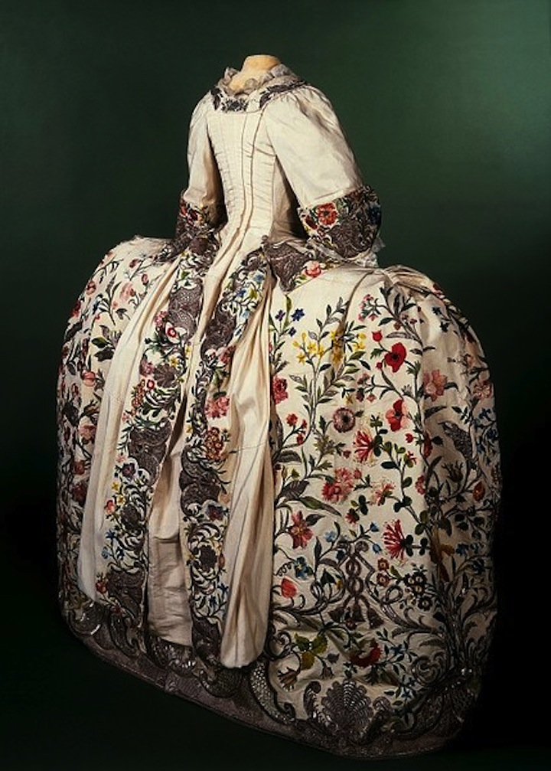
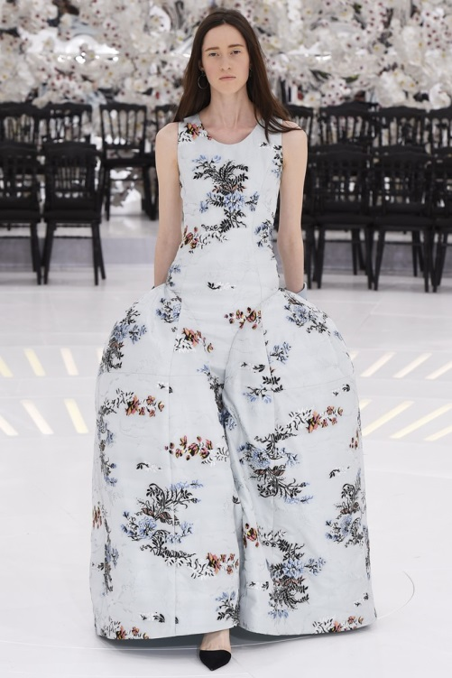
Dior, Spring 2014
Note: wide-hipped pannier-look, floral pattern
18th C. floral gown

Slide 14
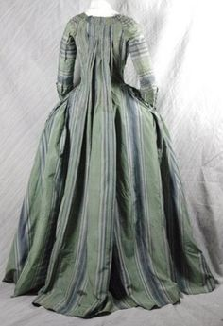
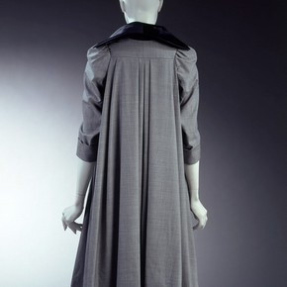
Vivienne Westwood, Spring 1996
18th C. Watteau-Backed gown (French gown with a loose back, worn at home)
Note: watteau-back

Slide 15
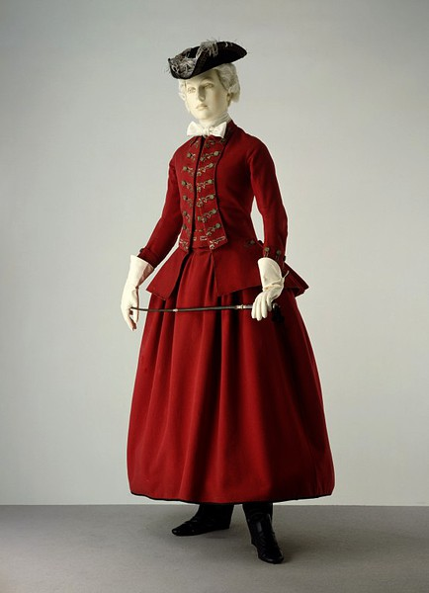
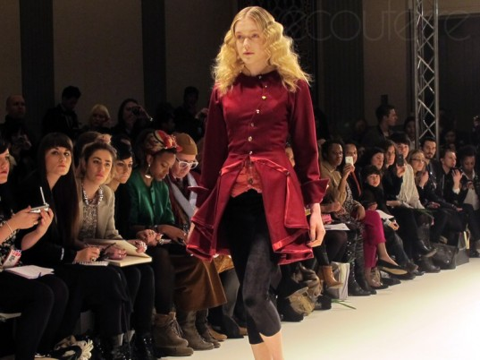
Note: red velvet redingote style
Prophetik, 2011
18th C. Redingote (English-inspired riding habit)

