Slide 1
1930s-1940s

Slide 2
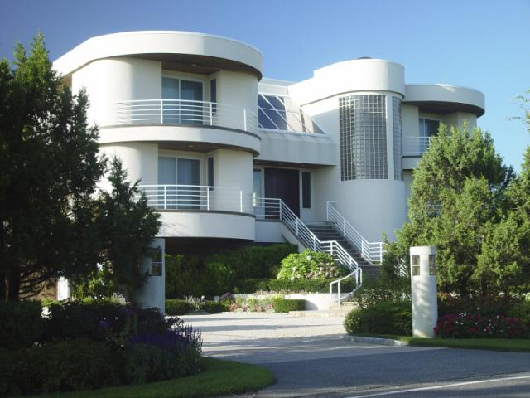
Notes:
Art Moderne was pared down and smoothed out, with an aerodynamic appearance. The advent of air travel, coupled with the modernization of other modes of transportation, had much to do with this speed-driven sensibility.

Slide 3
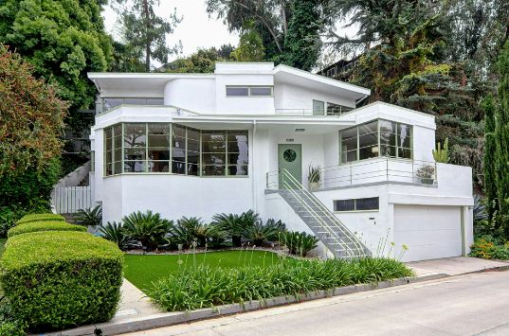

Slide 4
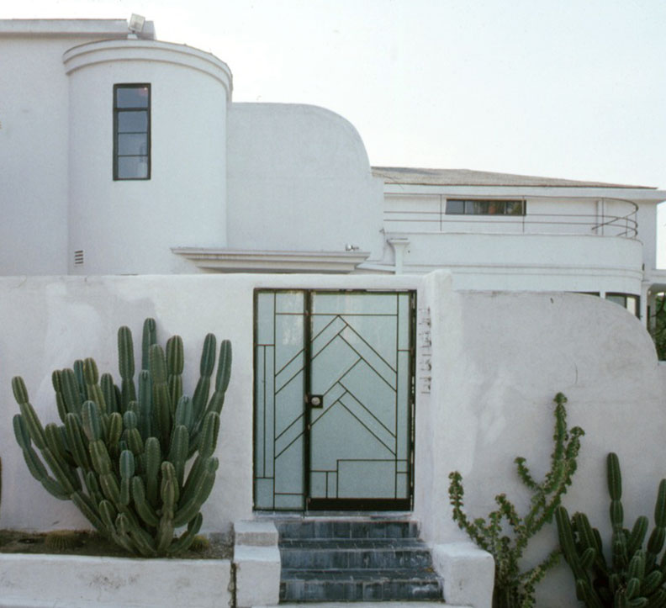

Slide 5
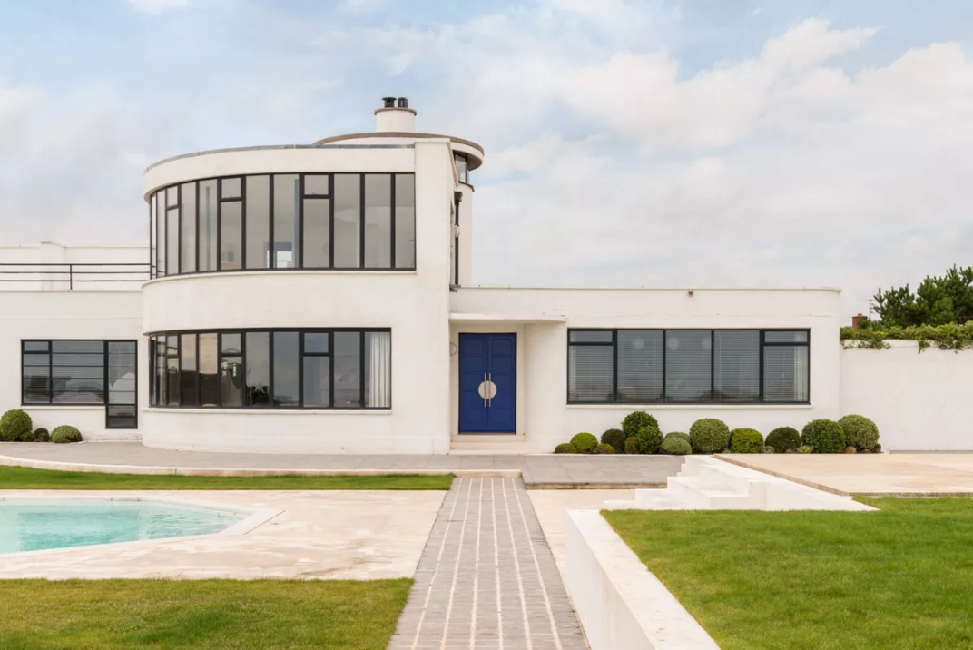

Slide 6
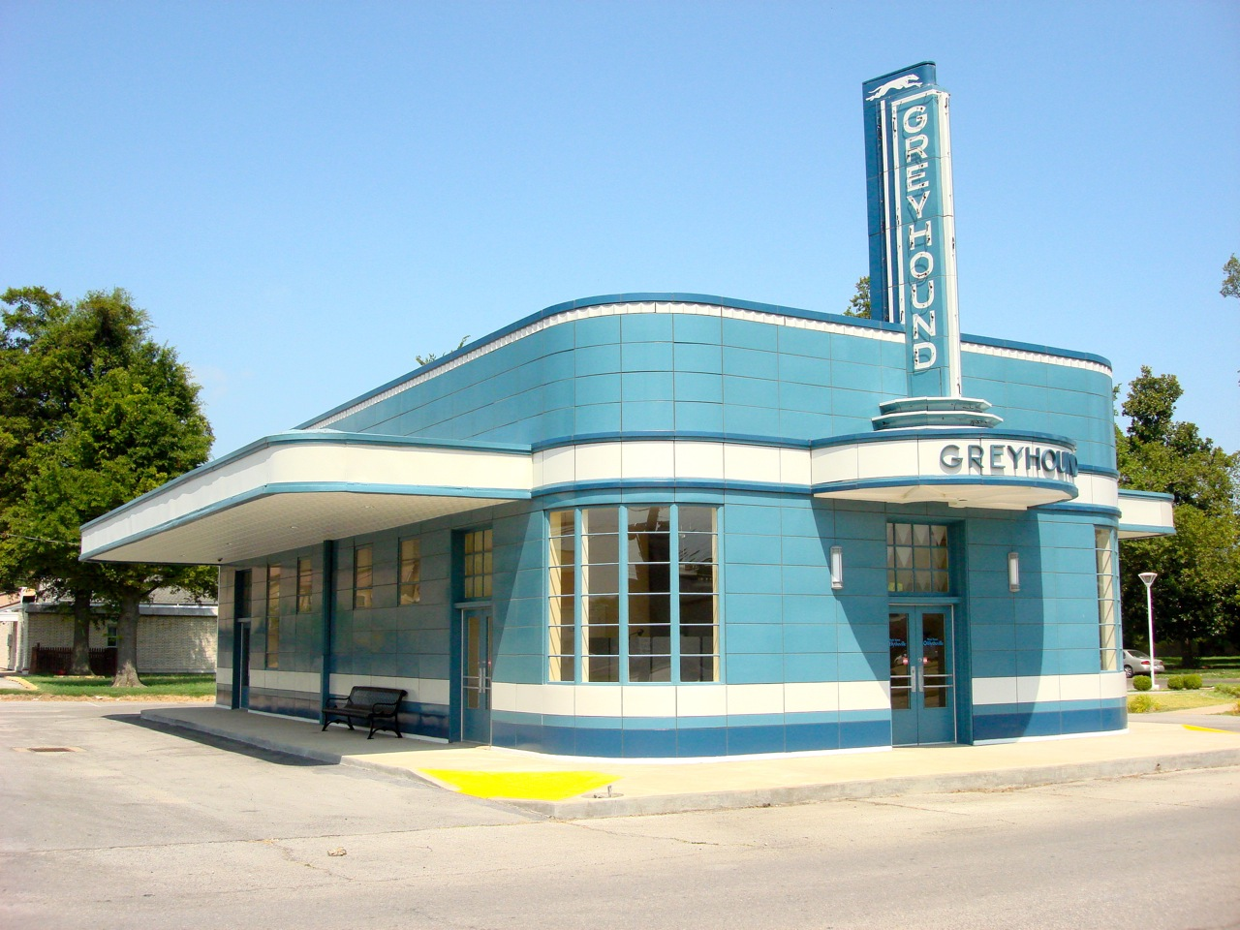

Slide 7
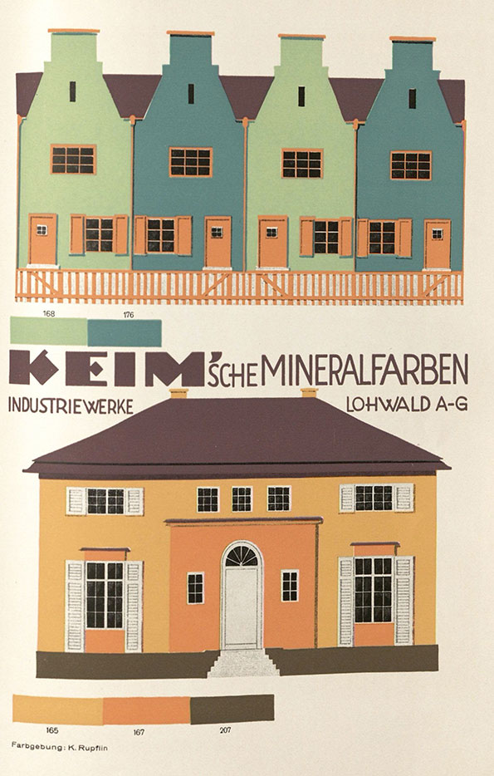

Slide 8
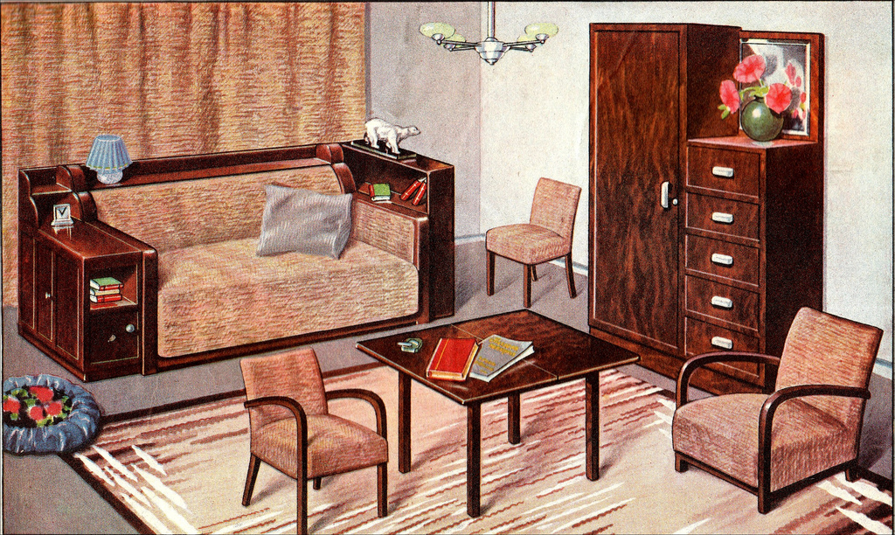

Slide 9
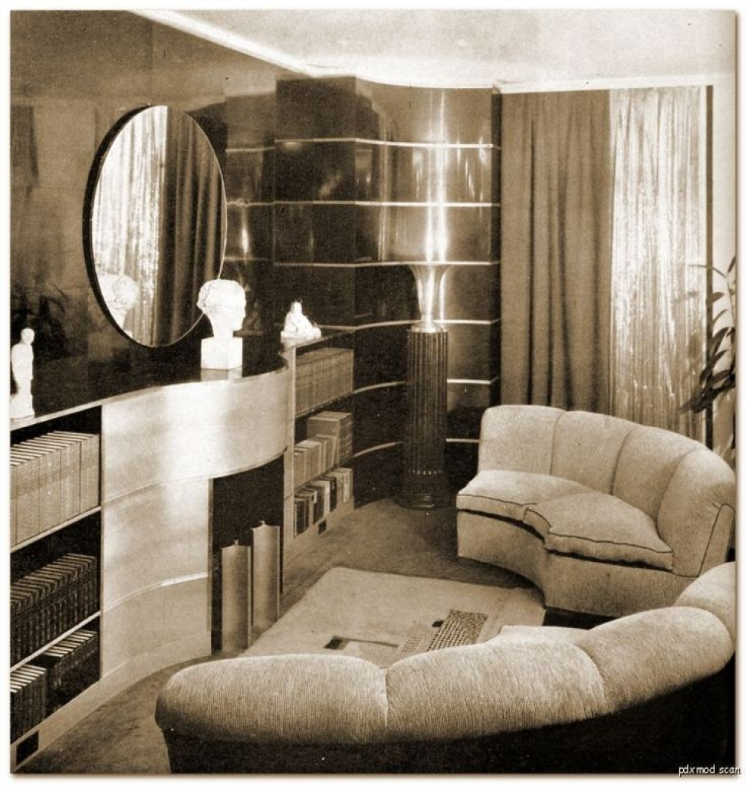

Slide 10
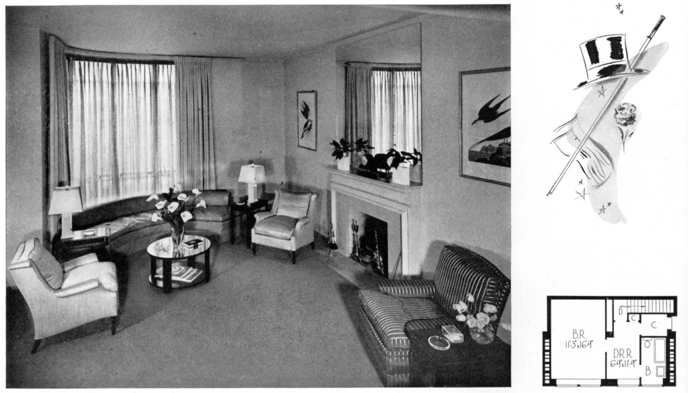

Slide 11
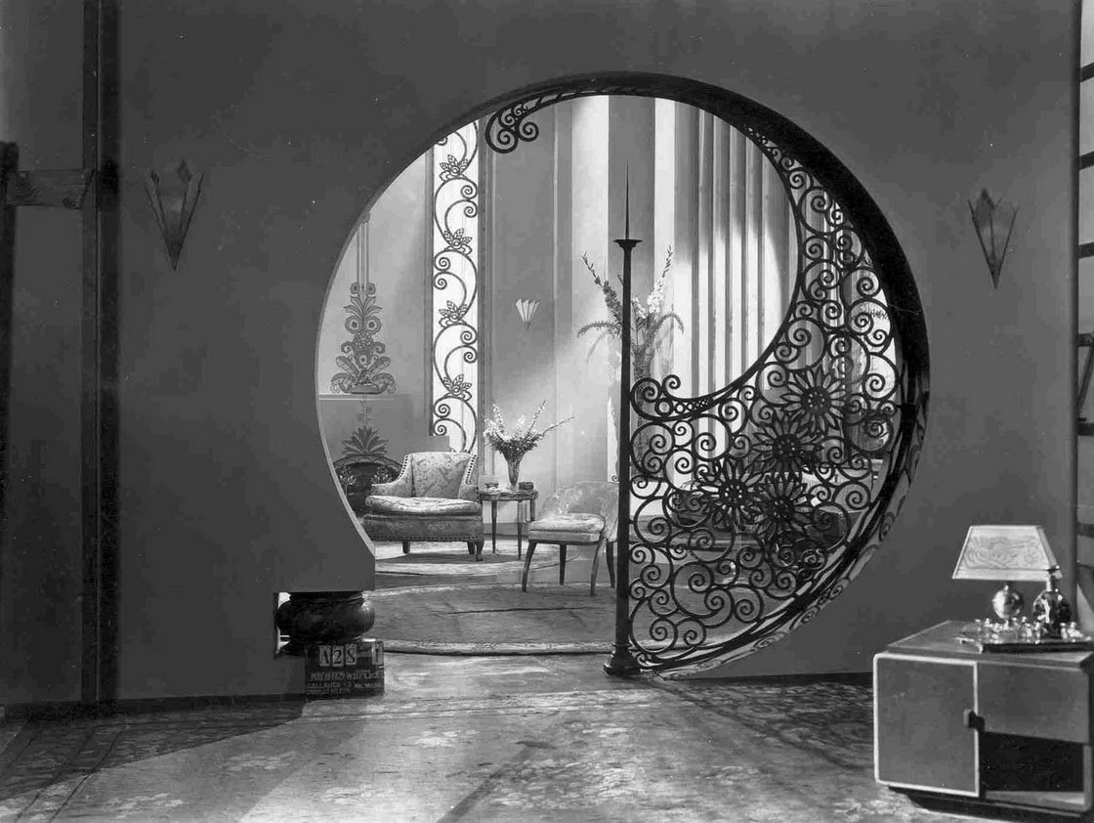

Slide 12
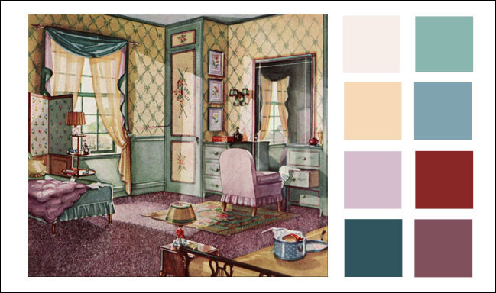

Slide 13
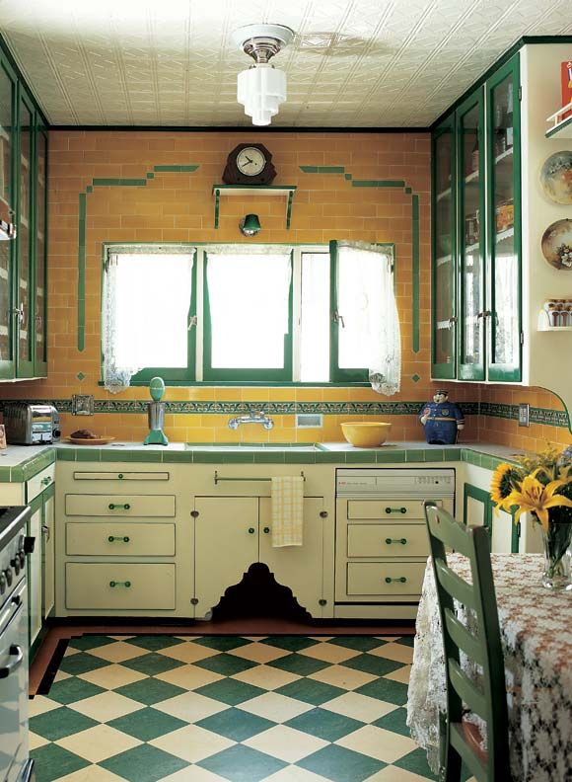

Slide 14
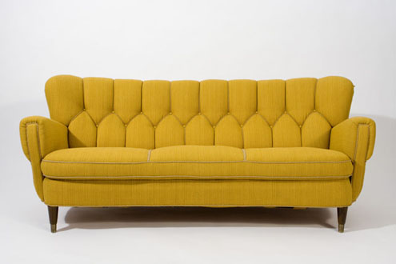

Slide 15
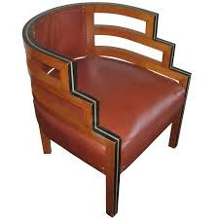
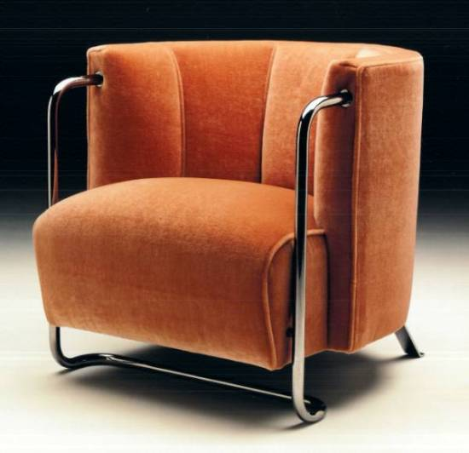

Slide 16
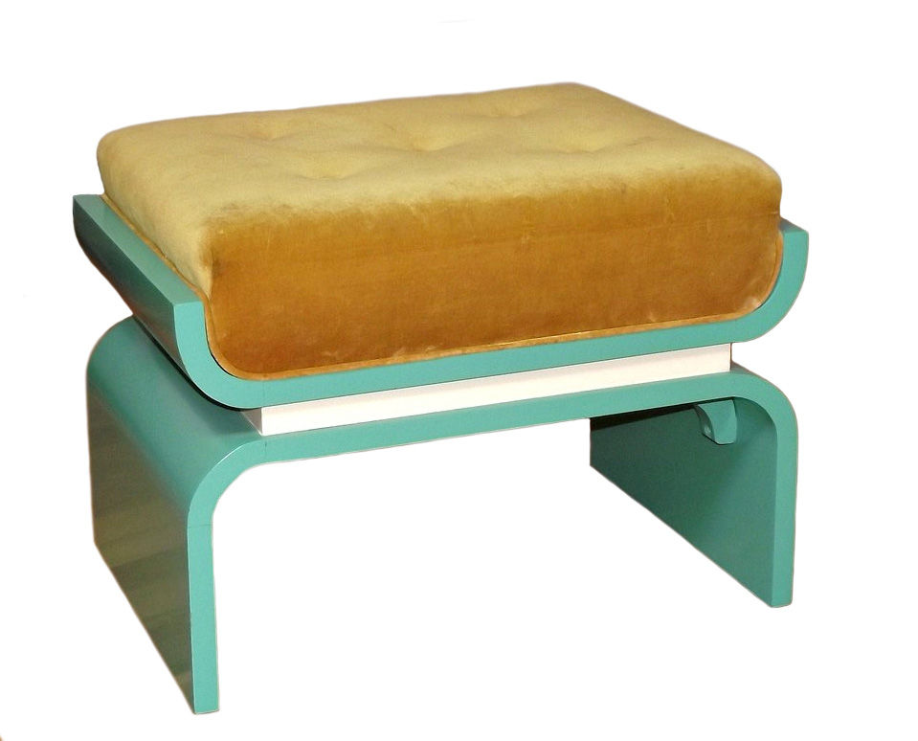

Slide 17
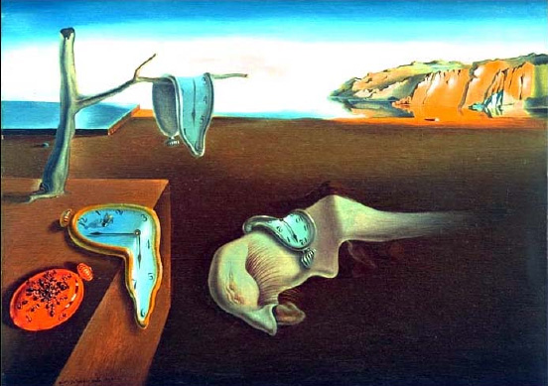

Slide 18
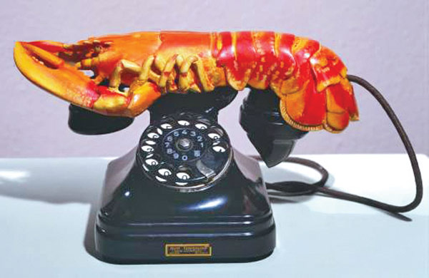

Slide 19
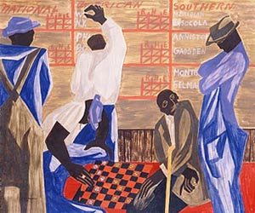

Slide 20
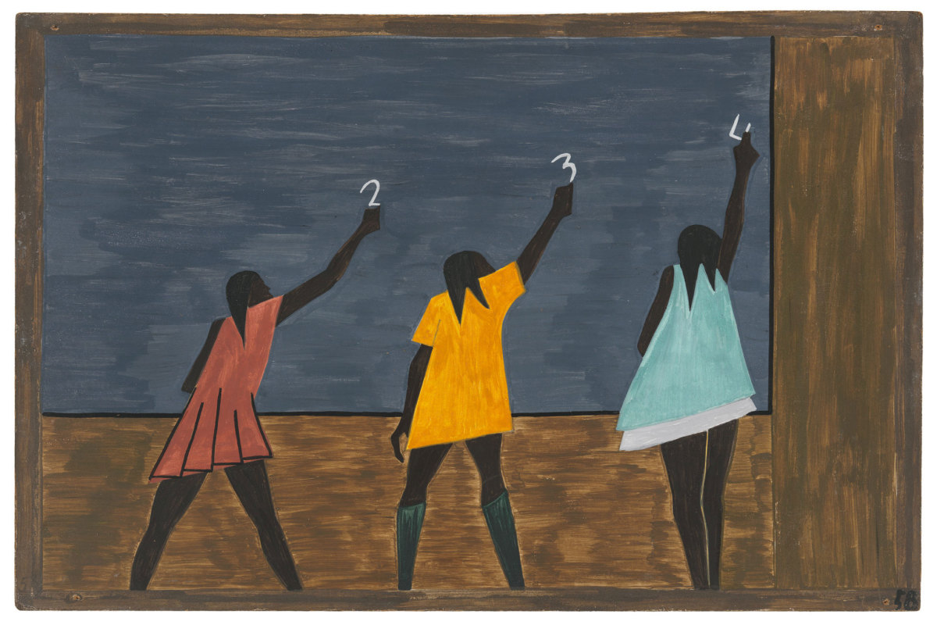

Slide 21
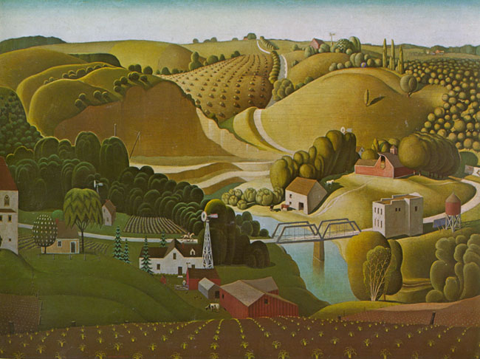

Slide 22
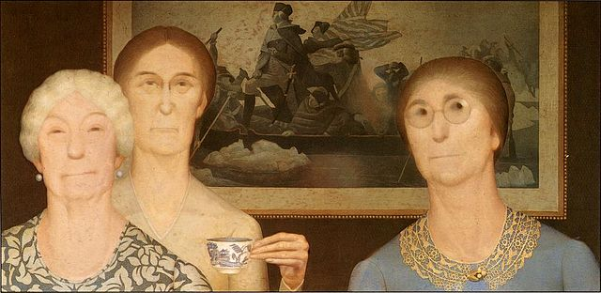

Slide 23
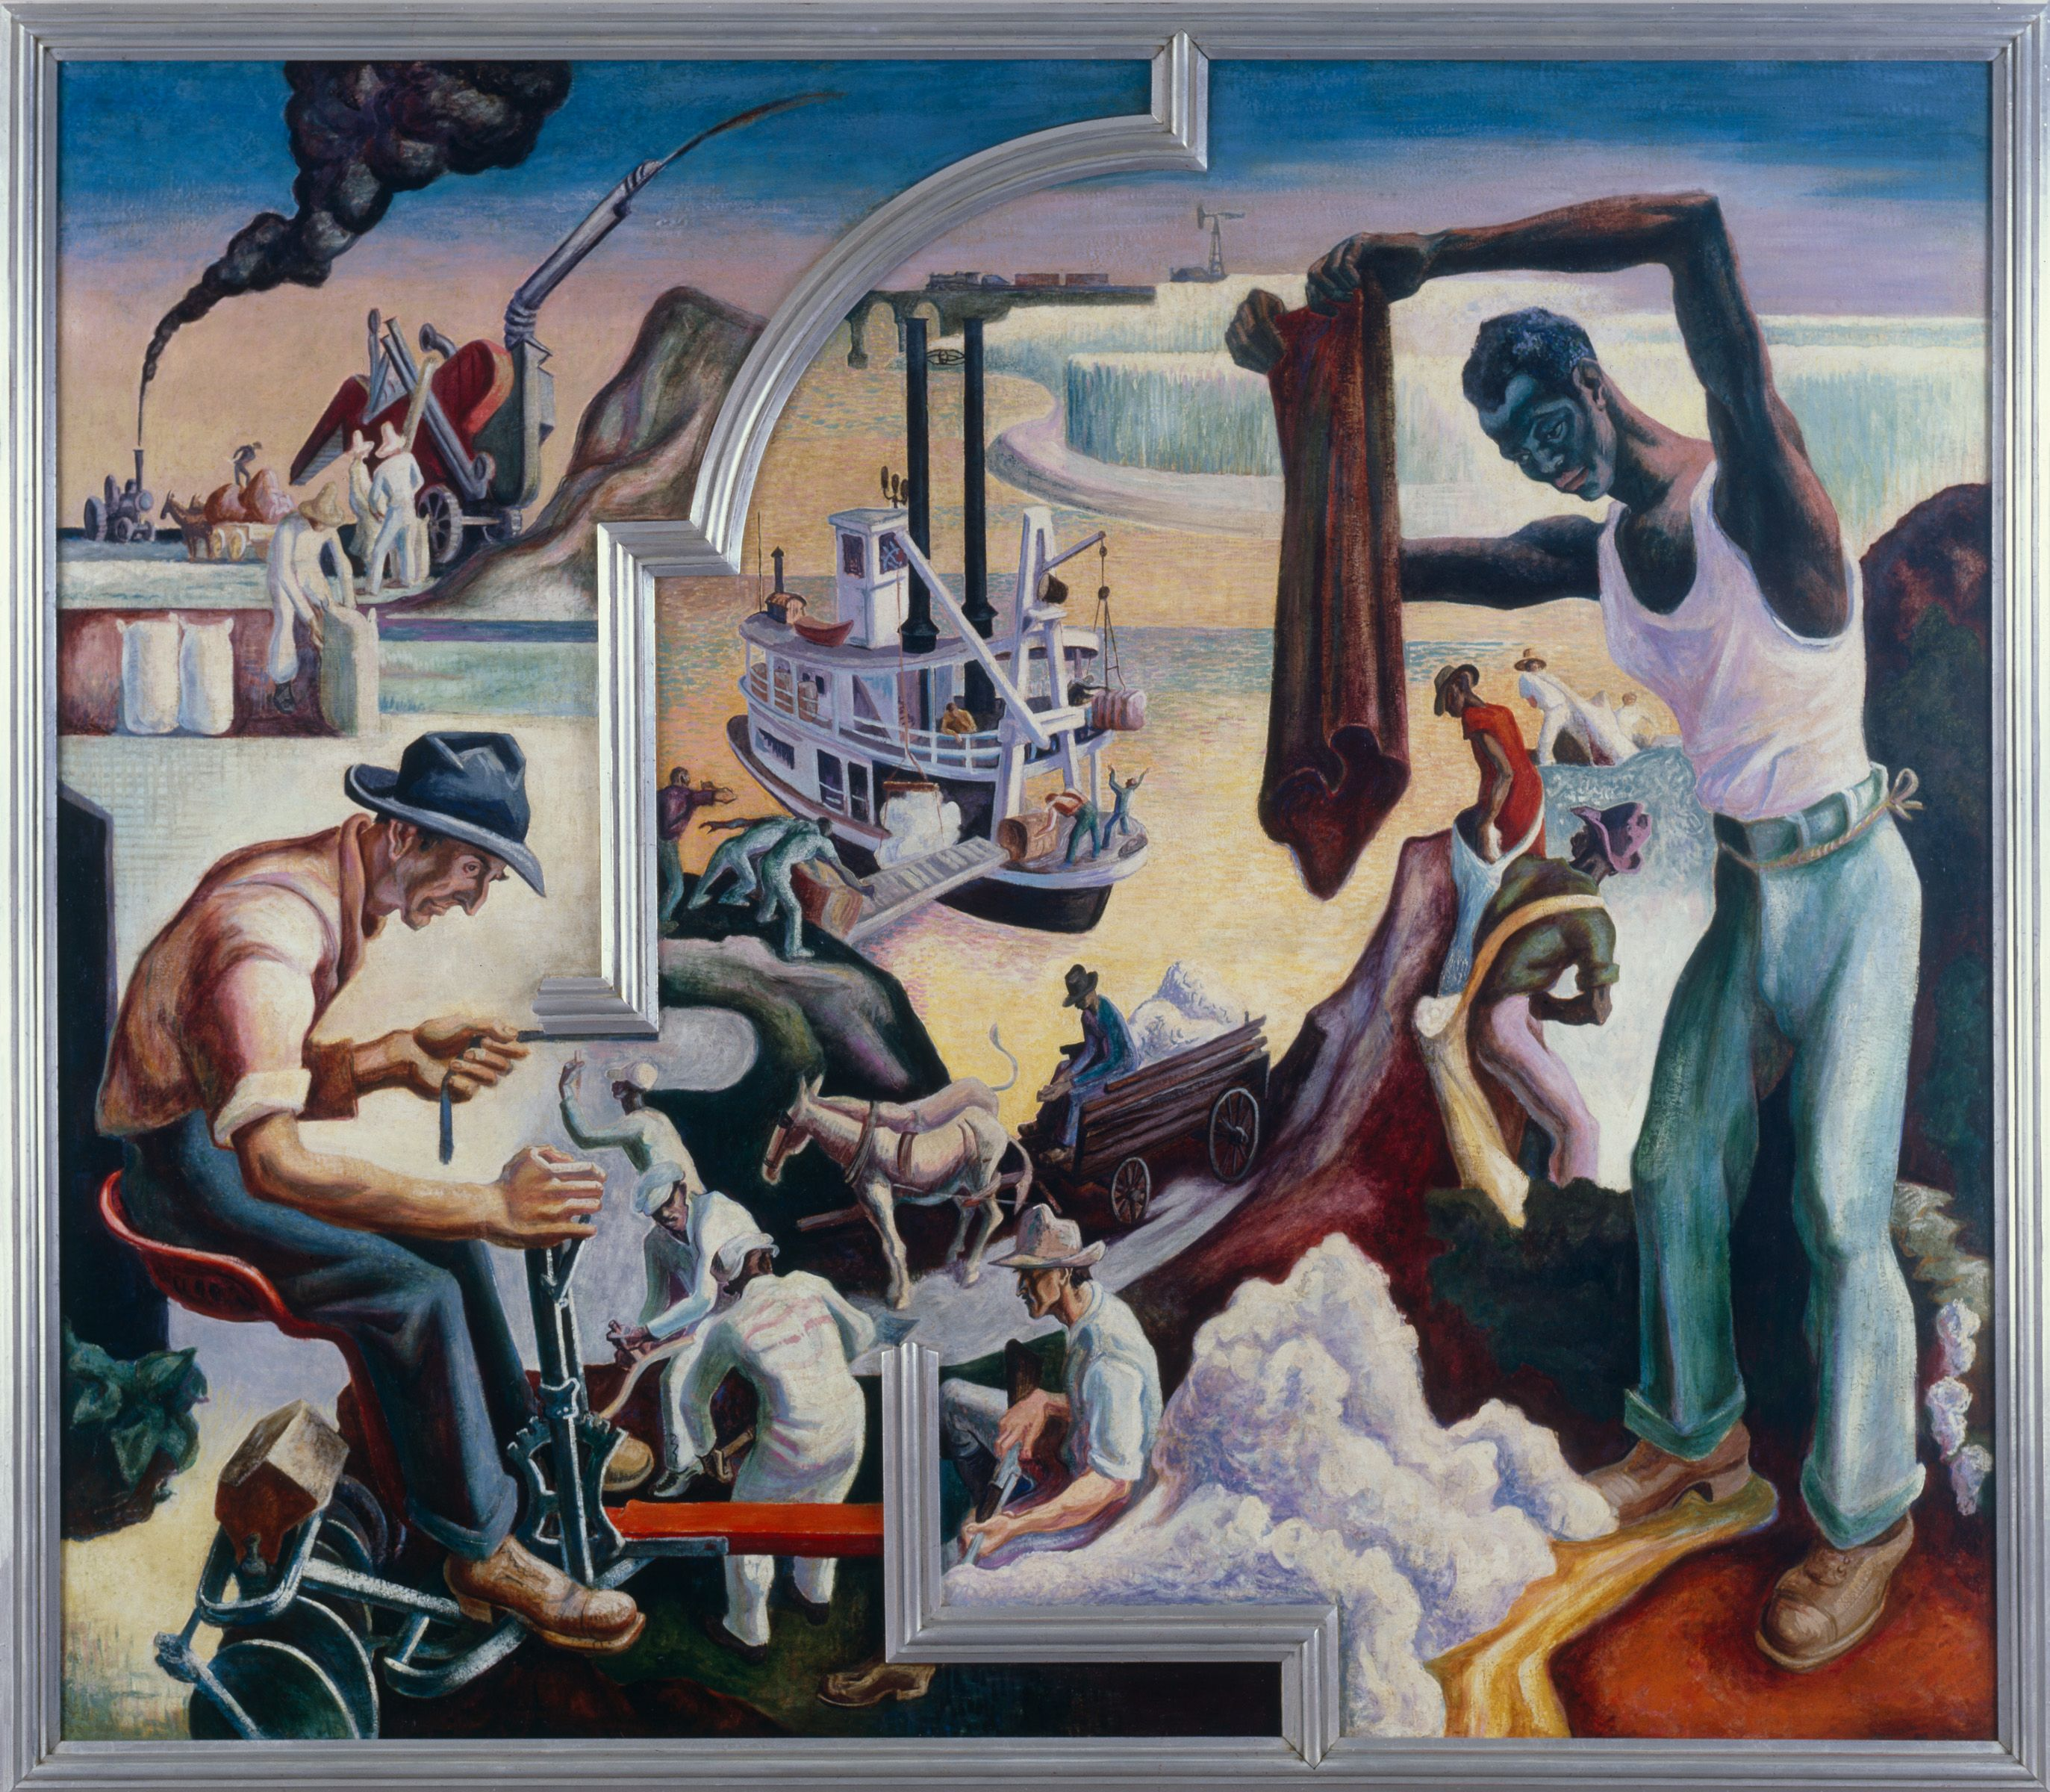

Slide 24
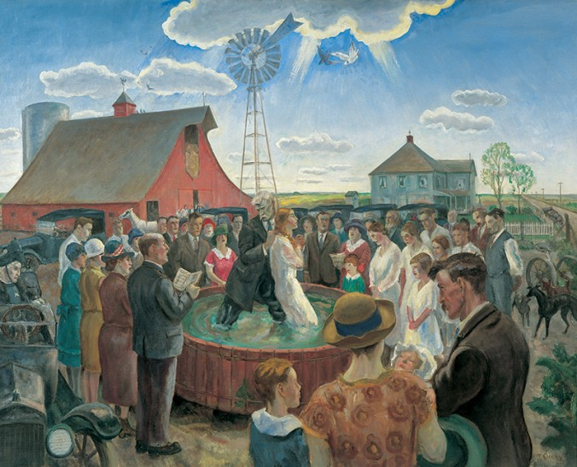

Slide 25
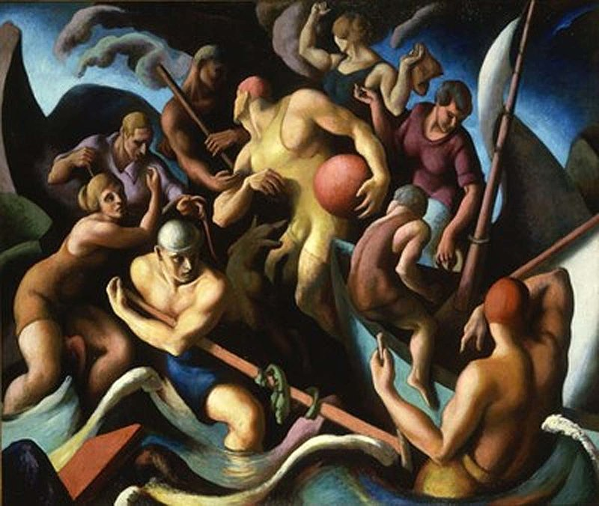

Slide 26
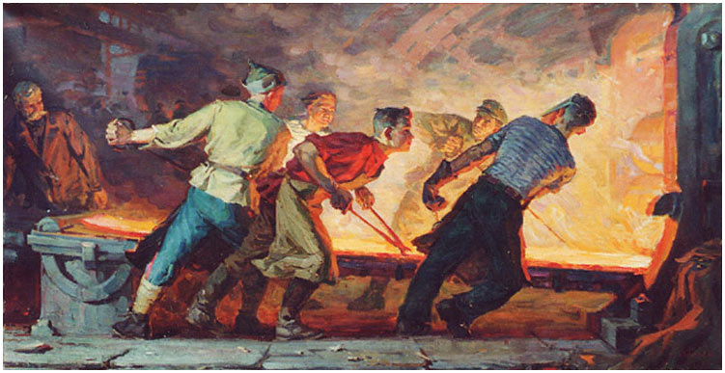

Slide 27
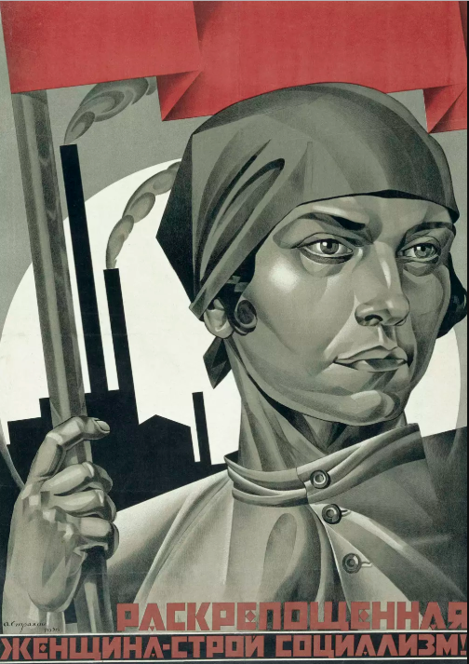

Slide 28
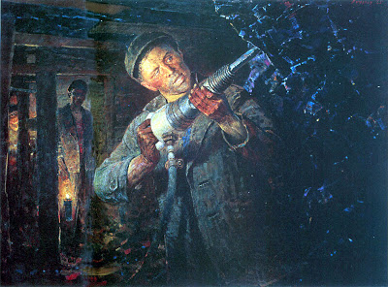
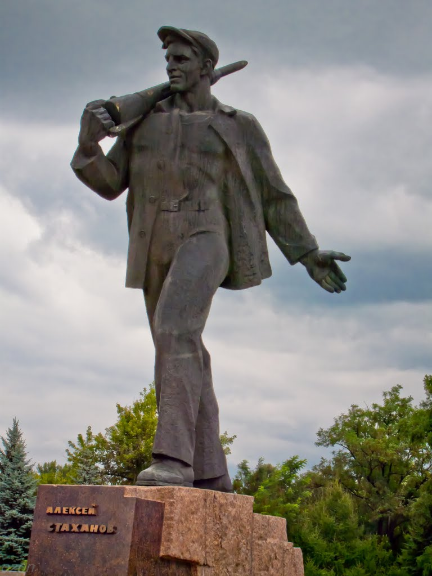

Slide 29
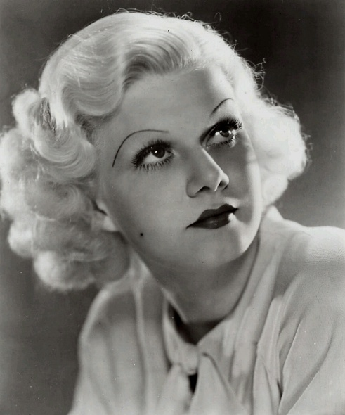
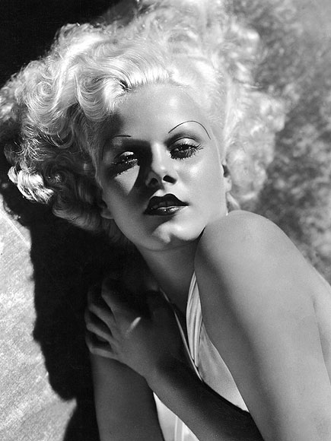
JEAN HARLOWE

Slide 30
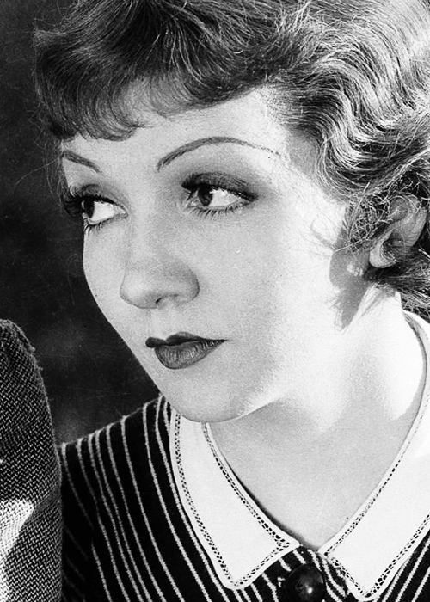
CLAUDETTE COLBERT

Slide 31
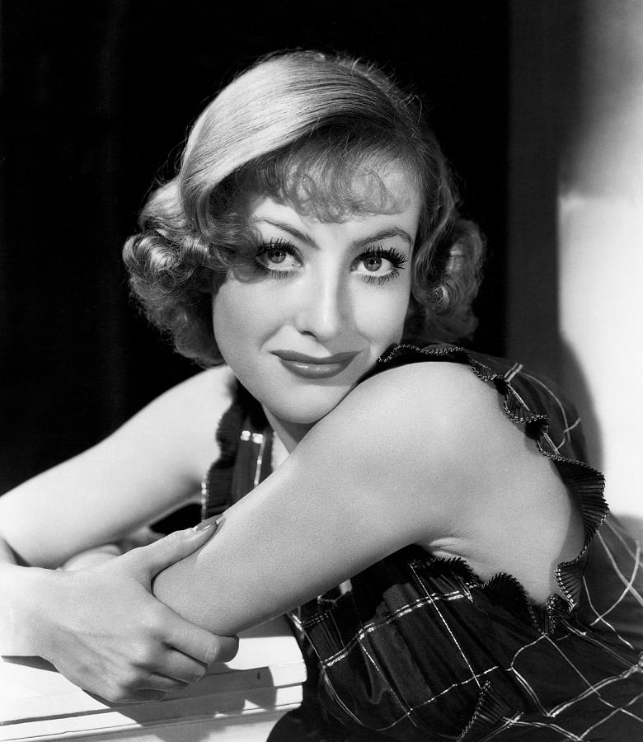
JOAN
CRAWFORD

Slide 32
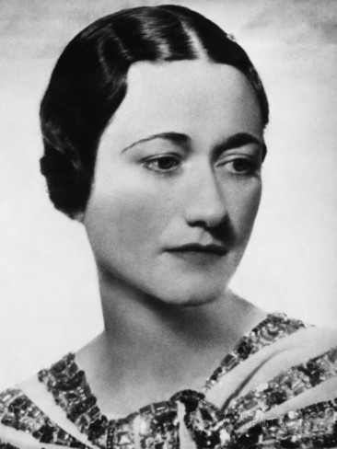
WALLIS SIMPSON

Slide 33
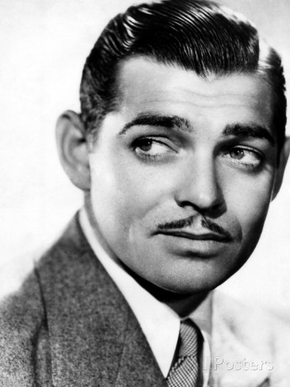
CLARK GABLE

Slide 34
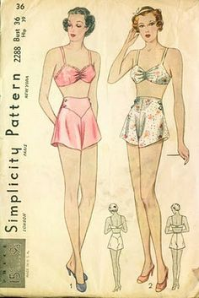

Slide 35
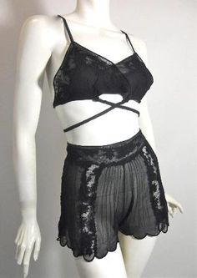

Slide 36
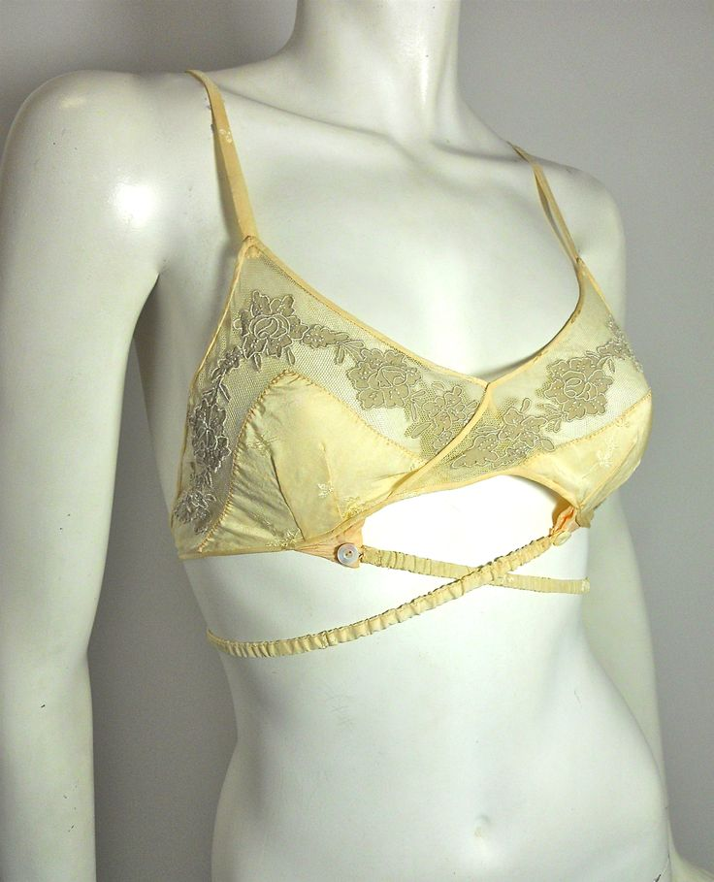

Slide 37
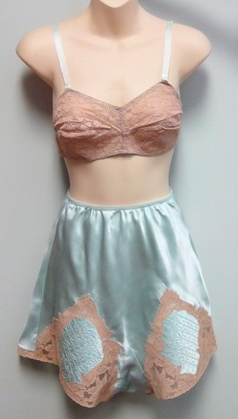

Slide 38
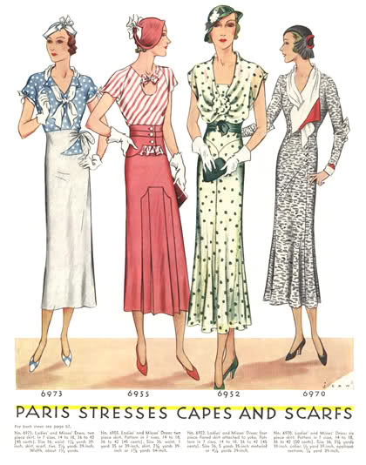

Slide 39
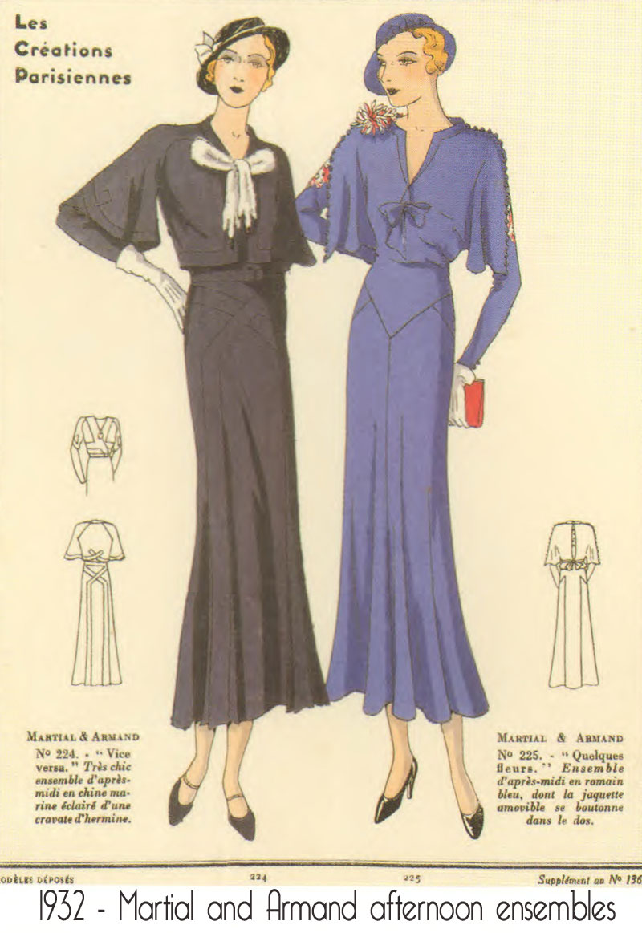

Slide 40
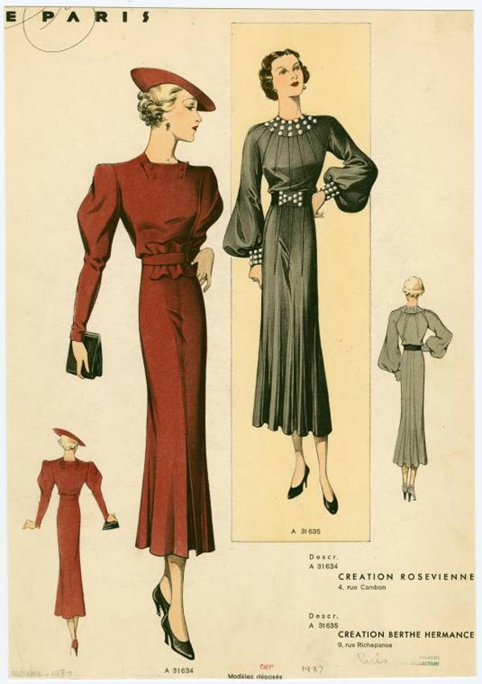

Slide 41
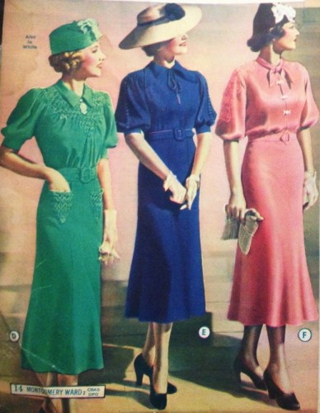

Slide 42
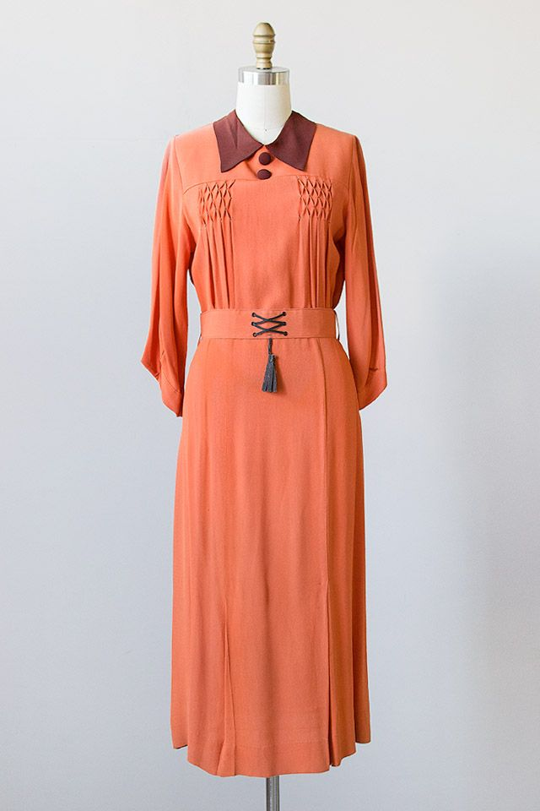

Slide 43
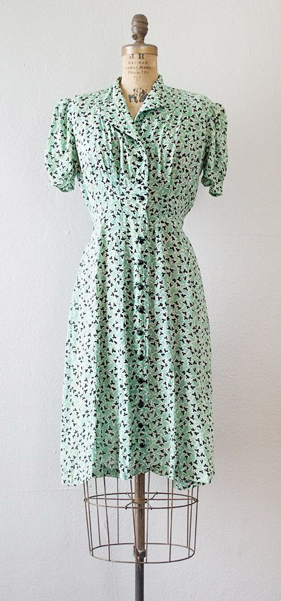
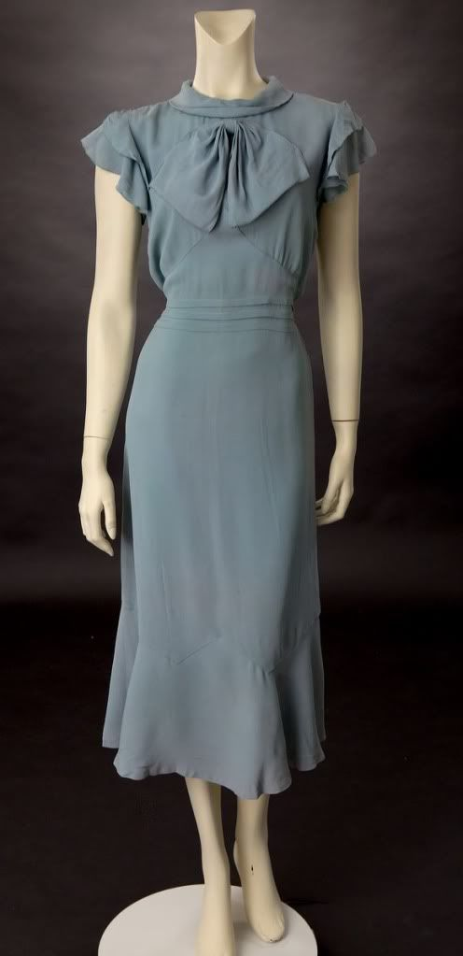

Slide 44
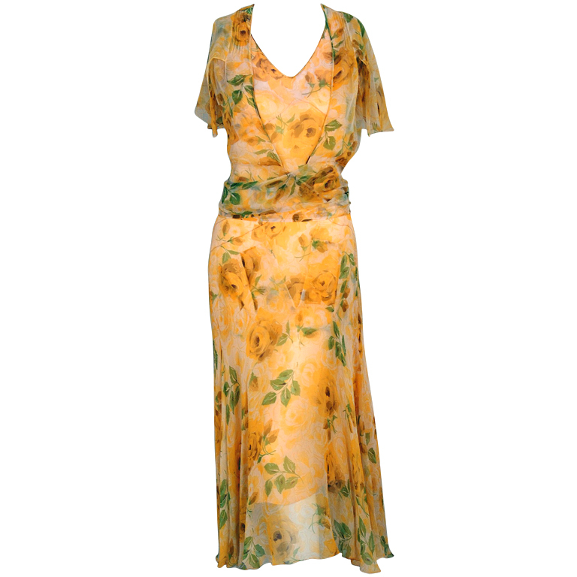
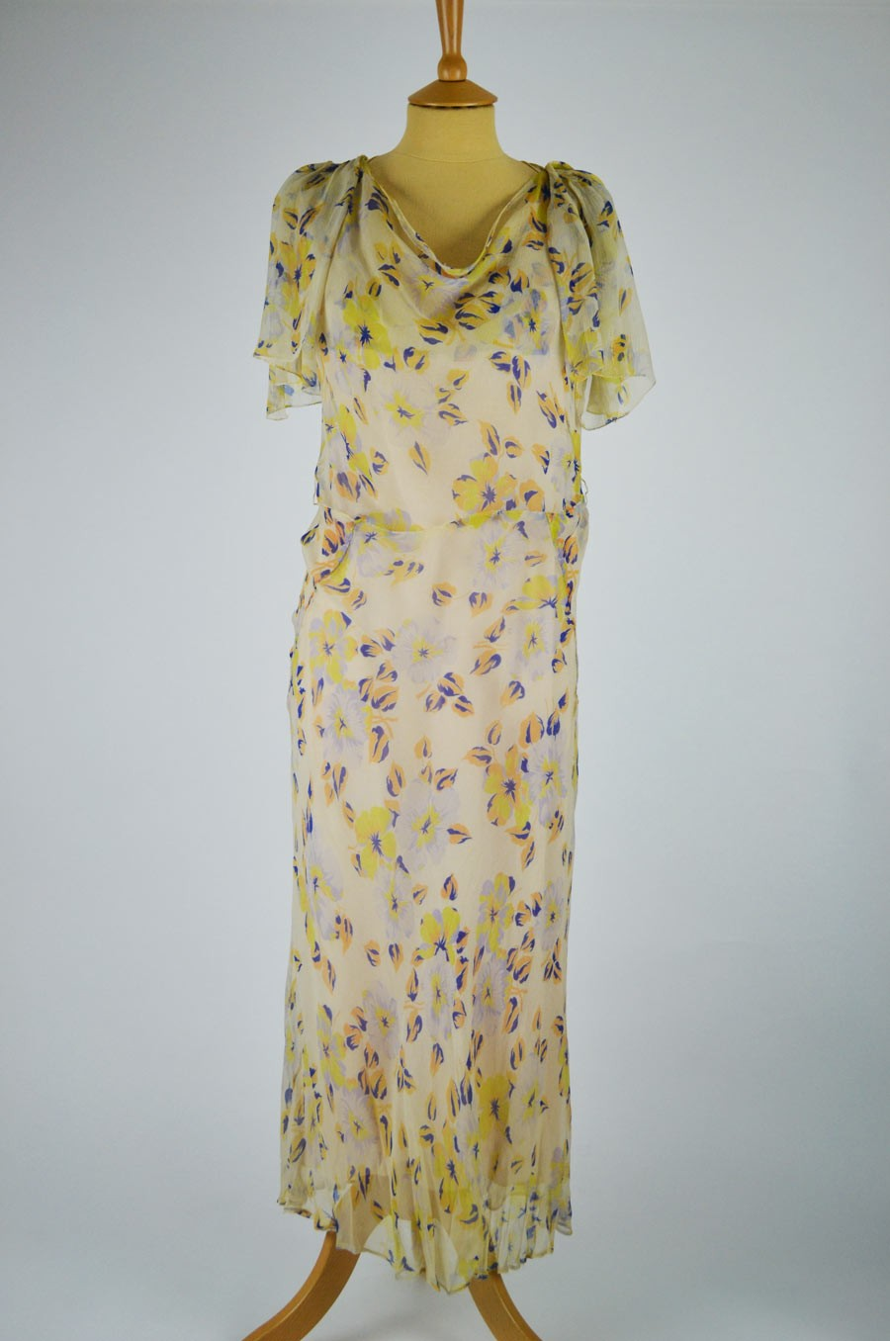

Slide 45
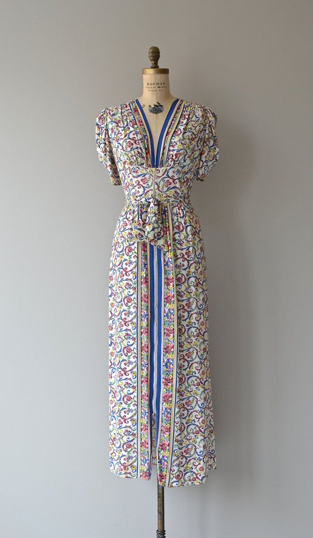
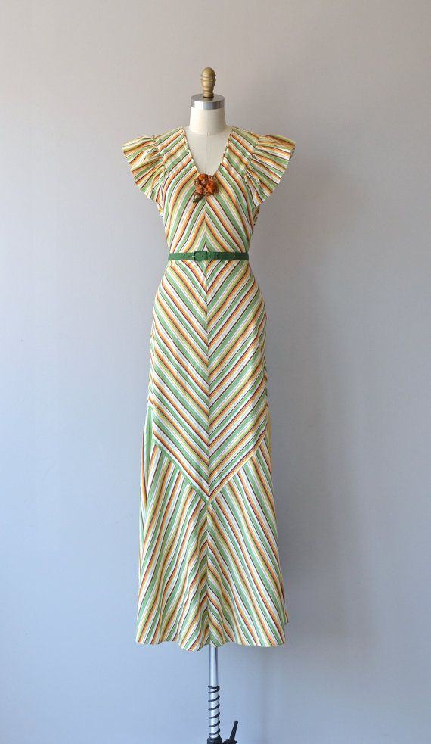

Slide 60
LETTY LYNTON
(designed by ADRIAN)

Slide 71
ELSA SCHIAPARELLI

Slide 85
Victor & Rolf, 2010

Slide 86
JIL SANDER by
RAF SIMONS, 2012

Slide 87
MADELEINE VIONNET

Slide 96
Mme. Grès

Slide 103
Jason Wu

Slide 104
MARIANO FORTUNY

Slide 114
1938-1939

Slide 118
1940s

Slide 127
Betty Grable

Slide 129
Rita Hayworth

Slide 130
Ingrid Bergman

Slide 131
Katherine Hepburn

Slide 163
EVENING

Slide 167
ADRIAN

Slide 172
Valentino, 2001

Slide 176
Stella McCartney, 2001

Slide 201
Valentino, 2011

Slide 207
FILM SET IN THE 1930s and 1940s
Bonnie & Clyde (1967)
Bonnie & Clyde (2013)
Murder on the Orient Express (1974)
4. Atonement (2007)

