Slide 1
1920s

Slide 2
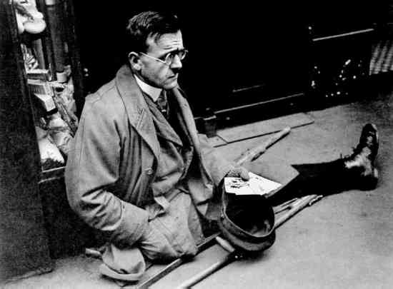
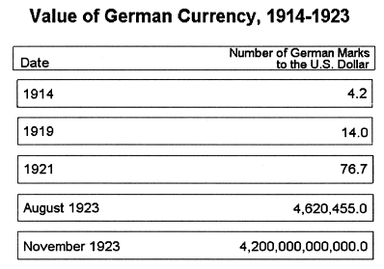
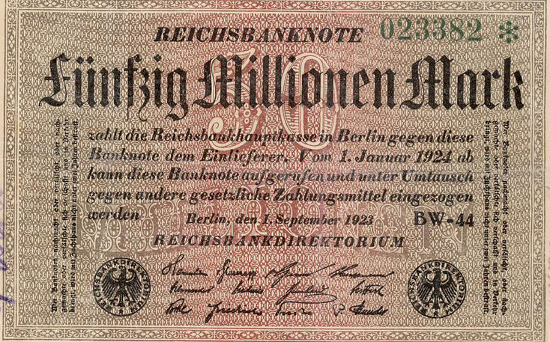
Germany Slides into Despair
Notes:
Much of Europe was shaped by the aftermath of WWI. Germany in particular, was devastated by the Treaty of Versailles, and slid into economic despair.

Slide 3
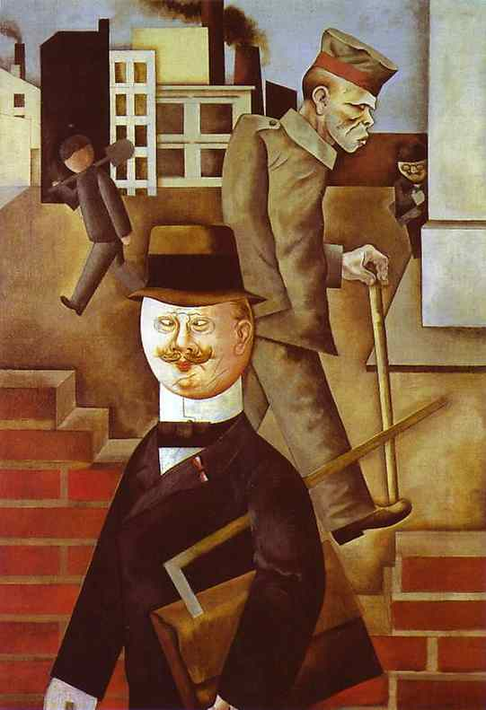
Notes:
The Great War led to a new style of art: Dadism; a form of art that ridiculed the horrors of the modern world. Note that this style is at one darkly humorous and industrial.

Slide 4
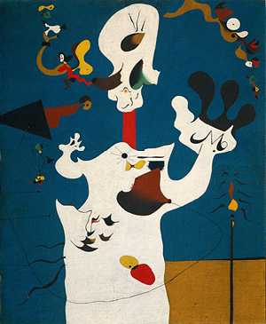
Notes:
There was also a furthering of abstract art, that was concerned with emotional expression.

Slide 5
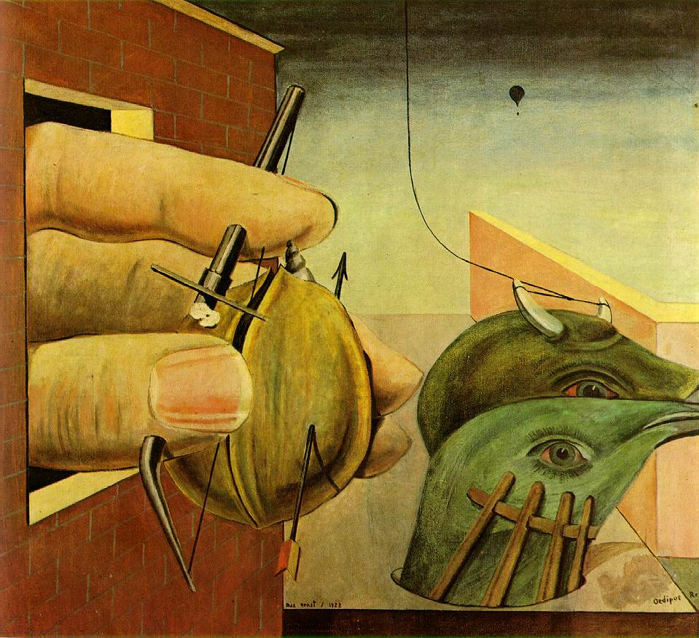
Notes:
And of course, surrealism, which questioned reality. All of these styles of art were in direct response to modern warfare.

Slide 6
Notes:
Architecture: Bauhaus: The Bauhaus, a German word meaning "house of building", was a school founded in 1919 in Weimar, Germany by architect Walter Gropius. The school emerged out of late-19th-century desires to reunite the applied arts and manufacturing, and to reform education. These had given birth to several new schools of art and applied art throughout Germany, and it was out of two such schools that the new Bauhaus was born.

Slide 7
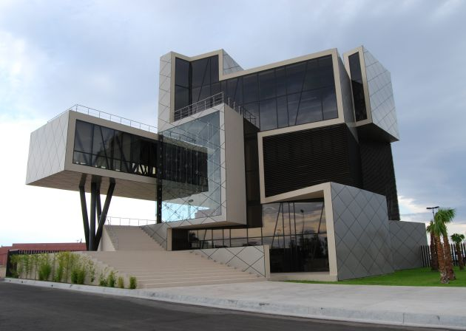
Notes:
Cubism: uses limited forms of expression. At its core it uses geometric shapes to fragment and compose forms. The object is basically broken down into its basic elements.

Slide 8
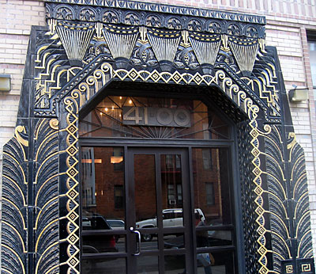
Notes:
Art Deco. also called style moderne, movement in the decorative arts and architecture that originated in the 1920s and developed into a major style in western Europe and the United States during the 1930s. Its name was derived from the Exposition Internationale des Arts Décoratifs et Industriels Modernes, held in Paris in 1925, where the style was first exhibited. Art Deco design represented modernism turned into fashion. Its products included both individually crafted luxury items and mass-produced wares, but, in either case, the intention was to create a sleek and antitraditional elegance that symbolized wealth and sophistication.

Slide 9
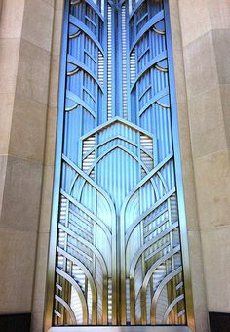
Notes:
Note the sleek geometry, symmetry, hard lines.

Slide 10
Notes:
Shining example.

Slide 11
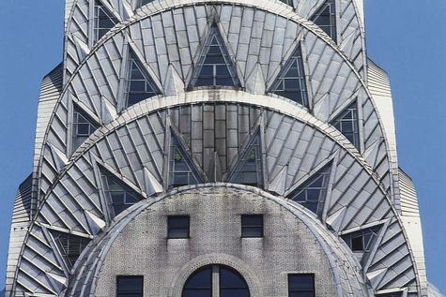
https://prezi.com/vrrmrfmygwjz/1920s-architecture/

Slide 12
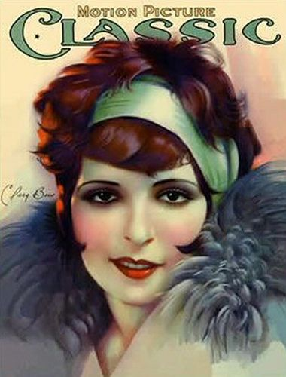
Notes:
Ideal Beauty: Actress Clara Bow embodied the 1920s “It Girl” – she’s the natural evolution from the Gibson Girl, sassy, flirtatious, independent.

Slide 13
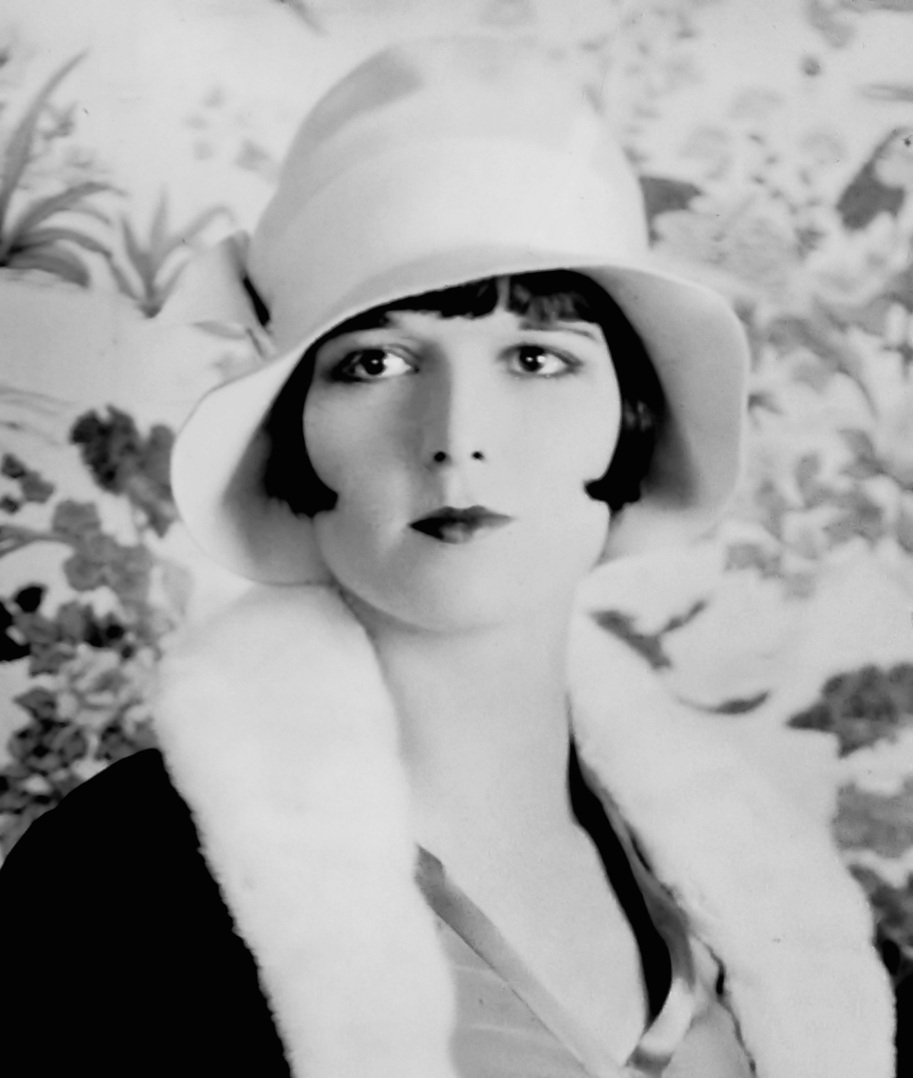
Notes:
Louise Broosks. Actress, beauty icon who popularized the bob haircut (which was purposefully boyish).

Slide 14
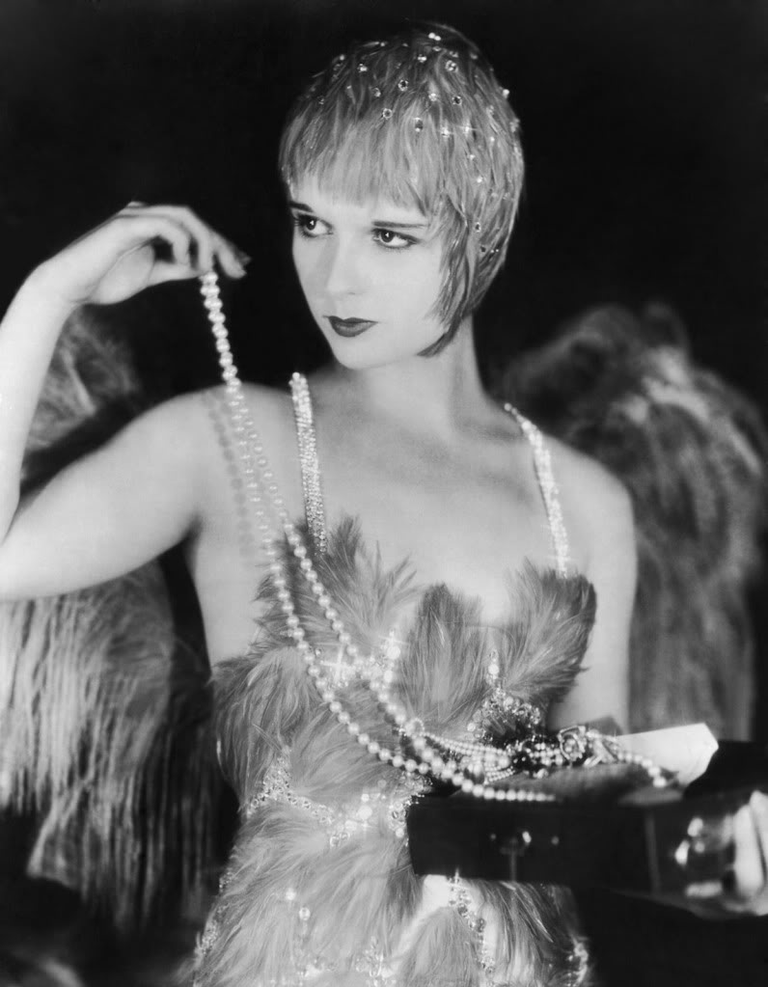
Notes:
Louise Brooks. Note the pursed small, rouged lips.

Slide 15
Notes:
Josephine Baker. American entertainer who expatriated to Paris where black entertainers were more accepted.

Slide 16
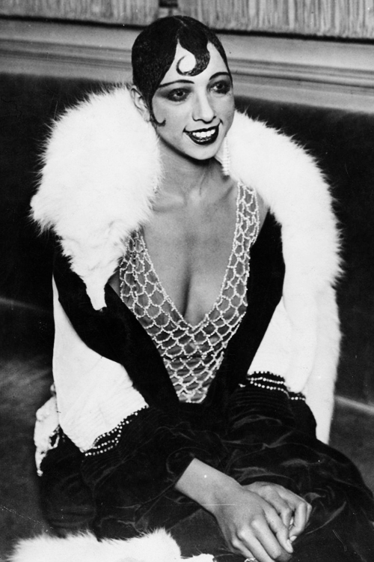
Notes:
Josephine Baker, Note the deep V-neckline.

Slide 17
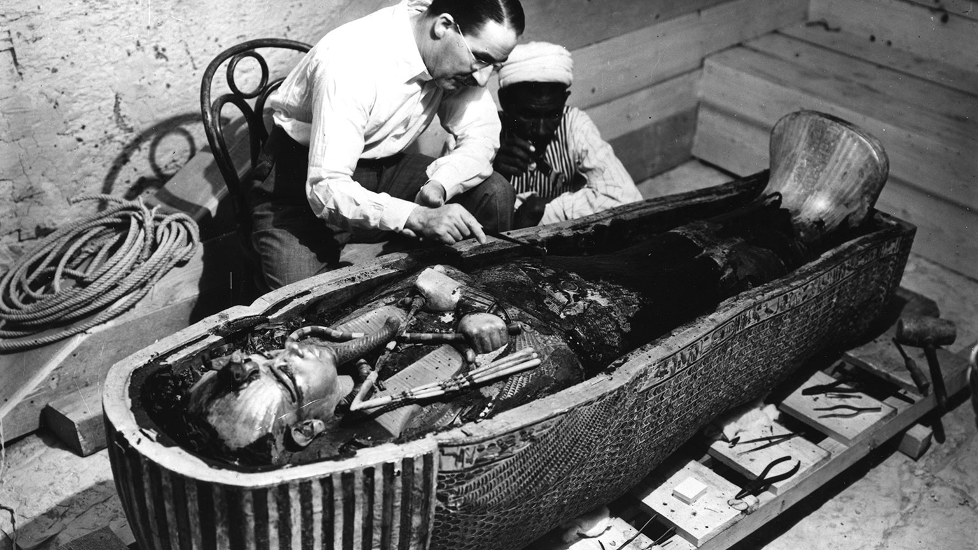
Notes:
Major event that inspired 1920s trend. Howard Carter uncovered King Tut’s tomb in 1922, sparking fascination with all things Ancient Egyptian.

Slide 18
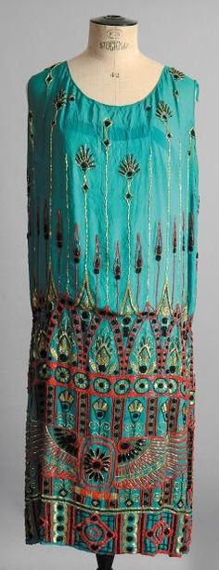
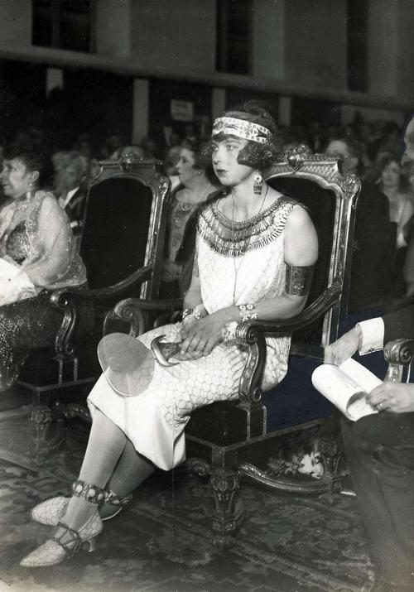
Notes:
Note: the woman on the right is not in costume, her fashion is simply mimicking that of Ancient Egypt.

Slide 19
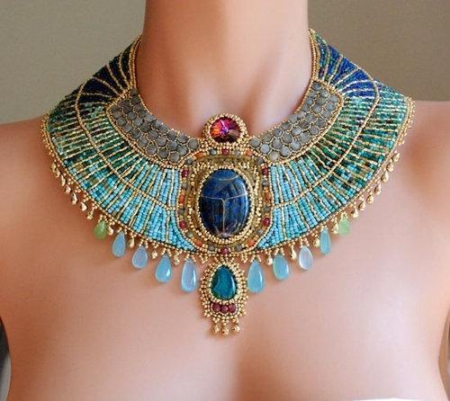
Notes:
1920s Egyptian-style necklace.

Slide 20
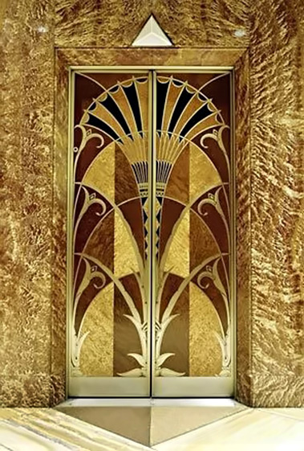
Notes:
Note the papyrus motif.

Slide 21
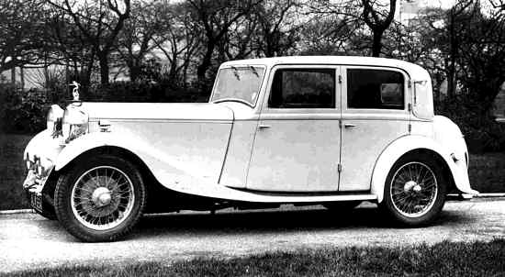
Notes:
1920s. The car provided the first time that young people had the opportunity to be by themselves. Led to increase in sexual activity, alcohol consumption, etc.

Slide 22
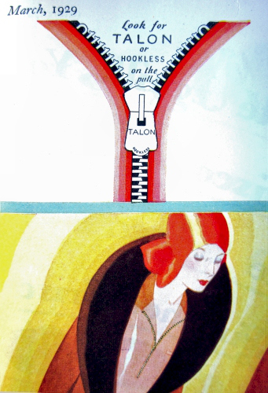
Notes:
1923: The zipper is invented, changing the way people get into and out of clothes. Transforms construction techniques.

Slide 23
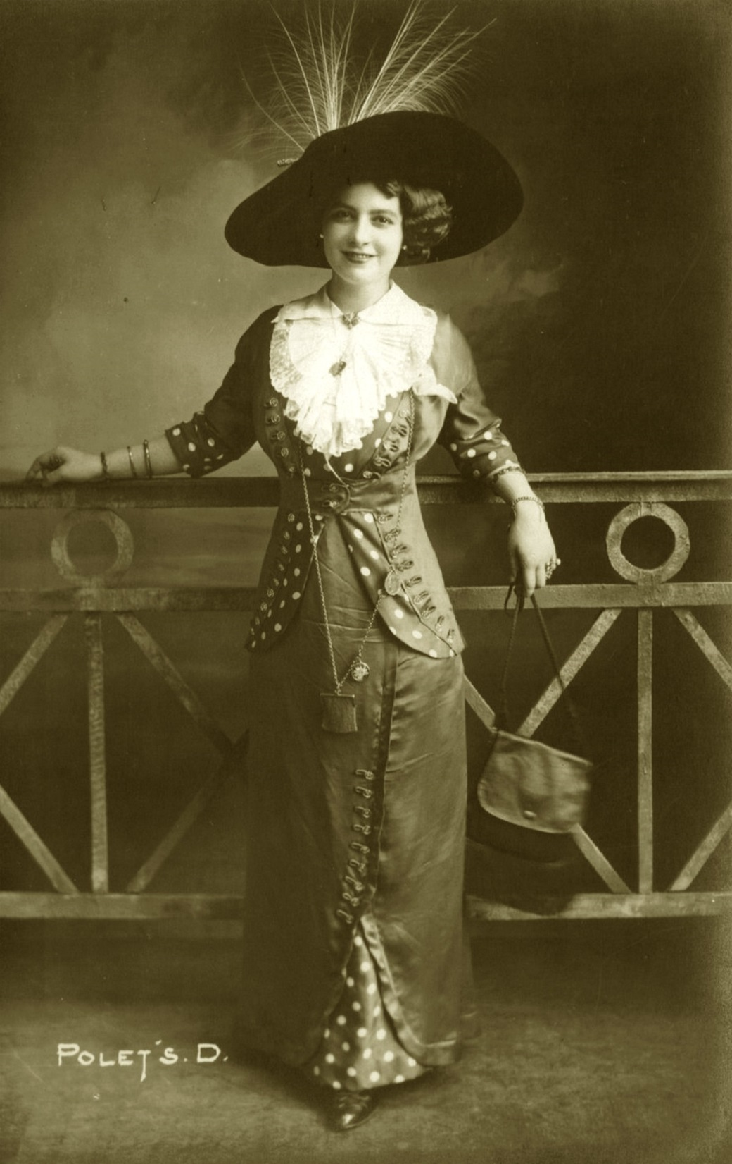
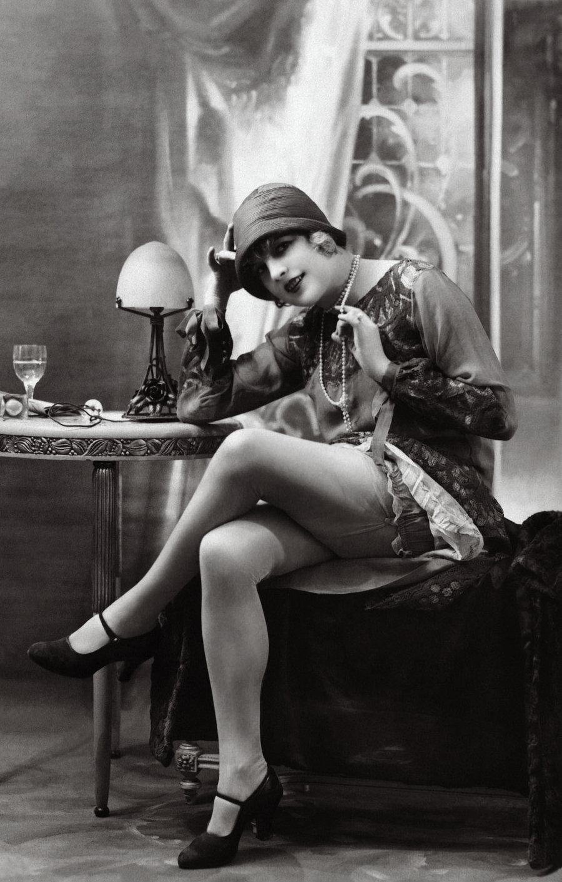
Notes:
Note the change (in a 10-15 year period). Covered up Gibson Girl to Flapper.

Slide 24
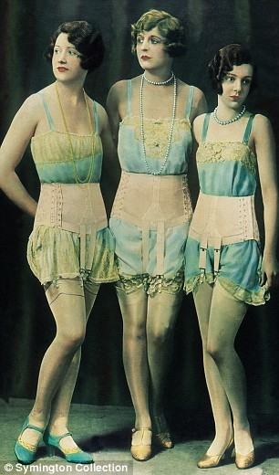
Notes:
Undergarments change dramatically. Note the shift in “corseting”, natural bustline (or flattened).

Slide 25
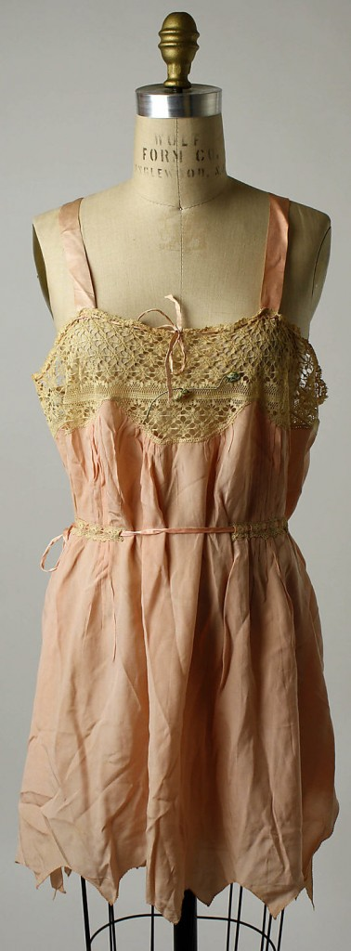
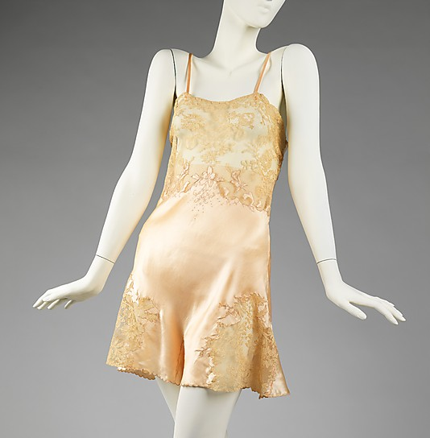
Notes:
This is it. Foundation garments become quite minimal

Slide 26
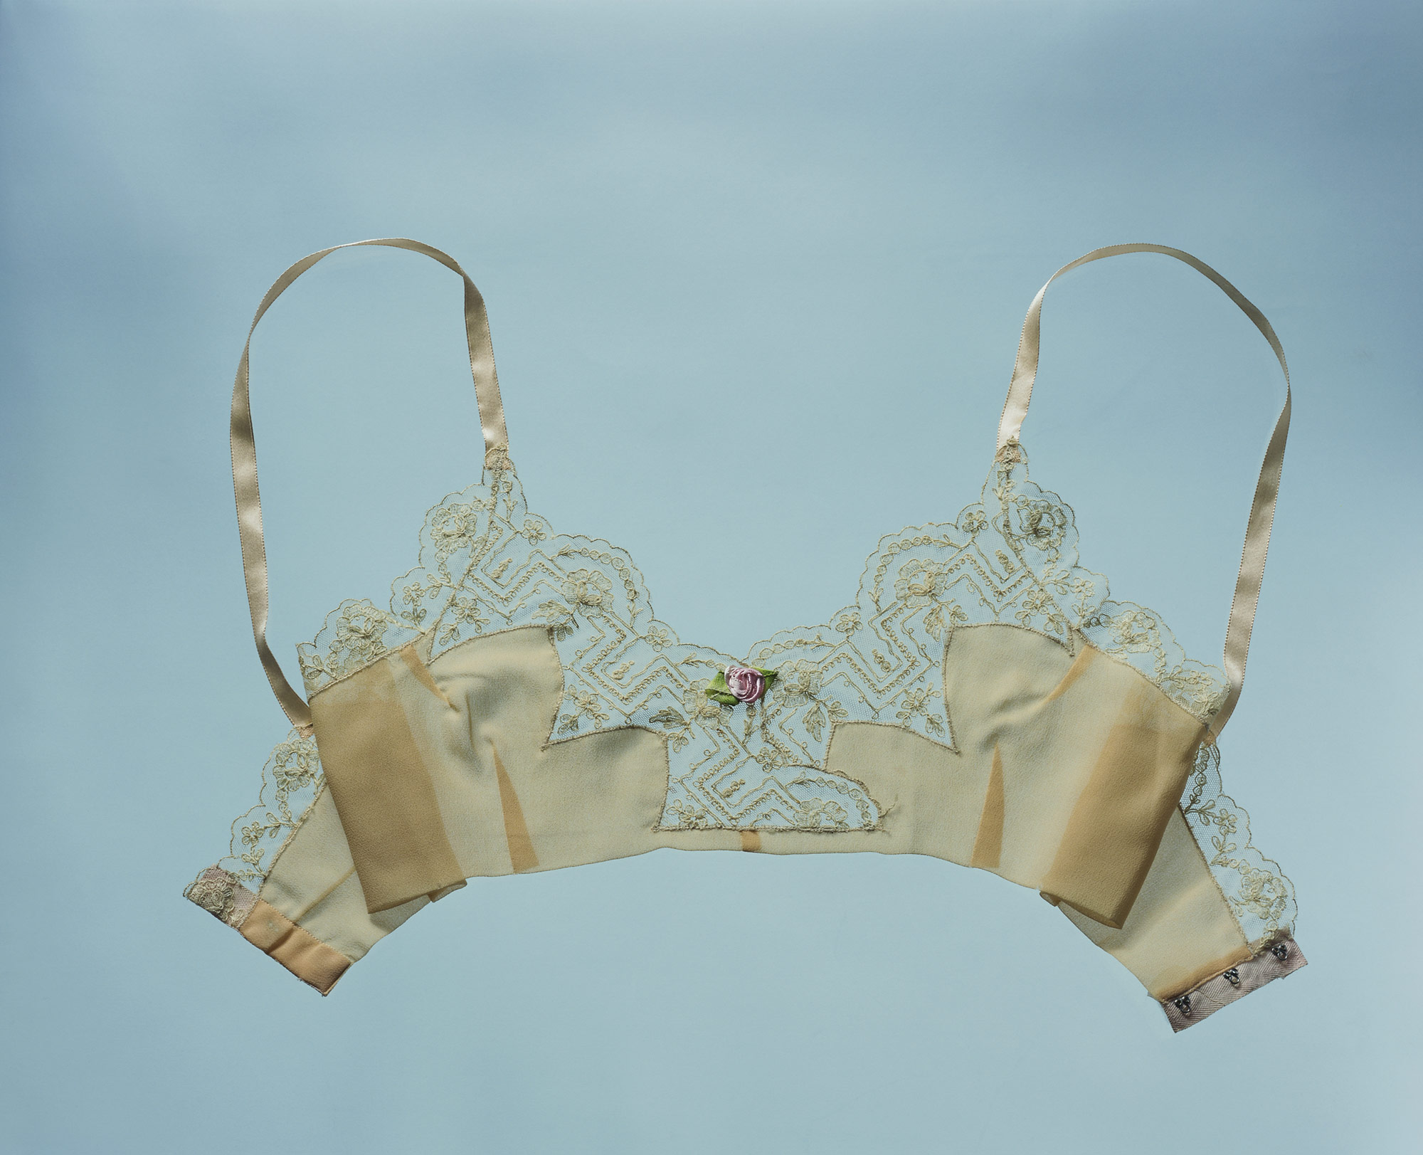
Notes:
Brassiere replaces the chemise. Note again the natural shaping.

Slide 27
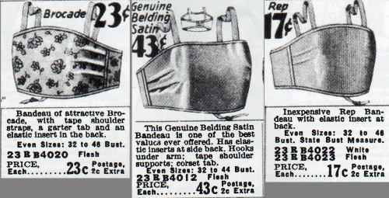
Notes:
Bust minimizers. Women’s silhouette shifts to flatter bust, undefined waistline, slim hips.

Slide 28
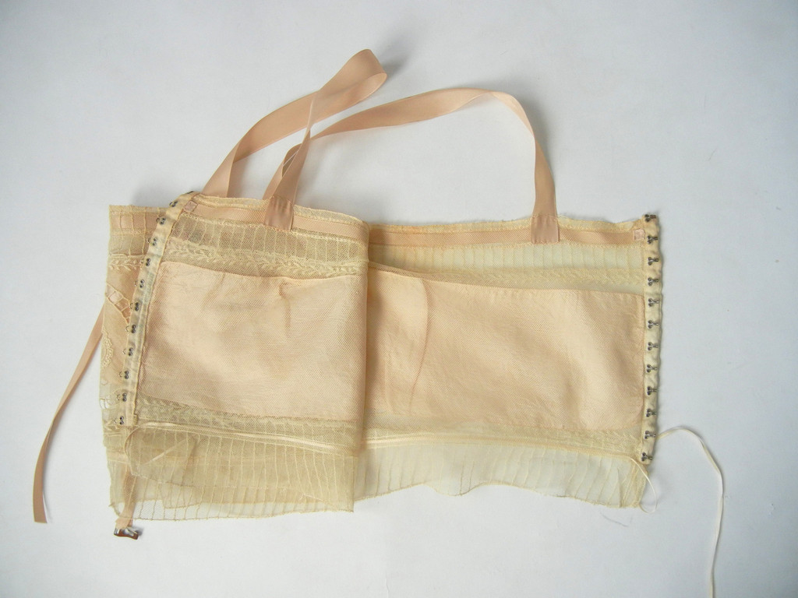
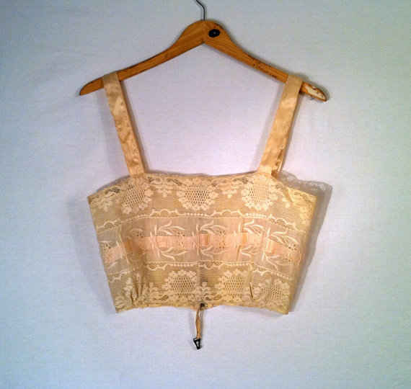
Notes:
Brassiers.

Slide 29
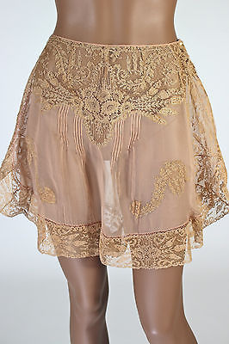
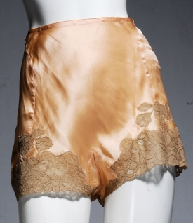
Notes:
Tap pants replace bloomers.

Slide 30
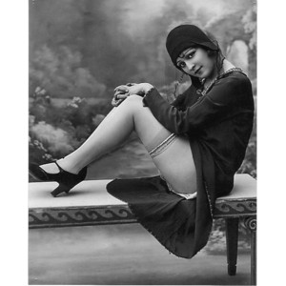
Notes:
Note the amount of leg shown (1925 = highest hemlines)

Slide 31
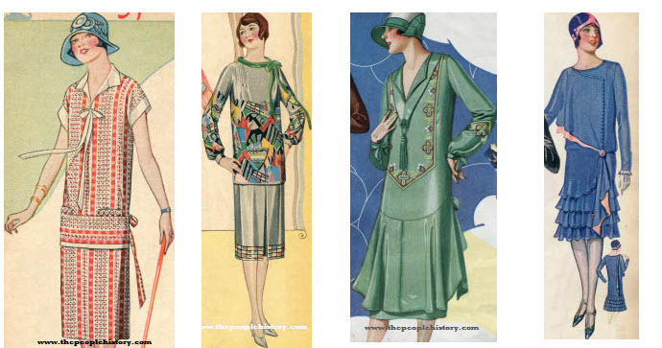
Notes:
Daywear. Armscye is high up on the shoulder allowing for increased range of motion.

Slide 32
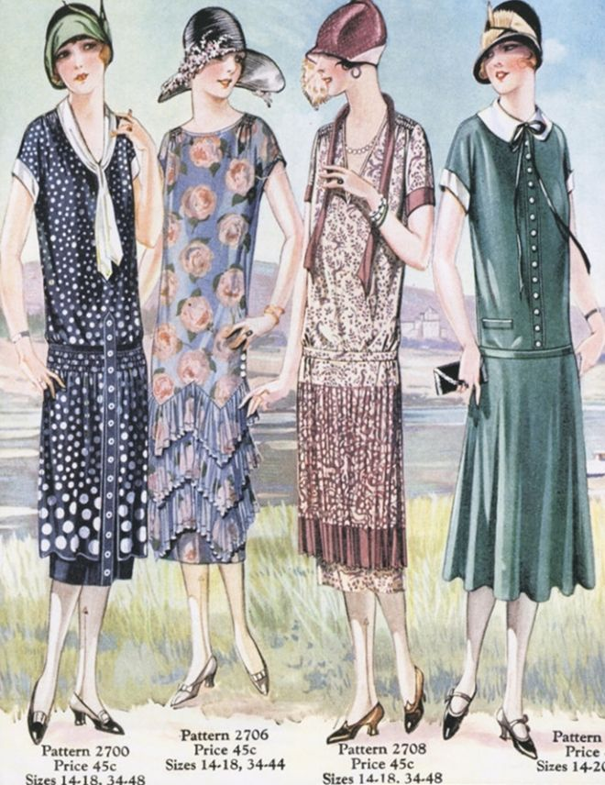
Notes:
Note columnar silhouette. Droppes waistline.

Slide 33
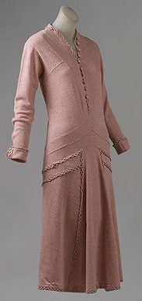
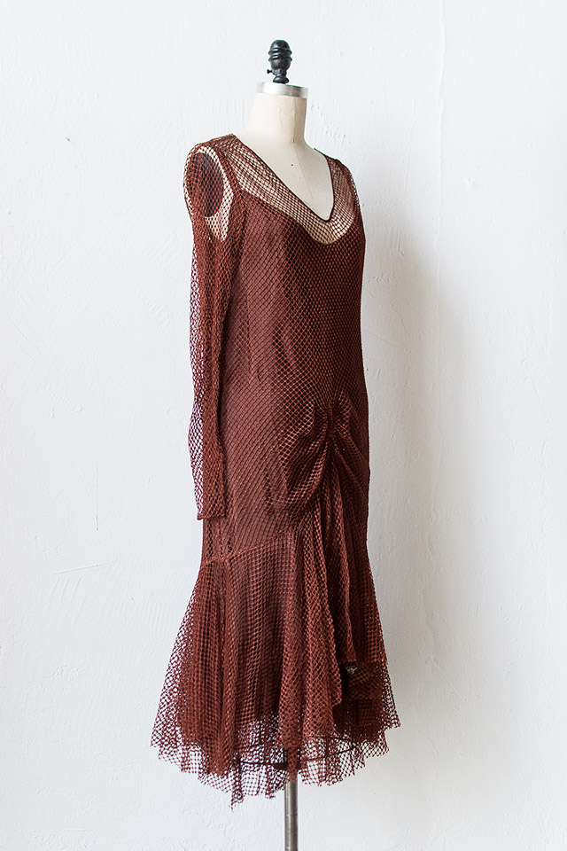

Slide 34
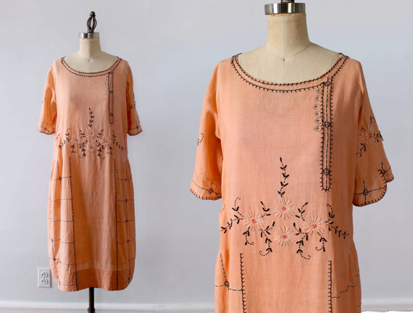
Notes:
Loose shift.

Slide 35
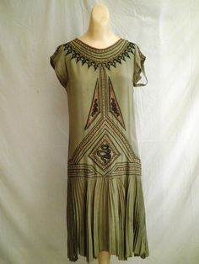

Slide 36
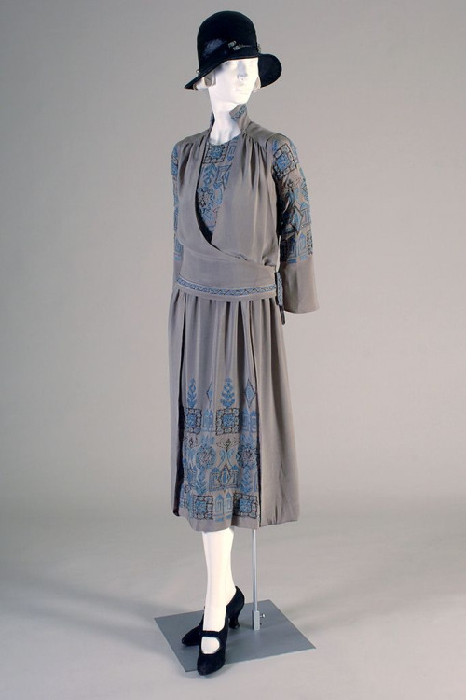

Slide 37
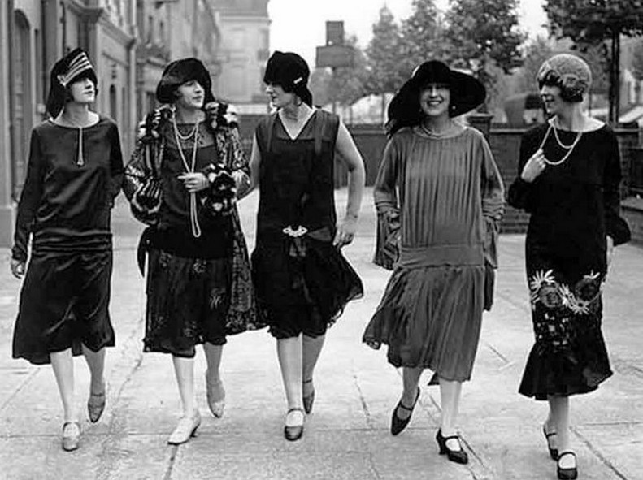
Notes:
Women show an exuberance and freedom of movement like never before.

Slide 38
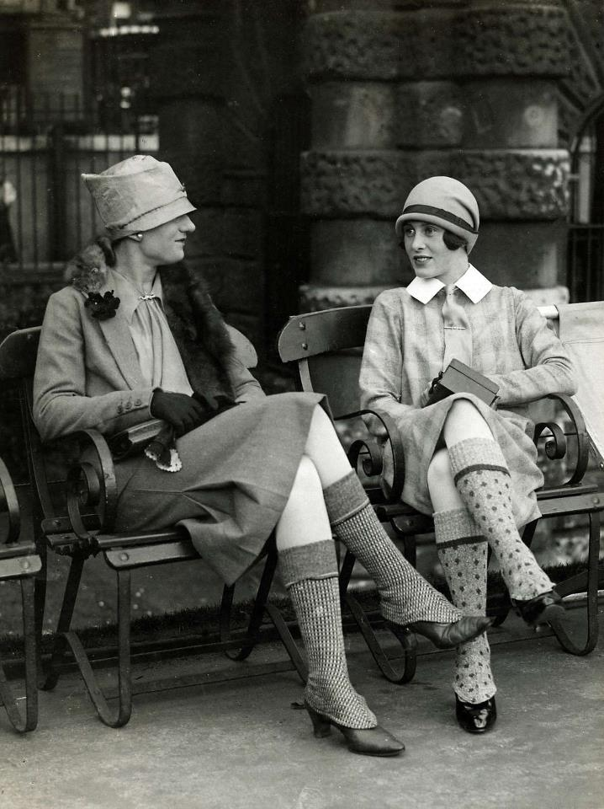
Notes:
Appropriation of menswear!

Slide 39
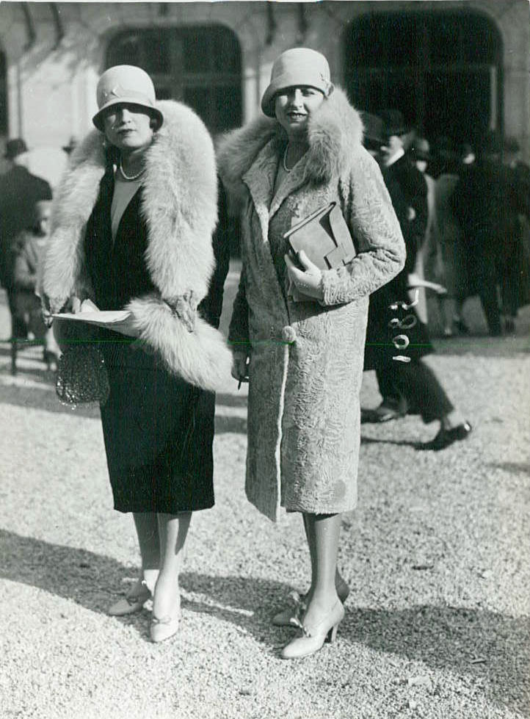
Notes:
Outerwear.

Slide 40
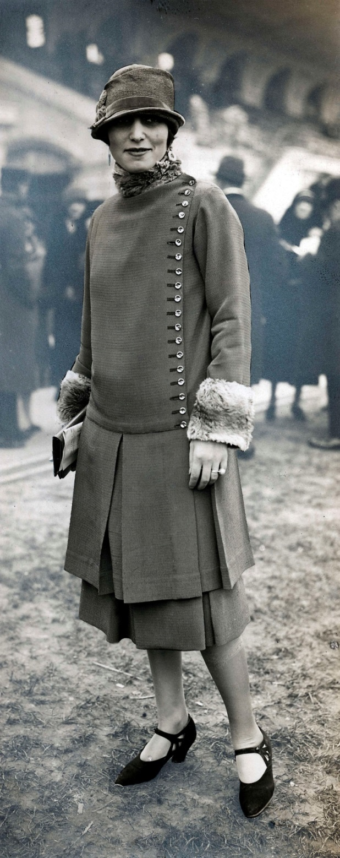

Slide 41
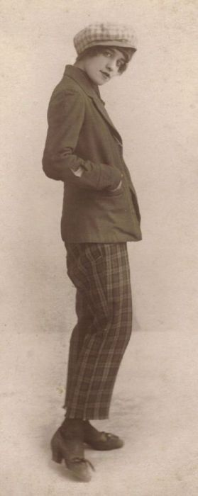
Notes:
Women do begin to wear pants, but not many and not frequently.

Slide 42
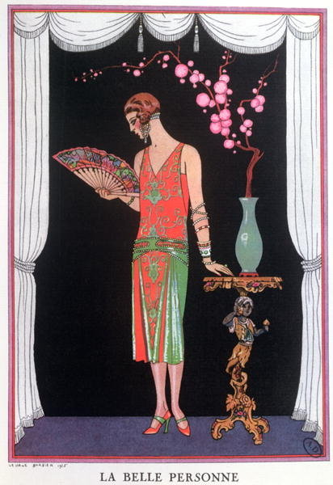
Notes:
Fashion illustrations enhance 1920s artforms.

Slide 43
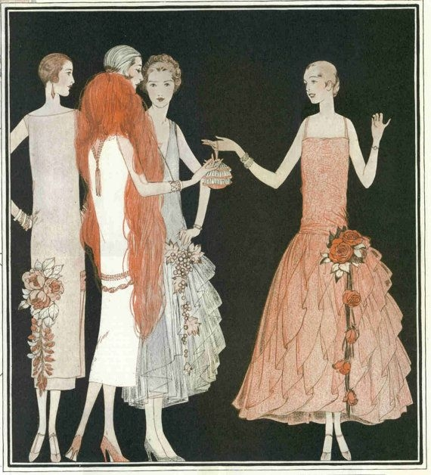
Notes:
Late 1920s, silhouette begins to add volume at the skirt.

Slide 44
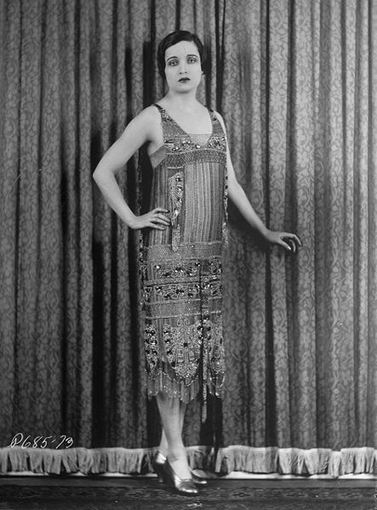
Notes:
Eveningwear. Lots of silk, fringe, beading, Egyptian motifs.

Slide 45
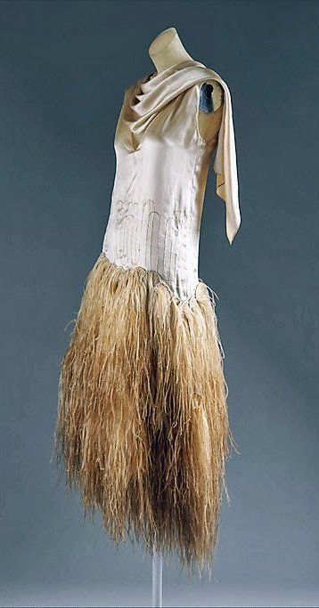
Notes:
Fringed feathers.

Slide 46
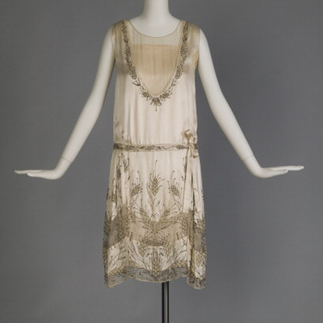
Notes:
Delicate beading on silk chiffon.

Slide 47
Notes:
Beaded fringe.

Slide 48
Notes:
Art Deco motifs.

Slide 49
Notes:
Hemlines lengthen towards end of decade.

Slide 50
Notes:
Handkerchief hemline 1920/29.

Slide 51
ROBE DE STYLE
Notes:
Pronounced Robe de schteel. Used modified panniers to life skirt volume at sides.

Slide 52
Notes:
Robe de Style.

Slide 53
Notes:
Another one, note the “girlish” design.

Slide 54
Notes:
Here you can see the panniers.

Slide 55
JEANNE LANVIN
Notes:
Designer: Jeanne Lanvin. French.

Slide 56
Notes:
Sleek deco illustrations.

Slide 57
Notes:
Lanvin often designed in Robe de Style.

Slide 59
Notes:
There is also an elegance to her designs that is noteworthy.

Slide 60
Notes:
Lanvin wedding gown.

Slide 61
Notes:
1930 Lanvin.

Slide 62
Coco Chanel
Notes:
Chanel was inspired by her school girl uniform and sporting lifestyle in her designs. She started as a milliner and eventually opened a couture house in Paris.

Slide 63
Notes:
Her classic black suit (note the pearls, cardigan and simple skirt)

Slide 64
Notes:
She also invented the little black cocktail dress, which she saw as quite versatile.

Slide 65
Notes:
Chanel cocktail.

Slide 68
Notes:
Fringed cocktail.

Slide 69
Notes:
Chanel suits, almost mannish.

Slide 70
Notes:
1920s. Women move away from the traditional long wool bathing attire. In 1922, women were arrested for wearing bathing suits similar to those on the right.

Slide 72
CLOCHE
Notes:
The most important hat style in the 1920s, the cloche. Fits closely to the head, little or no brim.

Slide 76
Notes:
Because the skirts were so short, the shoe becomes more important and more designed.

Slide 78
Notes:
Menswear. 3-piece suits.

Slide 79
Notes:
Some variety in working garments for men.

Slide 80
Notes:
Oxford baggies. A style that started with college men, very wide –legged trousers.

Slide 81
Notes:
Men also adopted these short golf-style pants, typically worn with argyle socks and sweaters.

