Slide 1
1860s-1880s

Slide 2
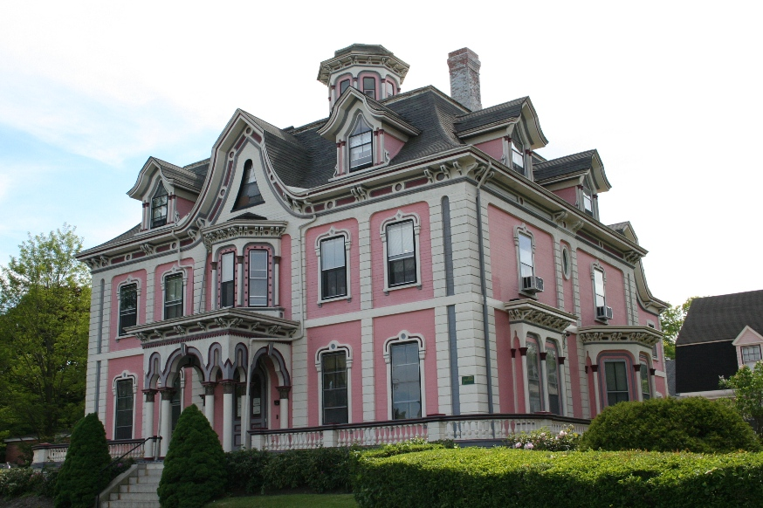

Slide 3
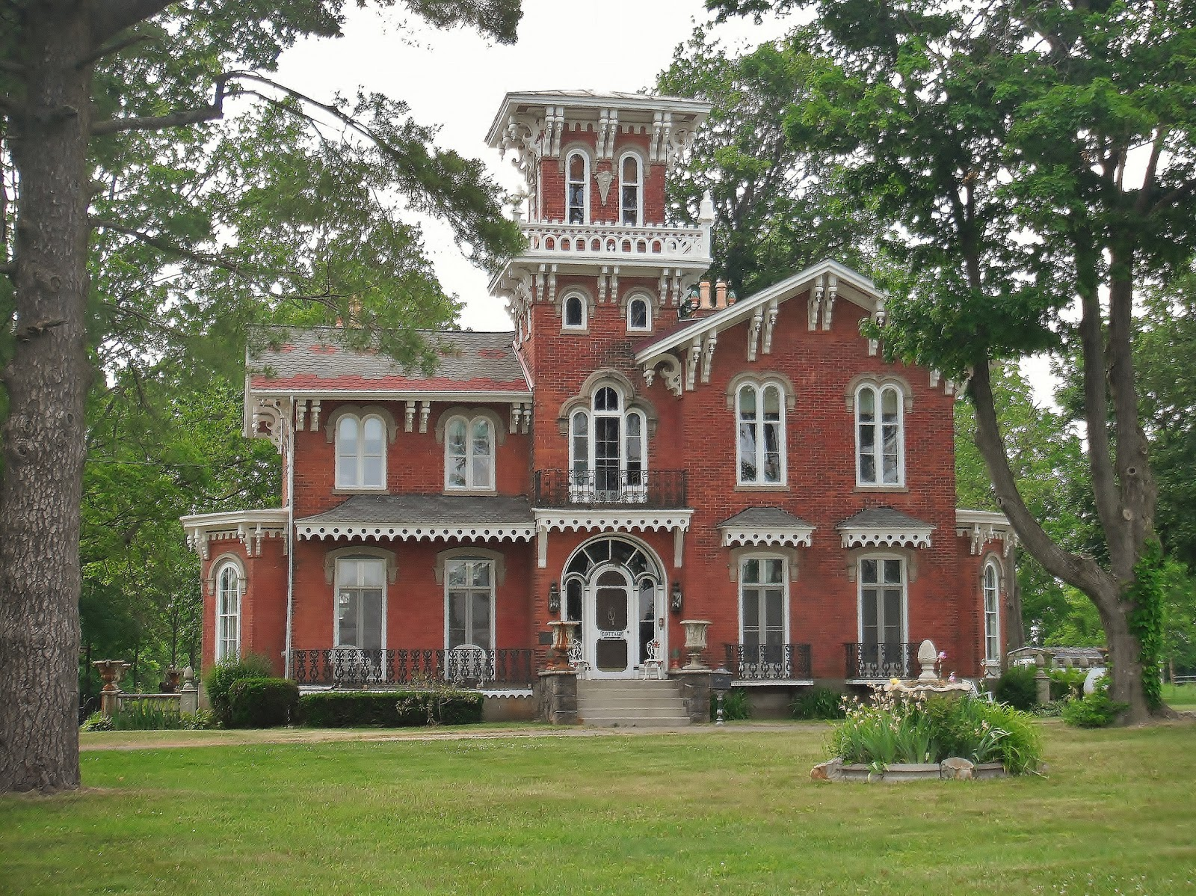

Slide 4
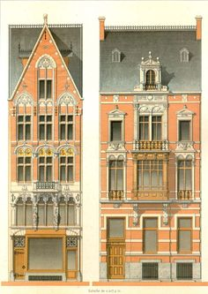

Slide 5
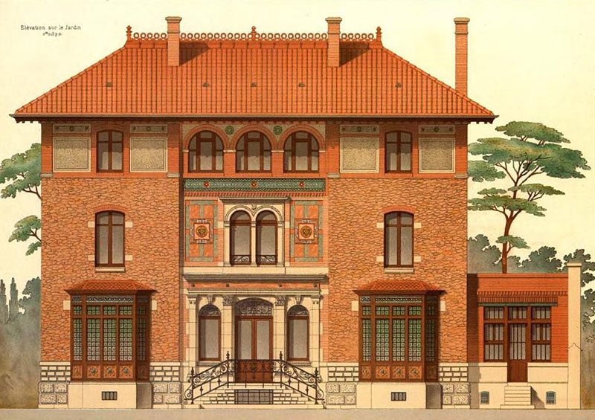

Slide 6
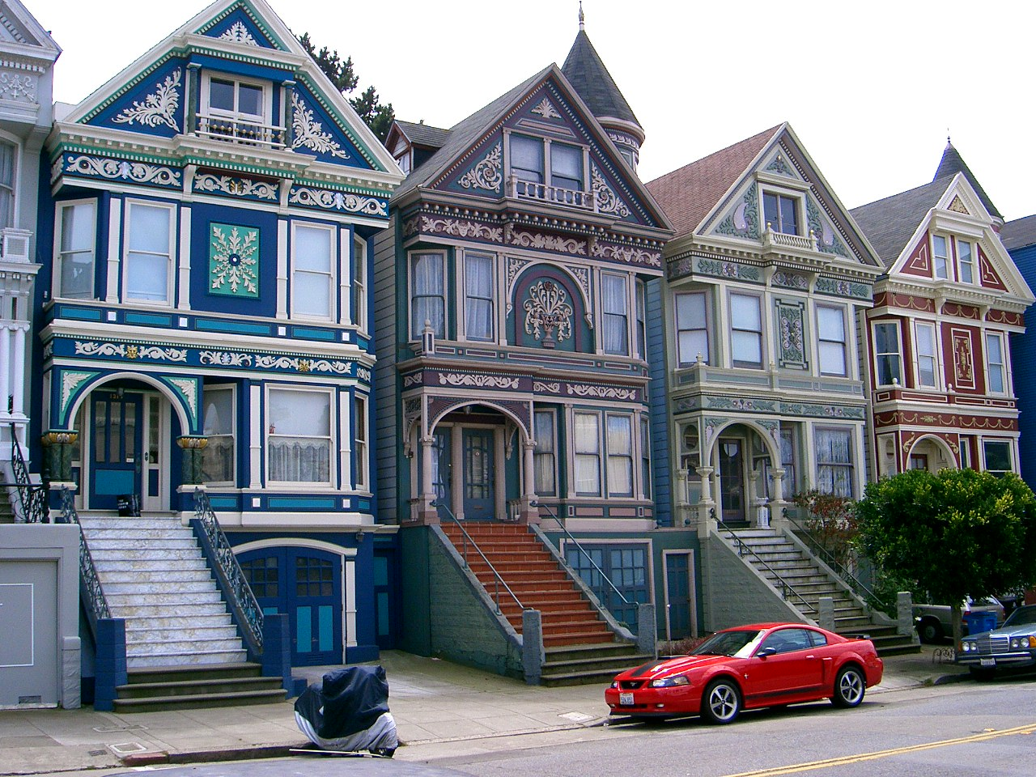

Slide 7
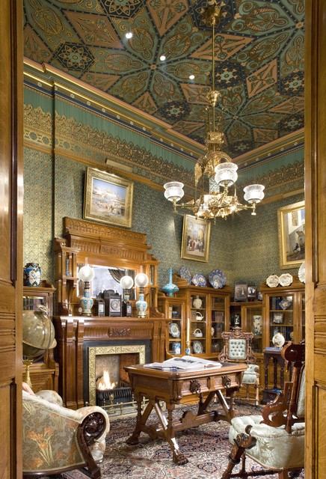

Slide 8
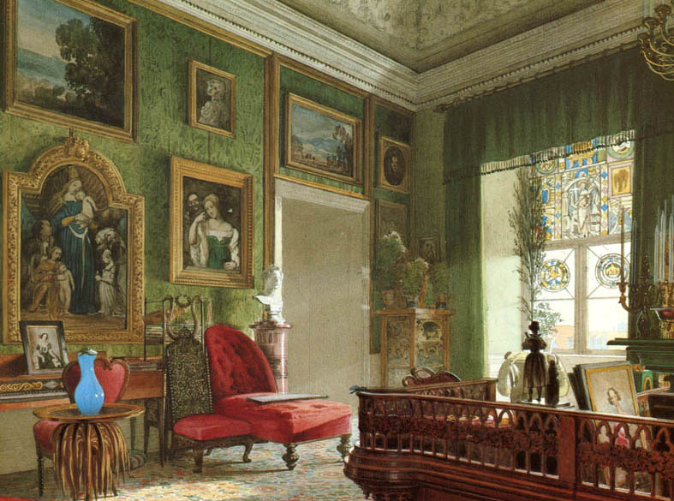

Slide 9
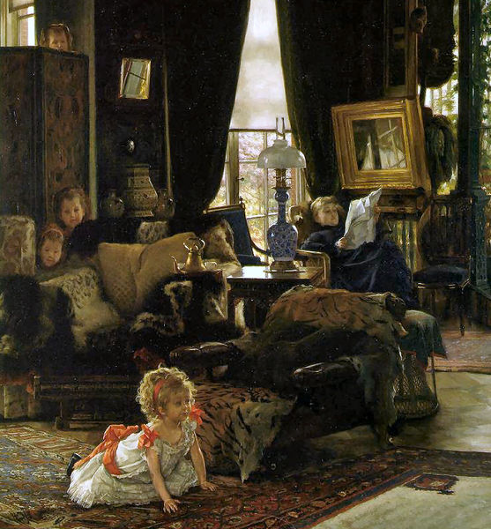

Slide 10
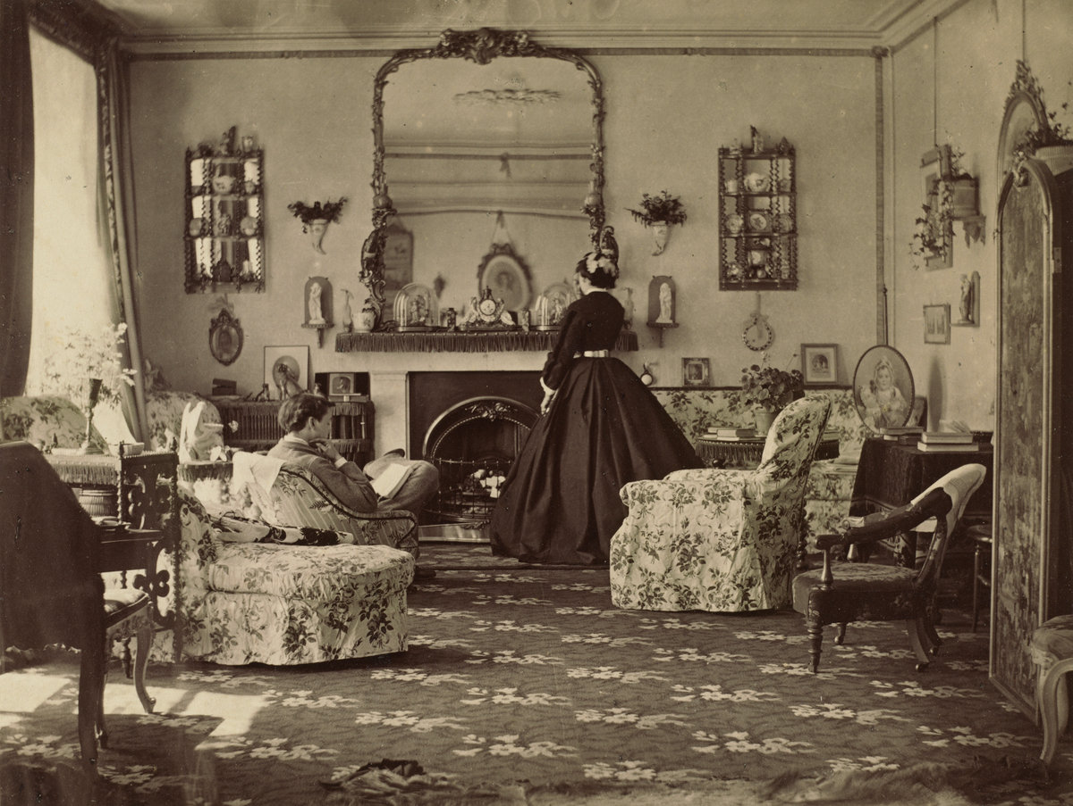

Slide 11
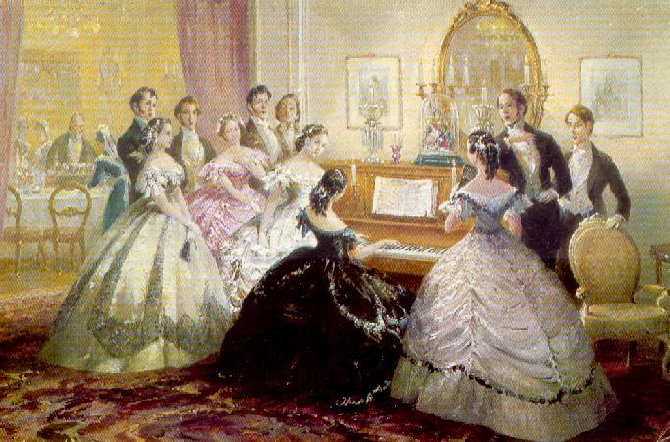

Slide 12
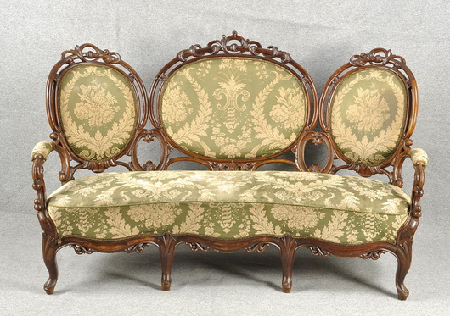

Slide 13
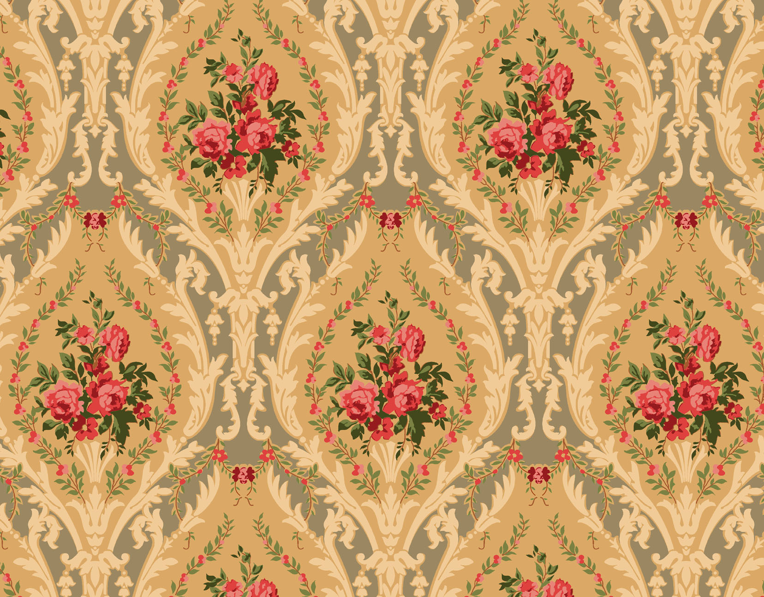

Slide 14
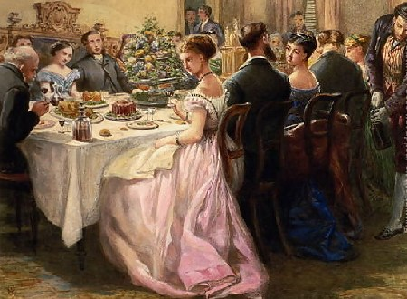

Slide 15
1860s

Slide 16
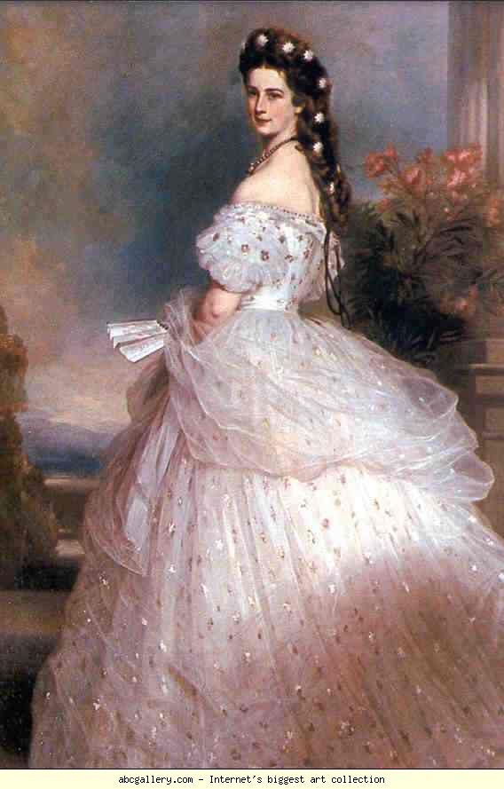
Notes:
Portraiture

Slide 17
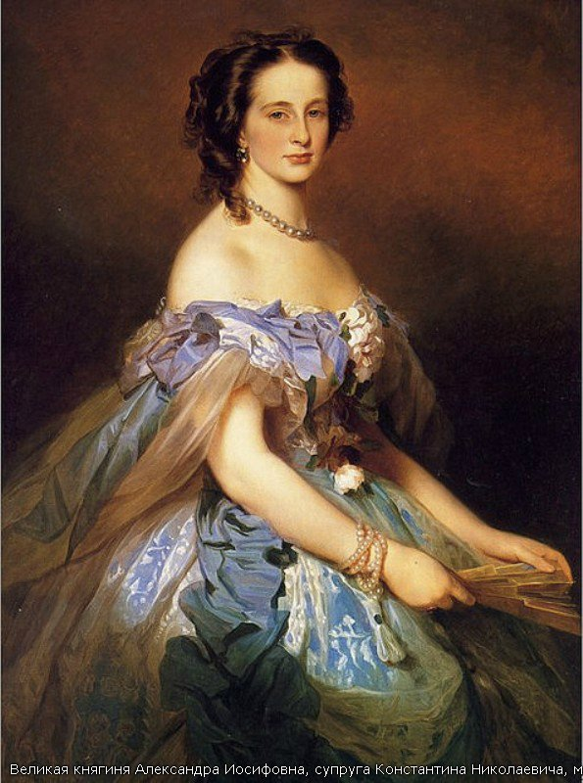

Slide 18
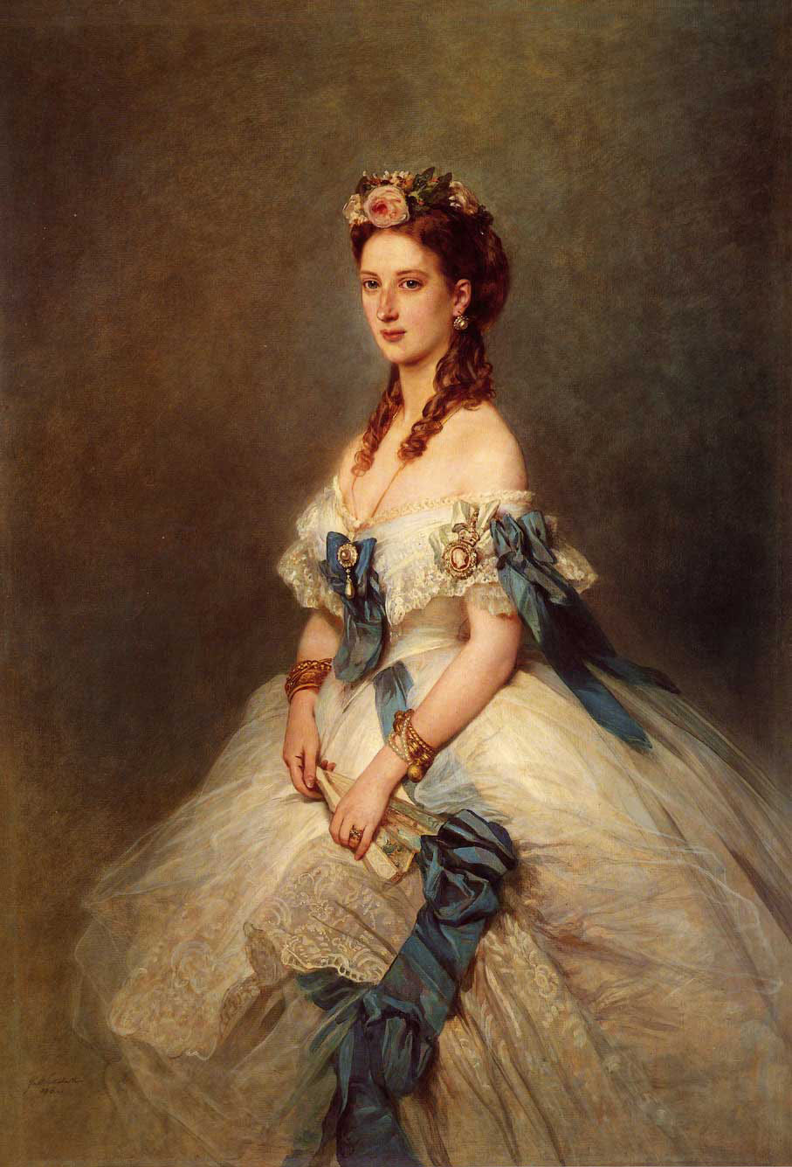

Slide 19
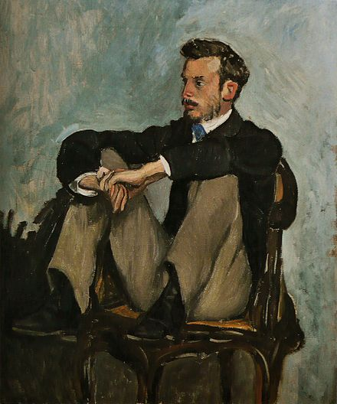

Slide 20
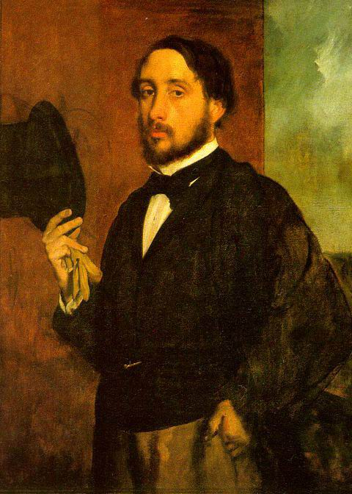

Slide 21
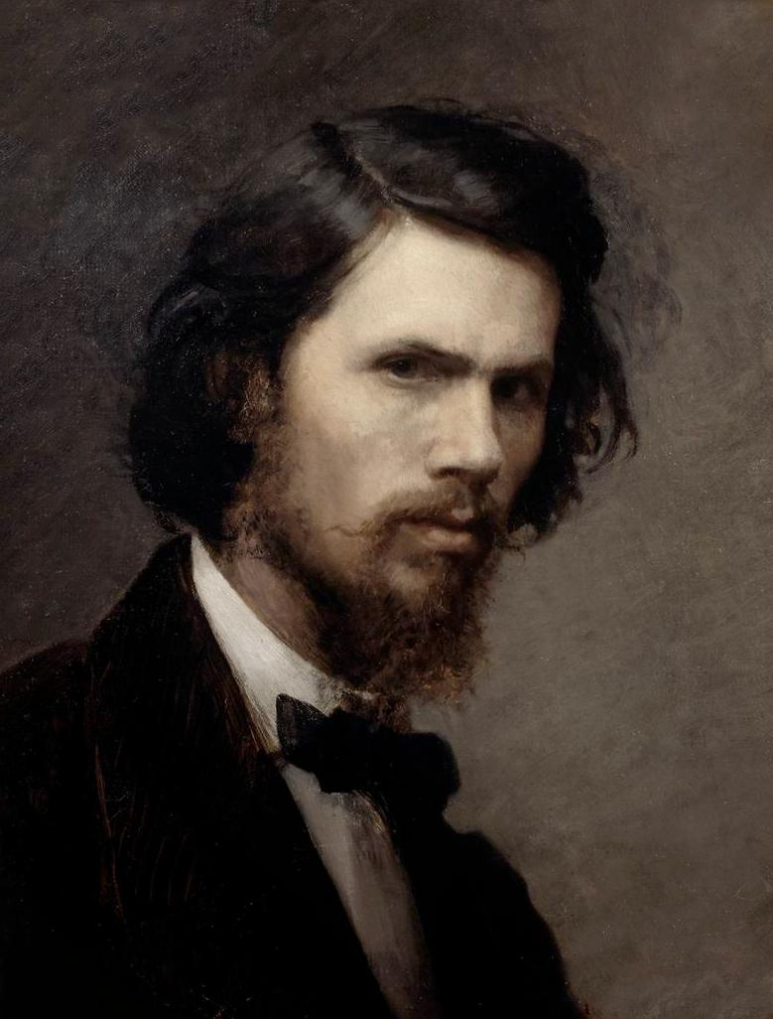

Slide 22
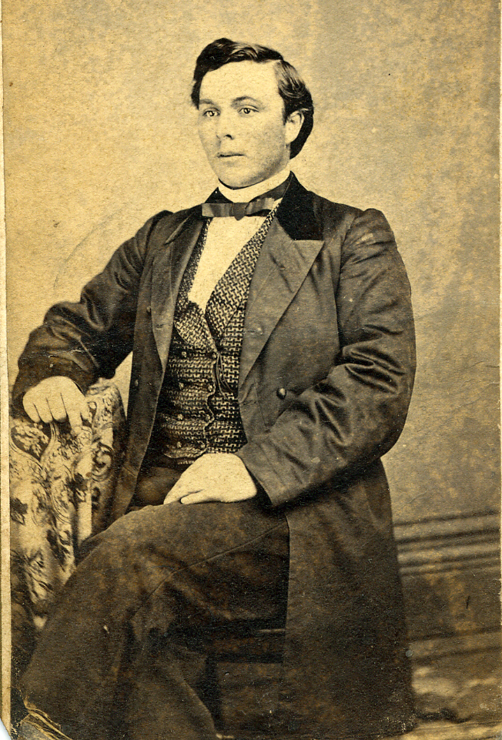

Slide 23
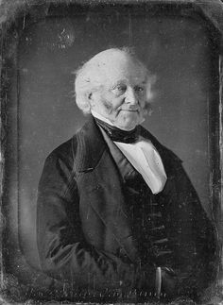

Slide 24
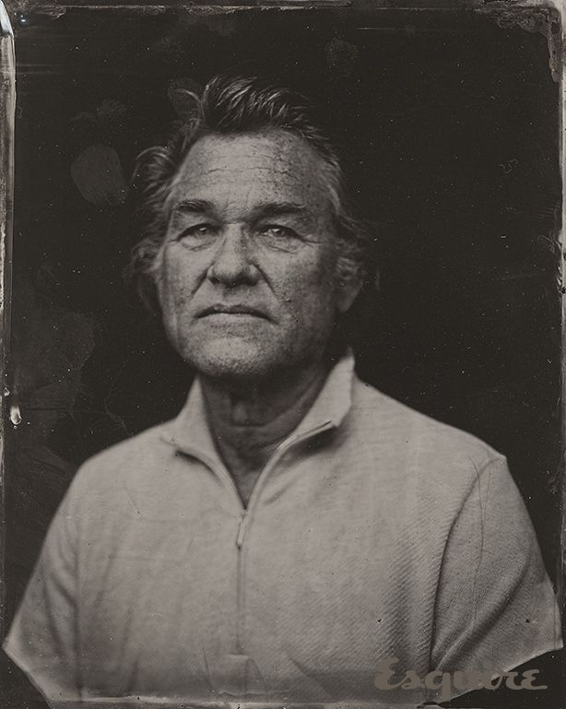
Notes:
1860s-inspired photography : )

Slide 25
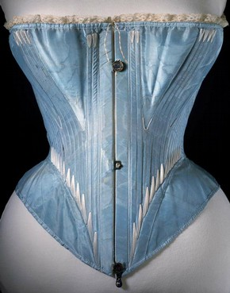
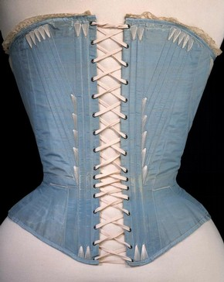
FOUNDATIONS

Slide 26
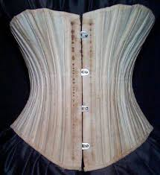
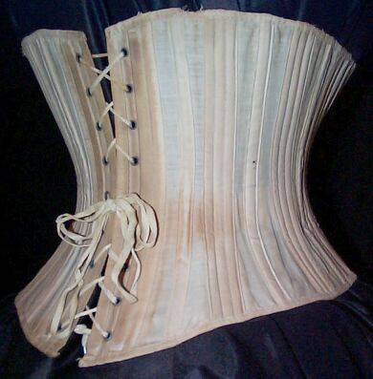

Slide 27
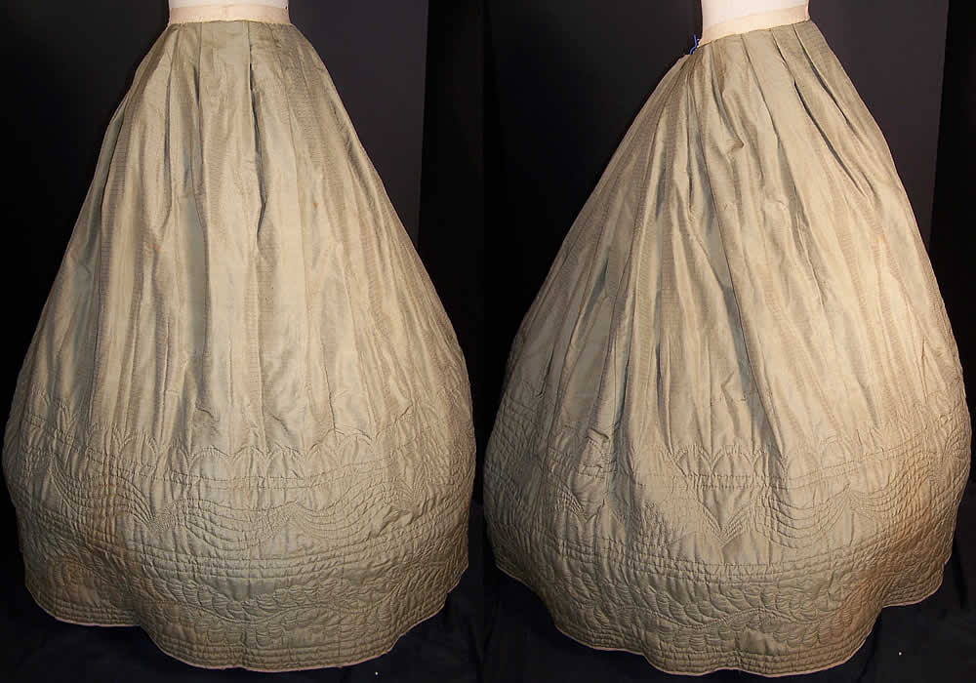

Slide 28
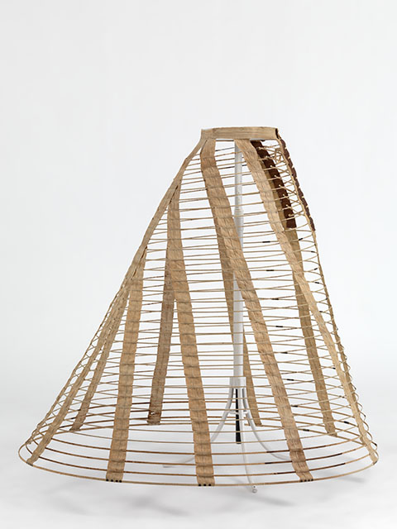

Slide 29
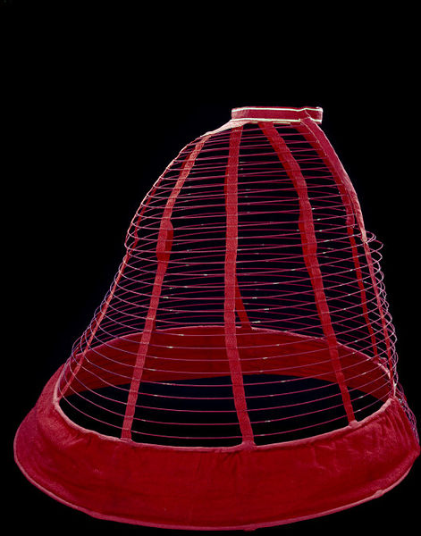

Slide 30
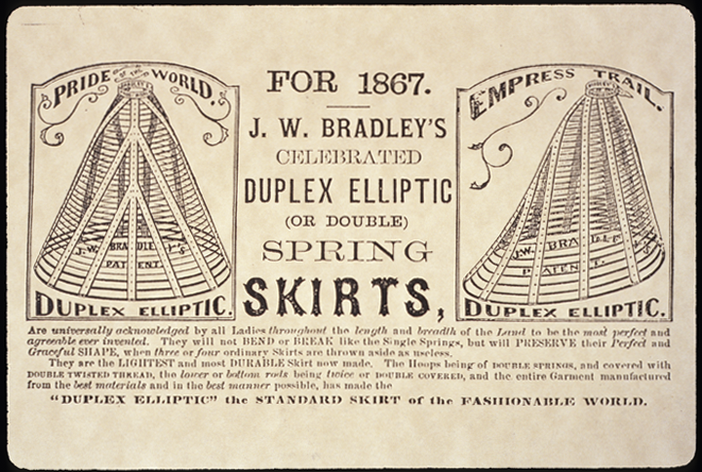

Slide 31
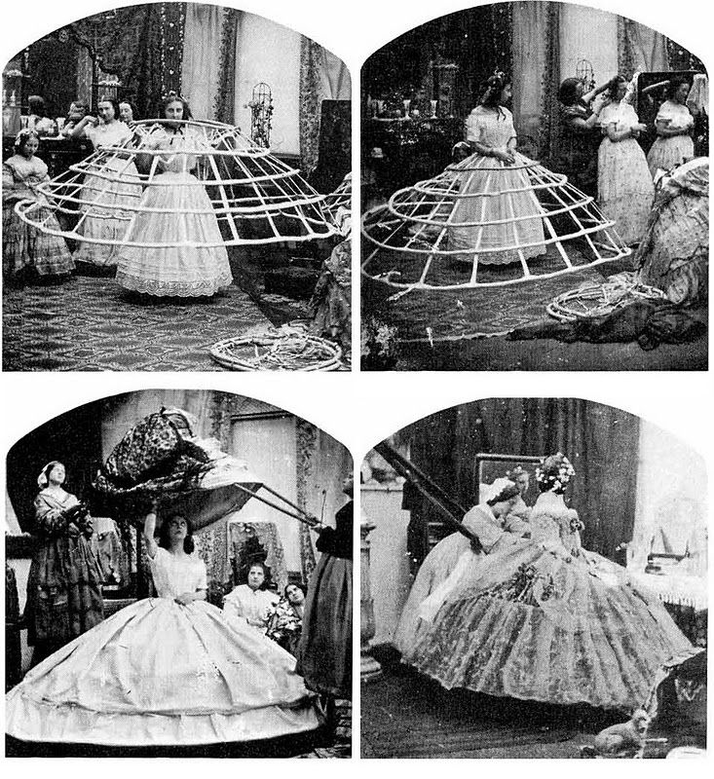

Slide 32
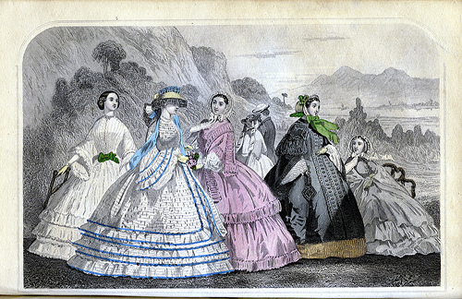
DAY WEAR

Slide 33
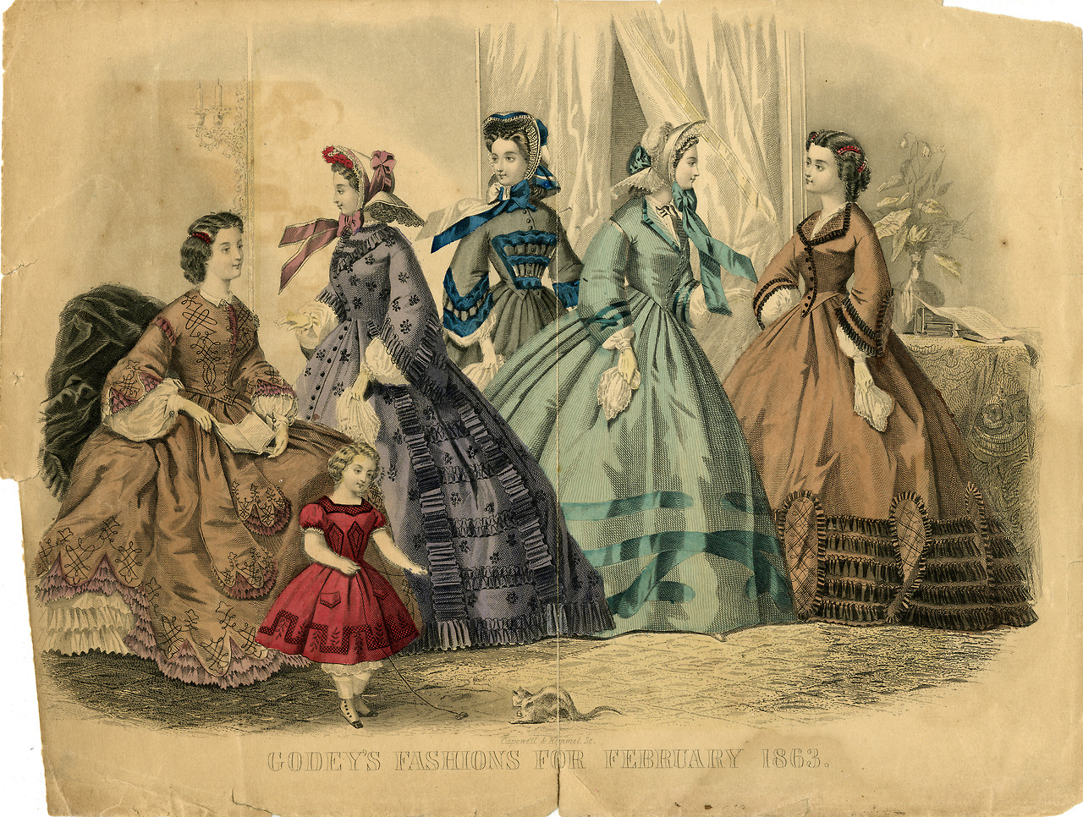

Slide 34
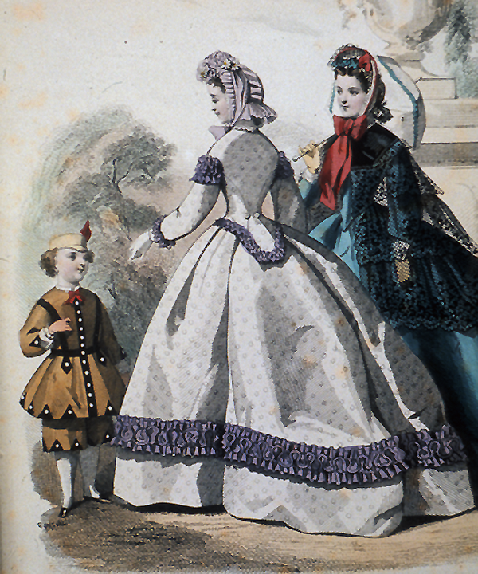
Notes:
Note: analine dyes

Slide 35
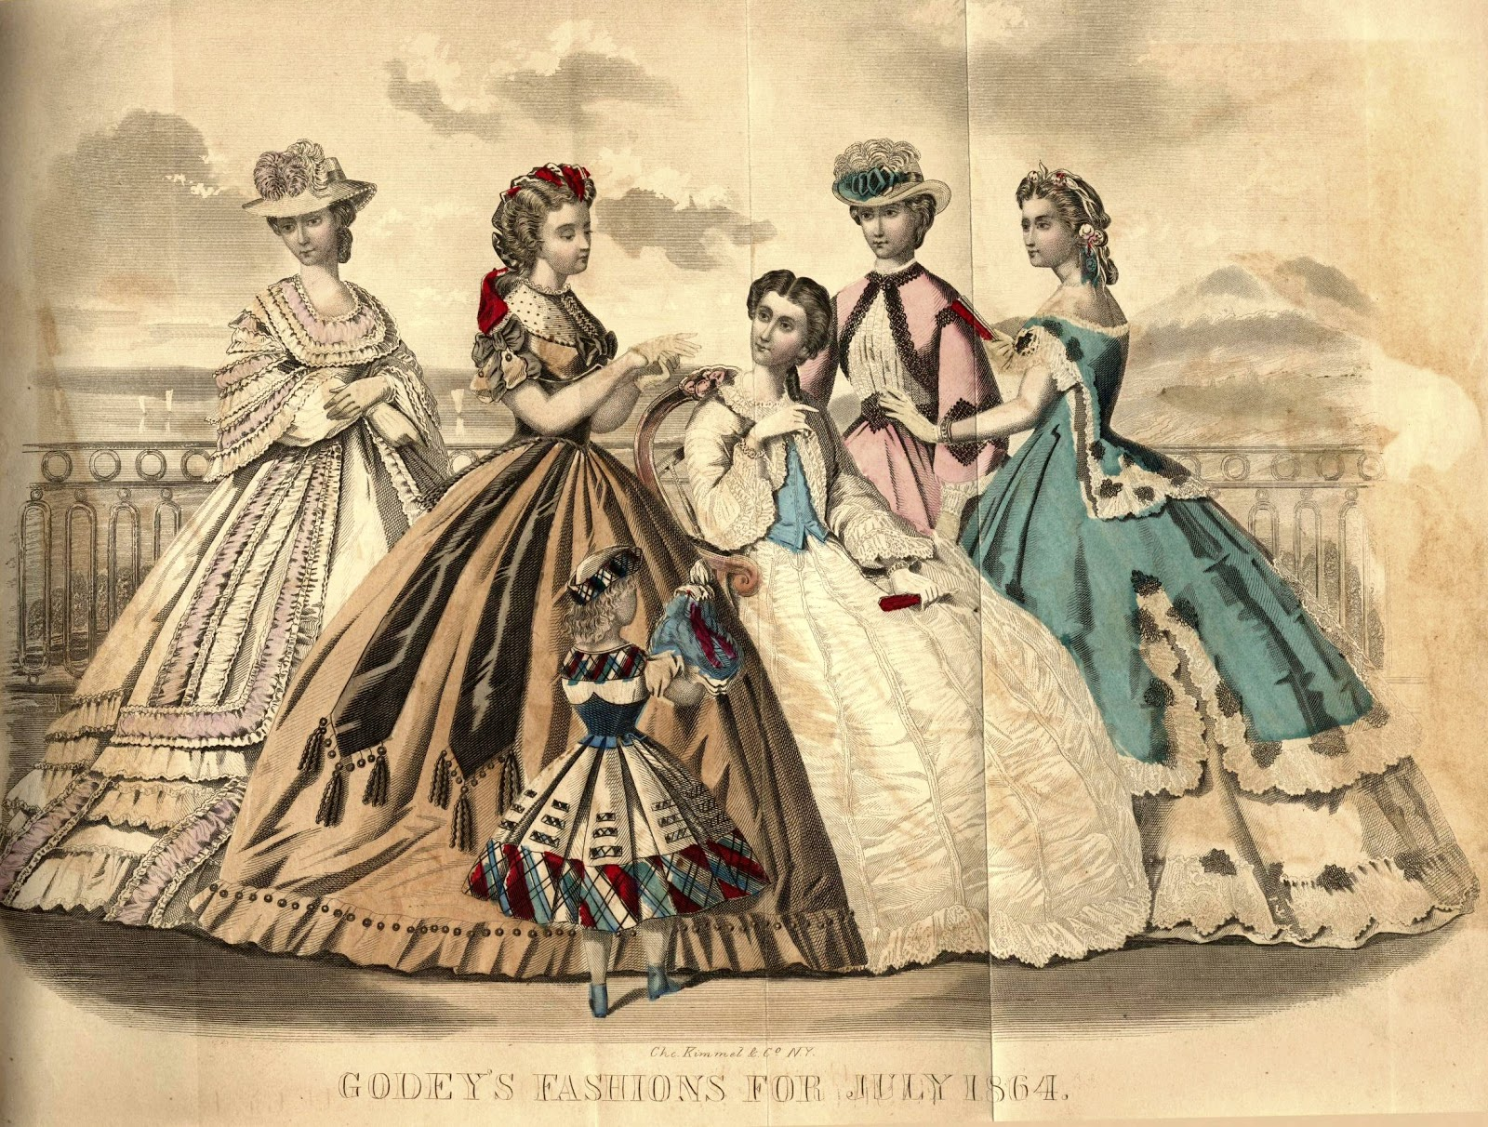

Slide 36
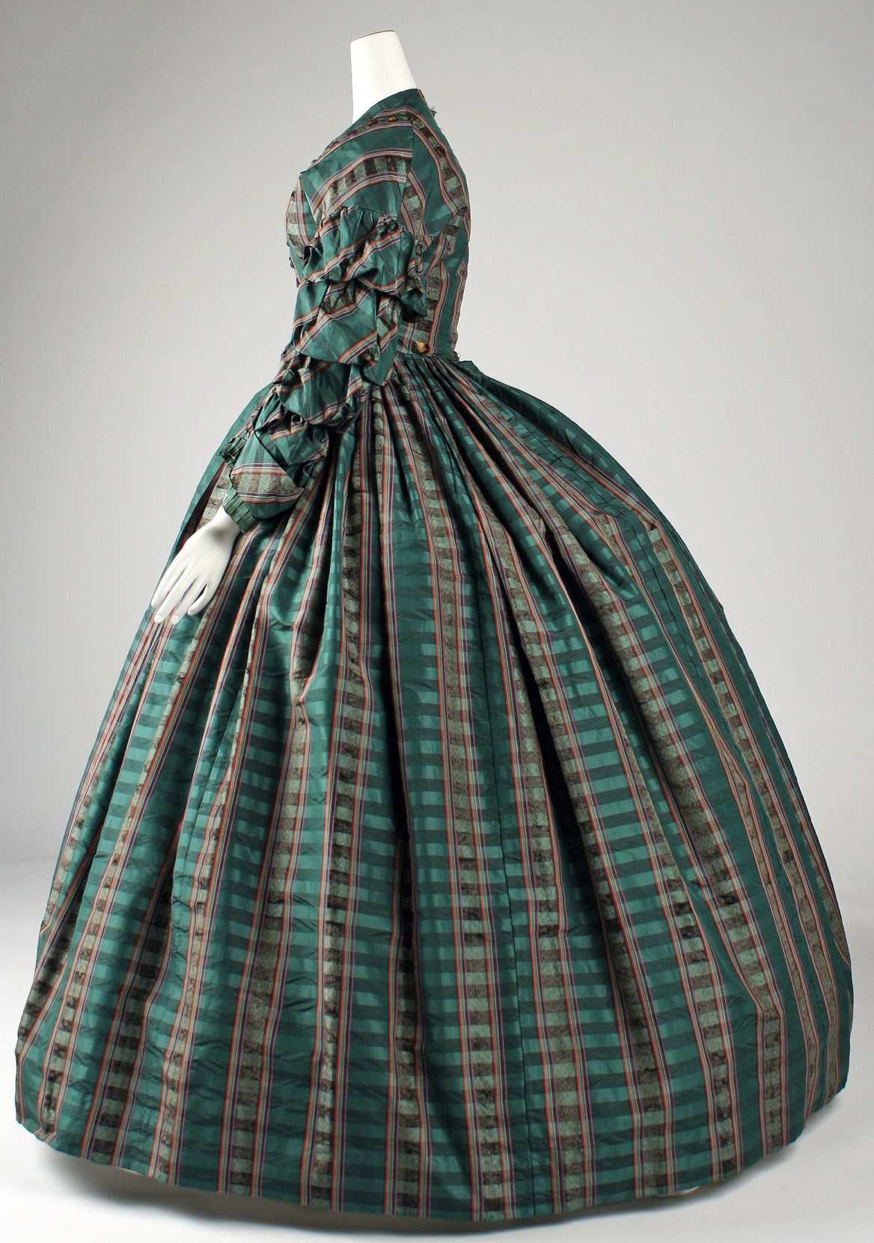

Slide 37
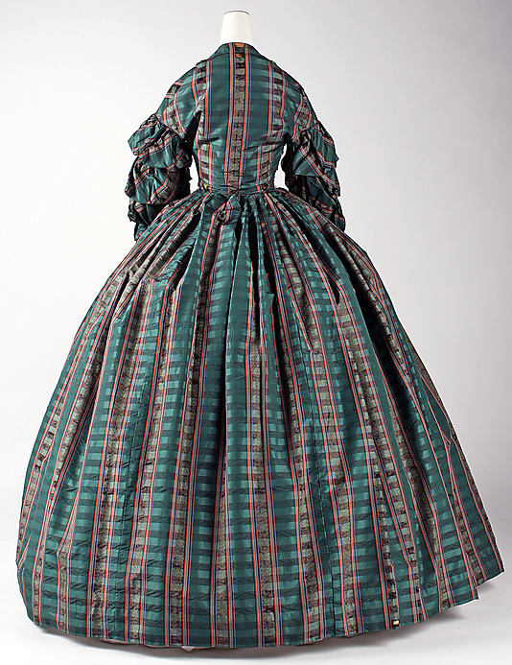

Slide 38
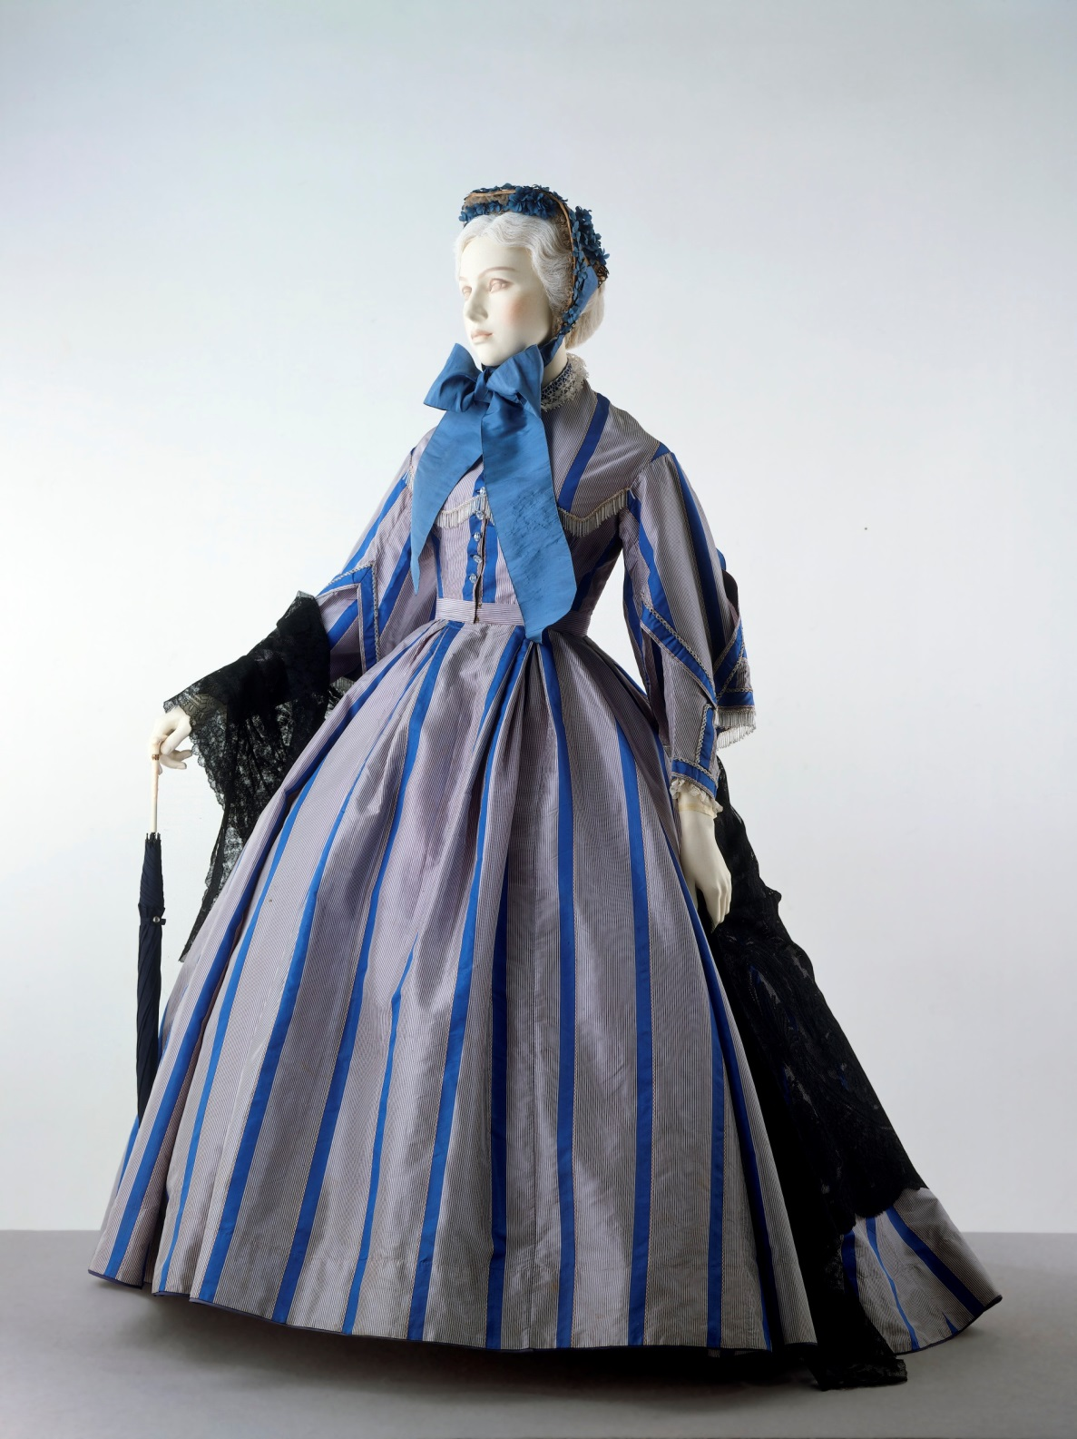

Slide 39
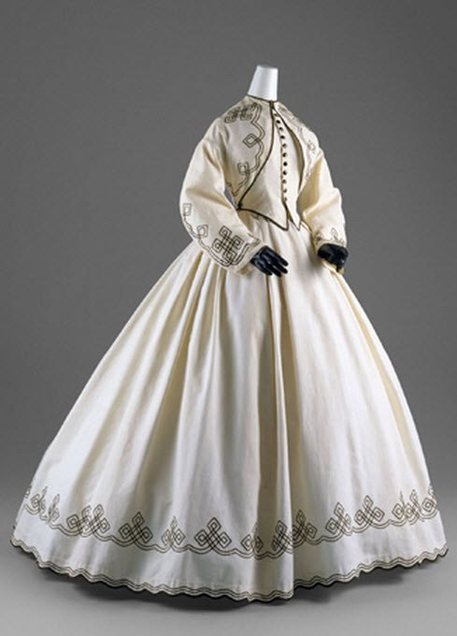

Slide 40
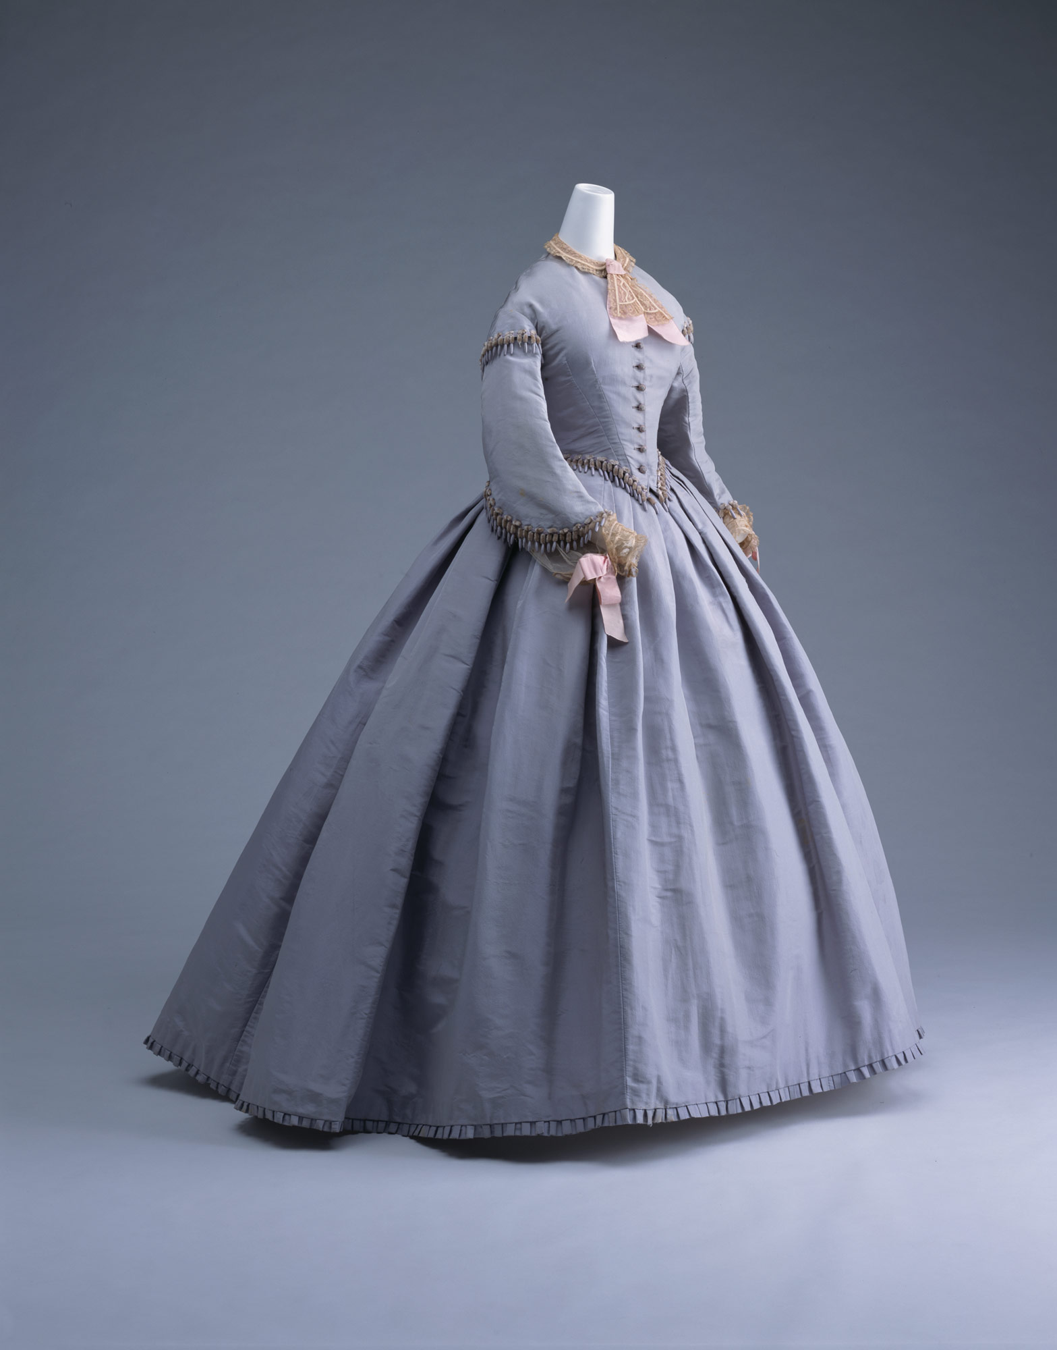

Slide 41
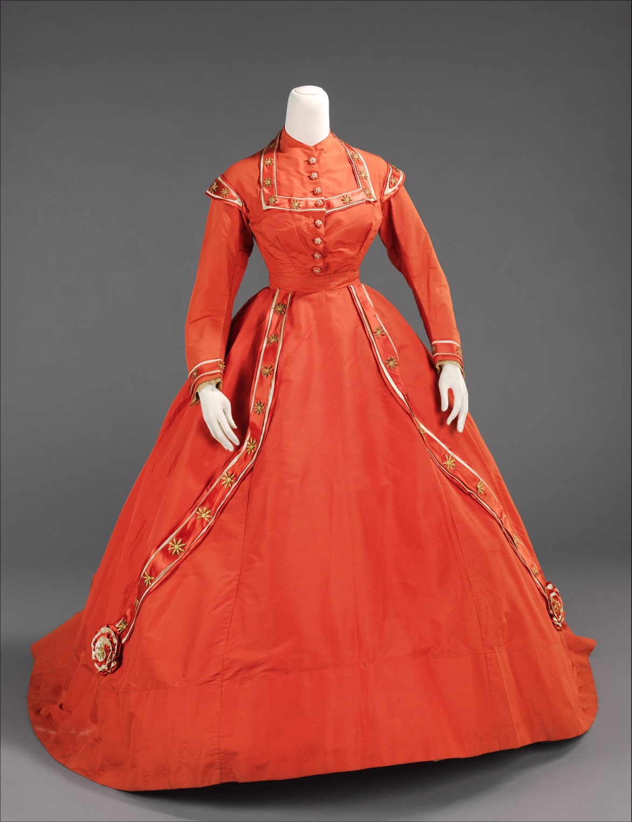

Slide 42
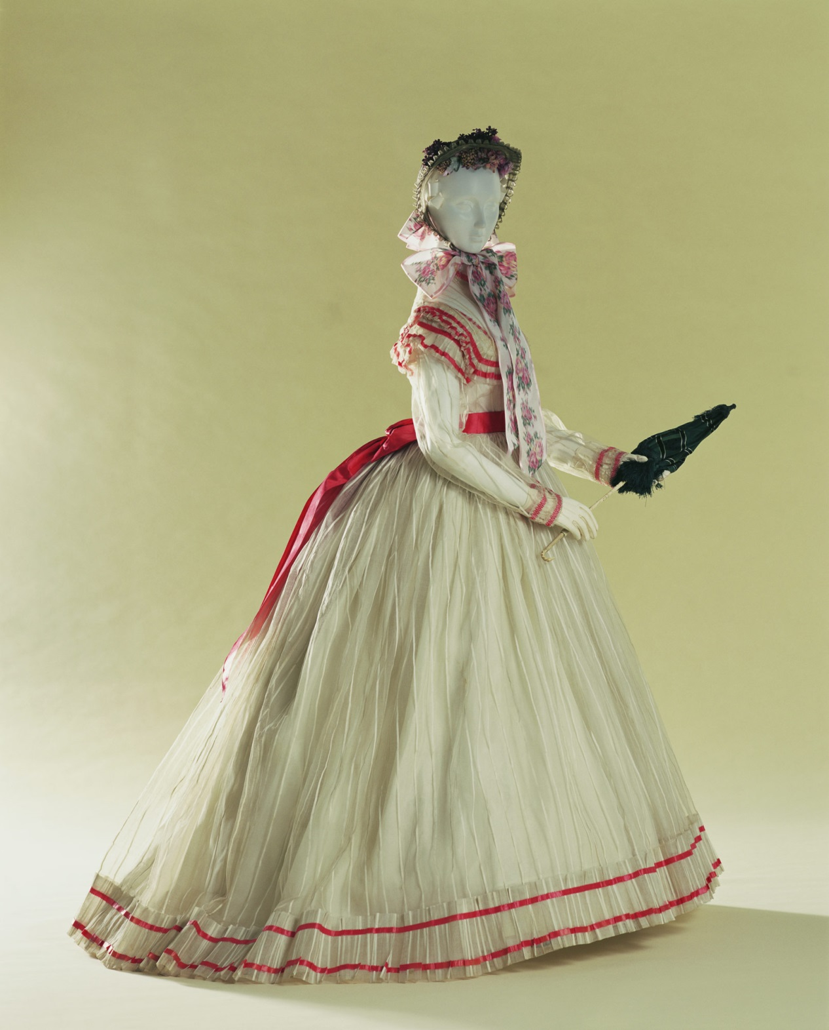

Slide 43
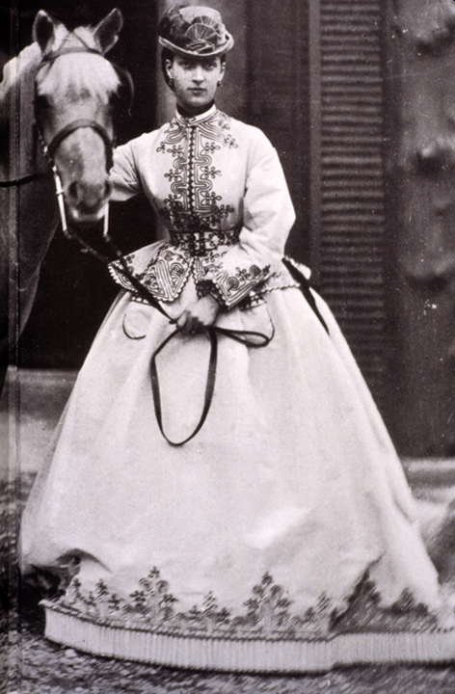
Notes:
Duchess of York: Riding Costume

Slide 44
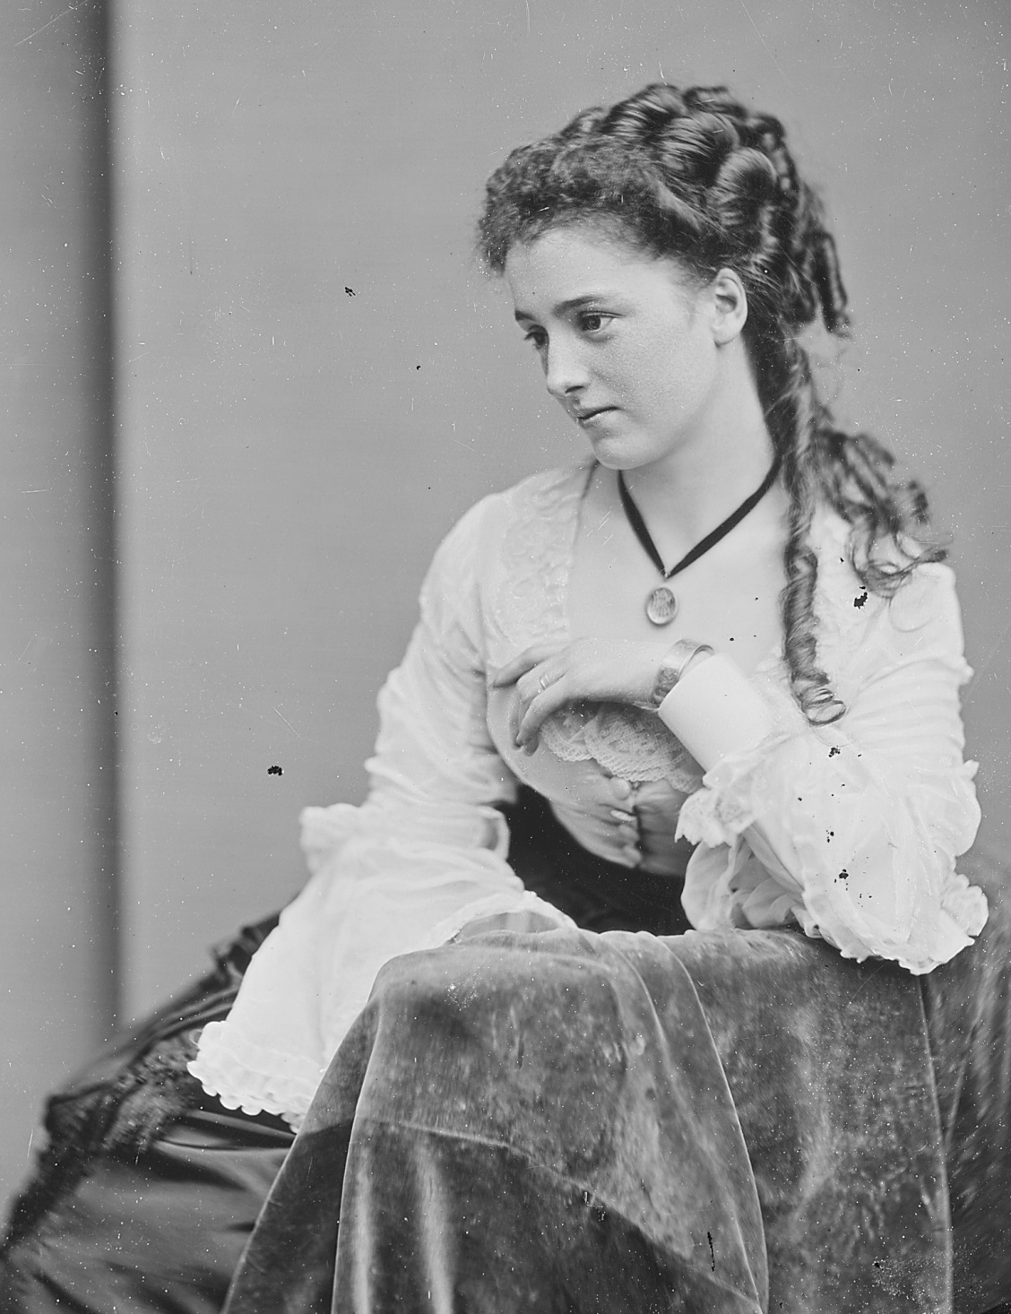

Slide 45
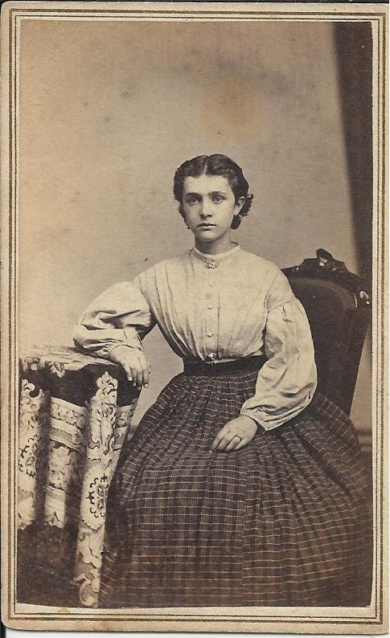

Slide 46
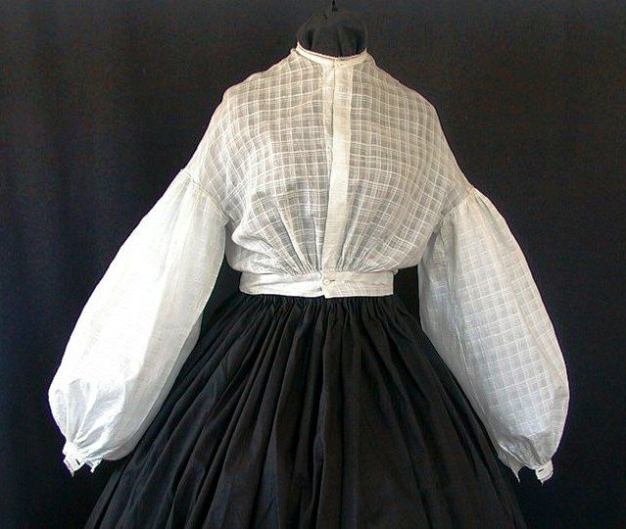

Slide 47
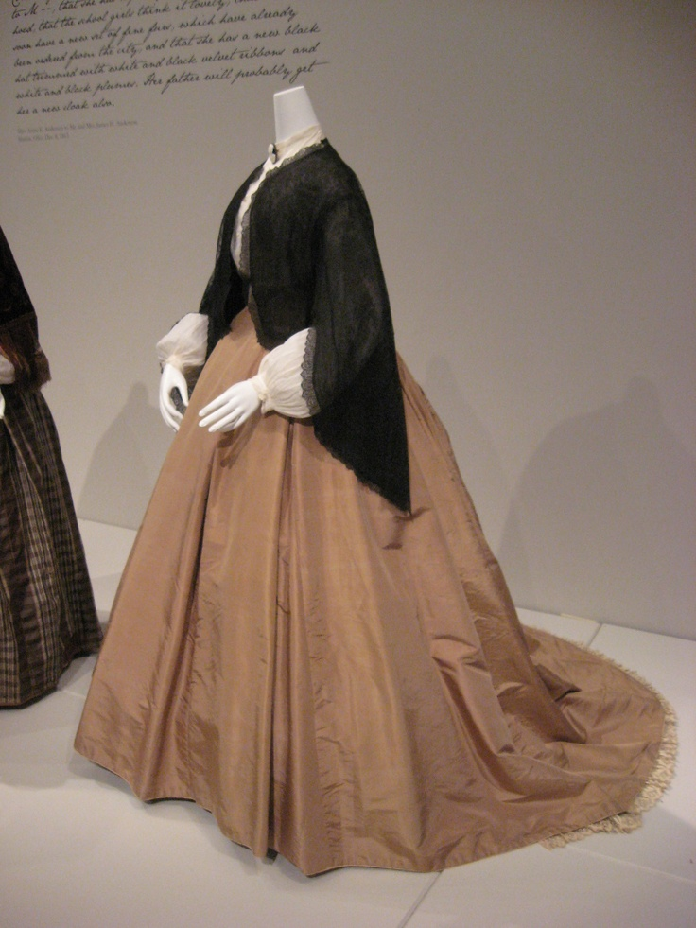

Slide 48
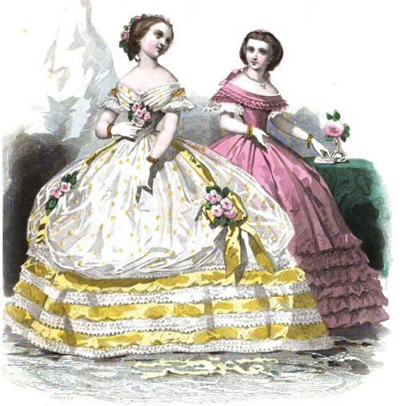
EVENING WEAR
Notes:
1860

Slide 49
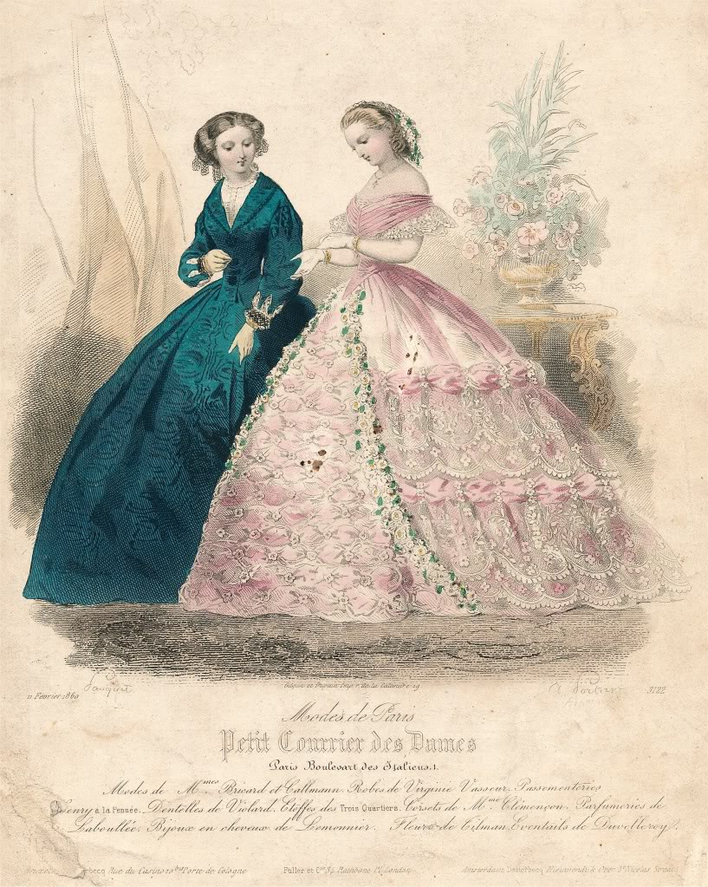

Slide 50
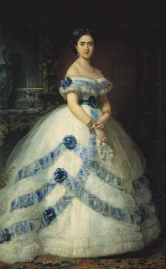

Slide 58
Notes:
1869

Slide 59
HAIR & ACCESSORIES

Slide 62
(tee hee hee)

Slide 68
1860s-inspired fashion
Notes:
Galliano, 1998

Slide 75
BUSTLE PERIOD
(1870-1890)

Slide 82
FOUNDATIONS

Slide 87
Note bustle
cages
for each
phase

Slide 94
Transition from 1860s into Bustle Period

Slide 95
PHASE I (1870-1878)
Bustle is simply draped up
Over the rump

Slide 103
PHASE II (1878-1883)
Cuirass Bodice drops over hips
Bustle lowers to back of thighs

Slide 113
PHASE III (1884-1890)
Shelf-like Bustle
(if you can set a dinner plate on it, it’s Phase III)

Slide 129
FASHION COMMENTARY

Slide 134
Notes:
Yamamoto 1986

Slide 135
Notes:
Valentino

